Slide 1
INTRODUCTION to
How Rocks Form

Slide 2
Initial Thoughts
How can we test ideas that are too hard to investigate?
Example: How can we test what it will be like to live on Mars?

Slide 3
EQ: How do ocean fossils end up on top of a mountain?
Learning Target: I can develop a model for how the earth changes over time.
Success Criteria: Use “Level 1 Model Rubric” to self-assess and list changes to the volcano model.

Slide 4
Make A Model/Flow Chart
Draw a model of how a Volcano is formed.

Slide 5
Does this count as a model???
To count as a model it has to show how something works… It also has to be usable to make predictions…
Can we use your “Volcano” to predict what will happen next?

Slide 6
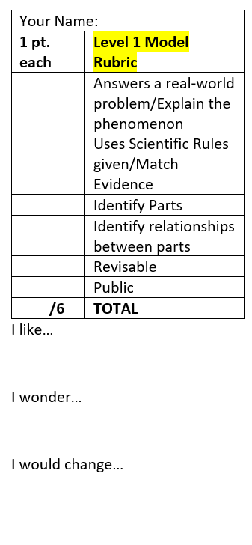
COMMUNITY OF SCIENCE SAYS… “Models are never finished… They are our best understanding so far.”
HOW DOES YOUR MODEL EXPLAIN THE PHENOMENON?
Might include things we cannot see.
Must include rules
LOOK at your LEVEL 1 Model Rubric to understand how you will be assessed.

Slide 7
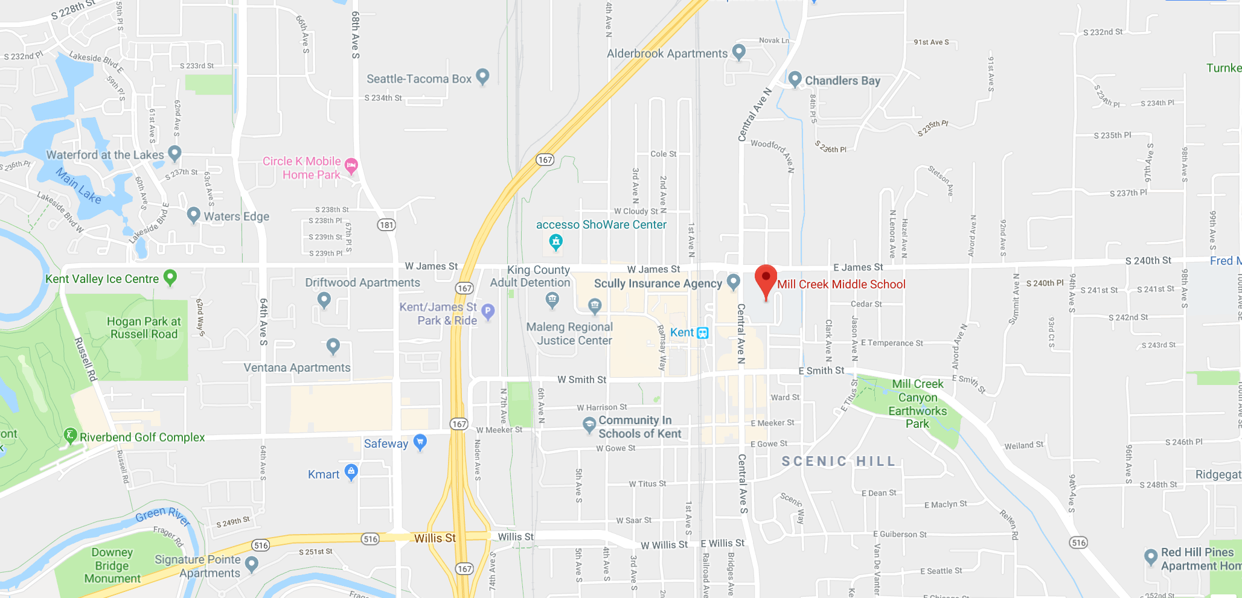
Maps are Models…
Use the “Level 1 Models Rubric” to test if a map works as a model.
Can a map help you answer questions when you’re lost? (Phenomena)
Does it use a key to help you understand how the model works?
Can it help you make predictions?
Is a map revisable when new roads are added?
Are maps public?
Is a map a model?

Slide 8
Does this count as a model???
Use your “Level 1 Models Rubric” to see if.. your “Volcano” is a model.
List what you need to change to make it a model.

Slide 9
Revised Thoughts
What was surprising?
What did you already know, but now see in a new way?
What do you still need help with? or Write a question about the topic.

