Slide 1
INTRODUCTION TO
Data Analysis

Slide 2
EQ: What is considered good data?
LEARNING TARGET
SUCCESS CRITERIA
Use mathematical reasoning when analyzing data to determine the most Important data
Analyze data to select 2 important pieces of evidence

Slide 3
How do you choose which data to use as evidence?
STEP 1: Turn & talk for 1 minute
1
STEP 2: Analyze the next slide
2
STEP 3: Decide with your partner…
3

Slide 4
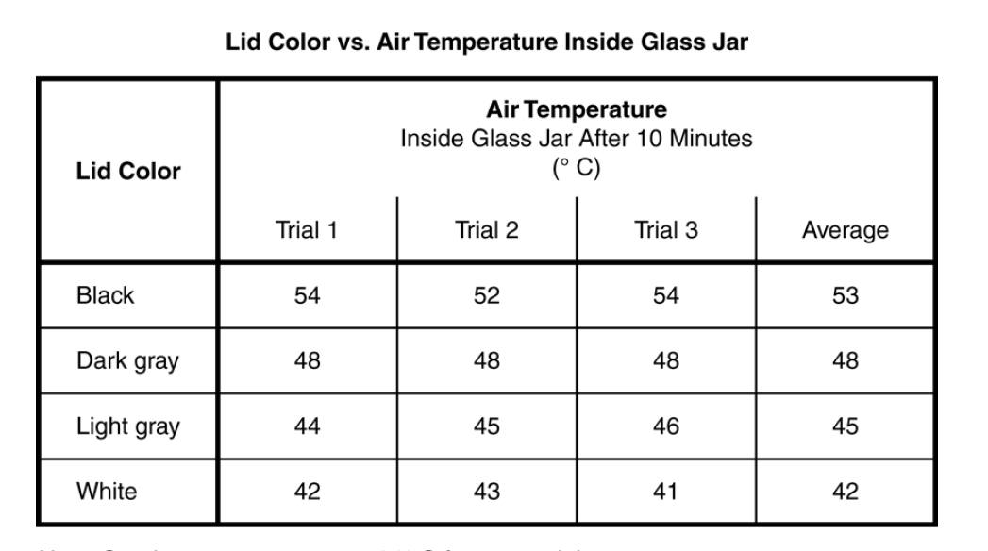
What is the most Important data? What is the least IMPORTANT data?

Slide 5
NOTES:
MOST IMPORTANT DATA:
Use Quantitative (When available)
Use Averages Only (When Available)
Comparisons to show why your chosen data is the most important
COMPARISON EXAMPLES:
Quantitative “High Data” with “Low Data”
“Before” compared to “After”
“9/10 dentists recommend Oral-B”

Slide 6
What could we do to represent this data in an easier way to understand?
STEP 1: Turn & talk for 1 minute
1
STEP 2: Analyze the next slide
2
STEP 3: Decide with your partner…
3

Slide 7
MAKE A GRAPH!!!!!!! Nasa: Best GraphinG Video Link

Slide 8
WOULD YOU RATHER LOOK AT THIS OR… (Click on Next Slide)…
AVERAGE TEMPERATURE CHANGE IN DIFFERENT MATERIALS
 |  | DEGREES CELSIUS
Types of Materials (INSULATORS) | 1st Pd Avg. Temp Change | 2nd Pd Avg. Temp Change | 3rd Pd Avg. Temp Change | 5th Pd Avg. Temp Change | 6th Pd Avg. Temp Change | TOTAL AVG
Bubble Wrap | 10.5 | 4.5 | 4.0 | 5.0 | 2.0 | 5.2
Cotton Balls | 2.5 | 3.5 | 2.5 | 2.0 | 2.0 | 2.5
Sand | 8.0 | 10.5 | 10.5 | 13.5 | 6.0 | 9.7
Shredded Paper | 3.0 | 3.0 | 4.0 | 6.0 | 3.0 | 3.8
Fleece | 2.5 | 3.5 | 3.0 | 3.0 | 2.0 | 2.8
Air | 2.5 | 4.5 | 4.5 | 4.0 | 1.0 | 3.3

Slide 9
WOULD YOU RATHER LOOK AT THIS? WHY?

Slide 10
Record your thinking before looking at the next slide…
Finish this sentence:
Quantitative data is the best data because…

Slide 11
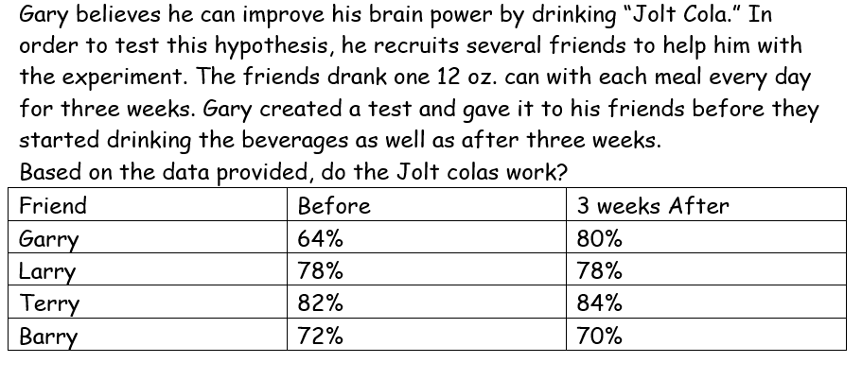
SUCCESS CRITERIA EXIT TICKET: SELECT 2 pieces of data as evidence.

Slide 12
PARENT/ STUDENT SUPPORT
THE NEXT TWO SLIDES ARE TO HELP PEOPLE GRAPH AND PRACTICE USING DATA

Slide 13
How to MAKE A GRAPH!!!!!!! Create Graphs In Science Link

Slide 14
Practice finding IMPORTANT & non-important Data… INTERACTIVE: Determine the type of graph to make from Zombie Data

