Slide 1
Botany introduction

Slide 2
Class Agenda
TODAY’s PLAN:
Today’s TaSK:
EQ: How do plants work as a system?
LT: I can evaluate information about plants to identify plant system interactions.
SC: Assess the “Botany Introduction” article using the step by step annotation process.
Follow and practice step by step guidelines while reading a scientific article using annotation techniques.

Slide 3
Initial Thoughts:
1. How are plant systems similar to human systems?
2. How can note-taking strategies such as “Annotation” help you grow in your learning?
3. How many plant parts do we consume (eat)?

Slide 4
Why do we need to annotate?
1. You will use this technique in 8th grade and all grades beyond.
Analyzing CER writing in all your readings will help you analyze your own writing.
Annotation is used as another strategy to strengthen your understanding of what you read.

Slide 5
Read your article:

Slide 6
On your Article – Vocabulary
Step 1: Read the article and then highlight the words you do not understand in yellow. (quick scan read)
Step 2: Look up those words and write definitions in yellow word boxes on the side of the text.

Slide 7
On your Article – Claim & Evidence
Step 3: Re-read the article. Draw boxes around the main Claim (idea) and sub-main ideas.
Step 4: Use squiggle lines to underline information
(Evidence) that supports the claim.
Step 5: Write questions and annotate (explain) reasoning on the side of your paper in thought bubbles. This can be used later for further research.
Questions & Explanations

Slide 8
On your Article – Quantitative vs. Qualitative
Step 6: Highlight Quantitative Evidence in blue and Qualitative Evidence in orange.
Step 7: Draw lines with arrows in blue (quantitative) and orange (qualitative) to show which evidence you think is the best to support the claim (connect the evidence to the claim using arrows).

Slide 9
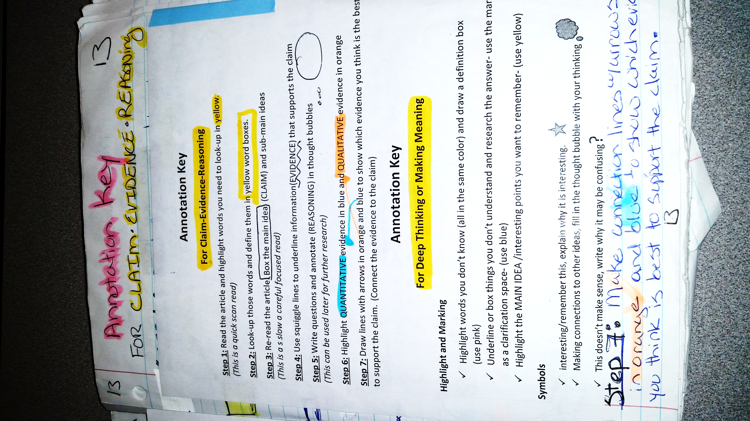
The End result should look something like this:
Question!

Slide 10
Last thoughts:
1. List 3 ways you could use annotation in any class.

