Slide 1
Initial Thoughts
What does volume measure? What does mass measure?
Why do some things sink and other things float?
What is happening inside the bottle after I shake it?

Slide 2
LEARNING TARGETS
EQ: How can we use models to help us learn and solve problems?
LT: I can describe why some objects are heavier than other objects.
SC: I can identify which types of matter have more or less density.

Slide 3
Make a Prediction
WITH YOUR PARTNER, DISCUSS & ANSWER IN YOUR NOTEBOOK:
What happens to the lava when the lamp is not turned on?
Why does the oil always end up on top when we shake the oil/water bottle?
Why does the lava lumps move up and down?

Slide 4
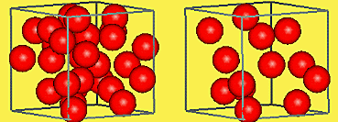
TRY THIS…
CLASS DISCUSSION:
Everyone stand up and spread out in the room…
How big is the volume of this room?
Could we measure the length x’s width x’s height?
It’s pretty big.
But what if we cut the room in half?
The volume would be half right?
So let’s think about the full space. We are all spread out.
Now let’s all move to half of the room and pretend like there is a invisible wall pushing us to one side.
Could we measure the volume of just this space? (Sit down)
PARTNER DISCUSS: Now are we more dense or less dense? Why/Why not? What are Atoms?

Slide 5
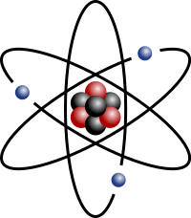
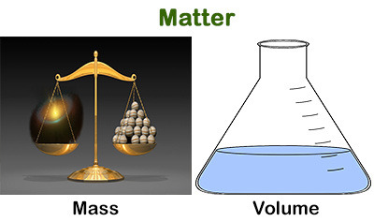
TRY THIS…
CLASS DISCUSSION:
Atoms are the “Stuff” that makes up everything!
They are the smallest form of matter, (And we cannot see them).
Remember our definition for Matter? Tell your partner what must it have to count as matter?
It must have volume (Means to take up space) and it must have mass (Means I can measure how many atoms are in it).
Could we count how many people we have when we were standing?
Could we pretend we are Atoms and as Atoms we represent mass?
Could we say we are (So many atoms) : (So much volume)?
In math, what do we call this kind of relationship?
It’s a ratio or a proportion right?
IN YOUR NOTEBOOK: Describe matter, volume & atoms.

Slide 6
TRY THIS…
PARTNER DISSCUSSION:
Looking at the cubes… So which item has more “Atoms” in it? How do you know? Why do you think that?
Looking at the oil/water bottles… Which matter has more density, oil or water? How do you know? Why do you think that?
What else is in the bottle? Just a little bit of it… Does it have a high density or low density?
Everyone draw a heart on their notebook… now draw a horizontal line through the middle.
This is how I remember the formula for density… “Density broke my heart.” What does the top of the line look like?
What does the bottom of the line look like?
The formula for density is mass divided by volume.

Slide 7
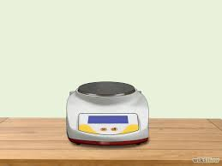
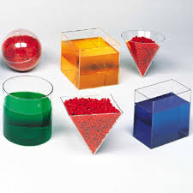
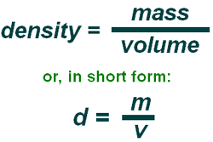
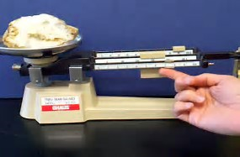
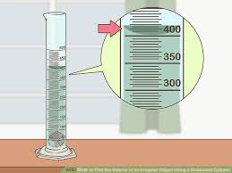
Rule # 2 Density
Density is the proportion (Relationship) of mass to volume.
This means an object’s density show’s how many atoms are in the specific volume of matter.
If there are more atoms (Mass) then the density is higher. (Heavier)

Slide 8
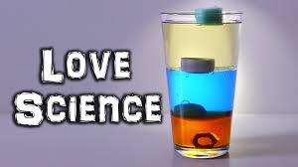
REVISED THOUGHTS: Density
What was surprising?
What did you already know but see in a new way?
What do you still need help with?

