Slide 1
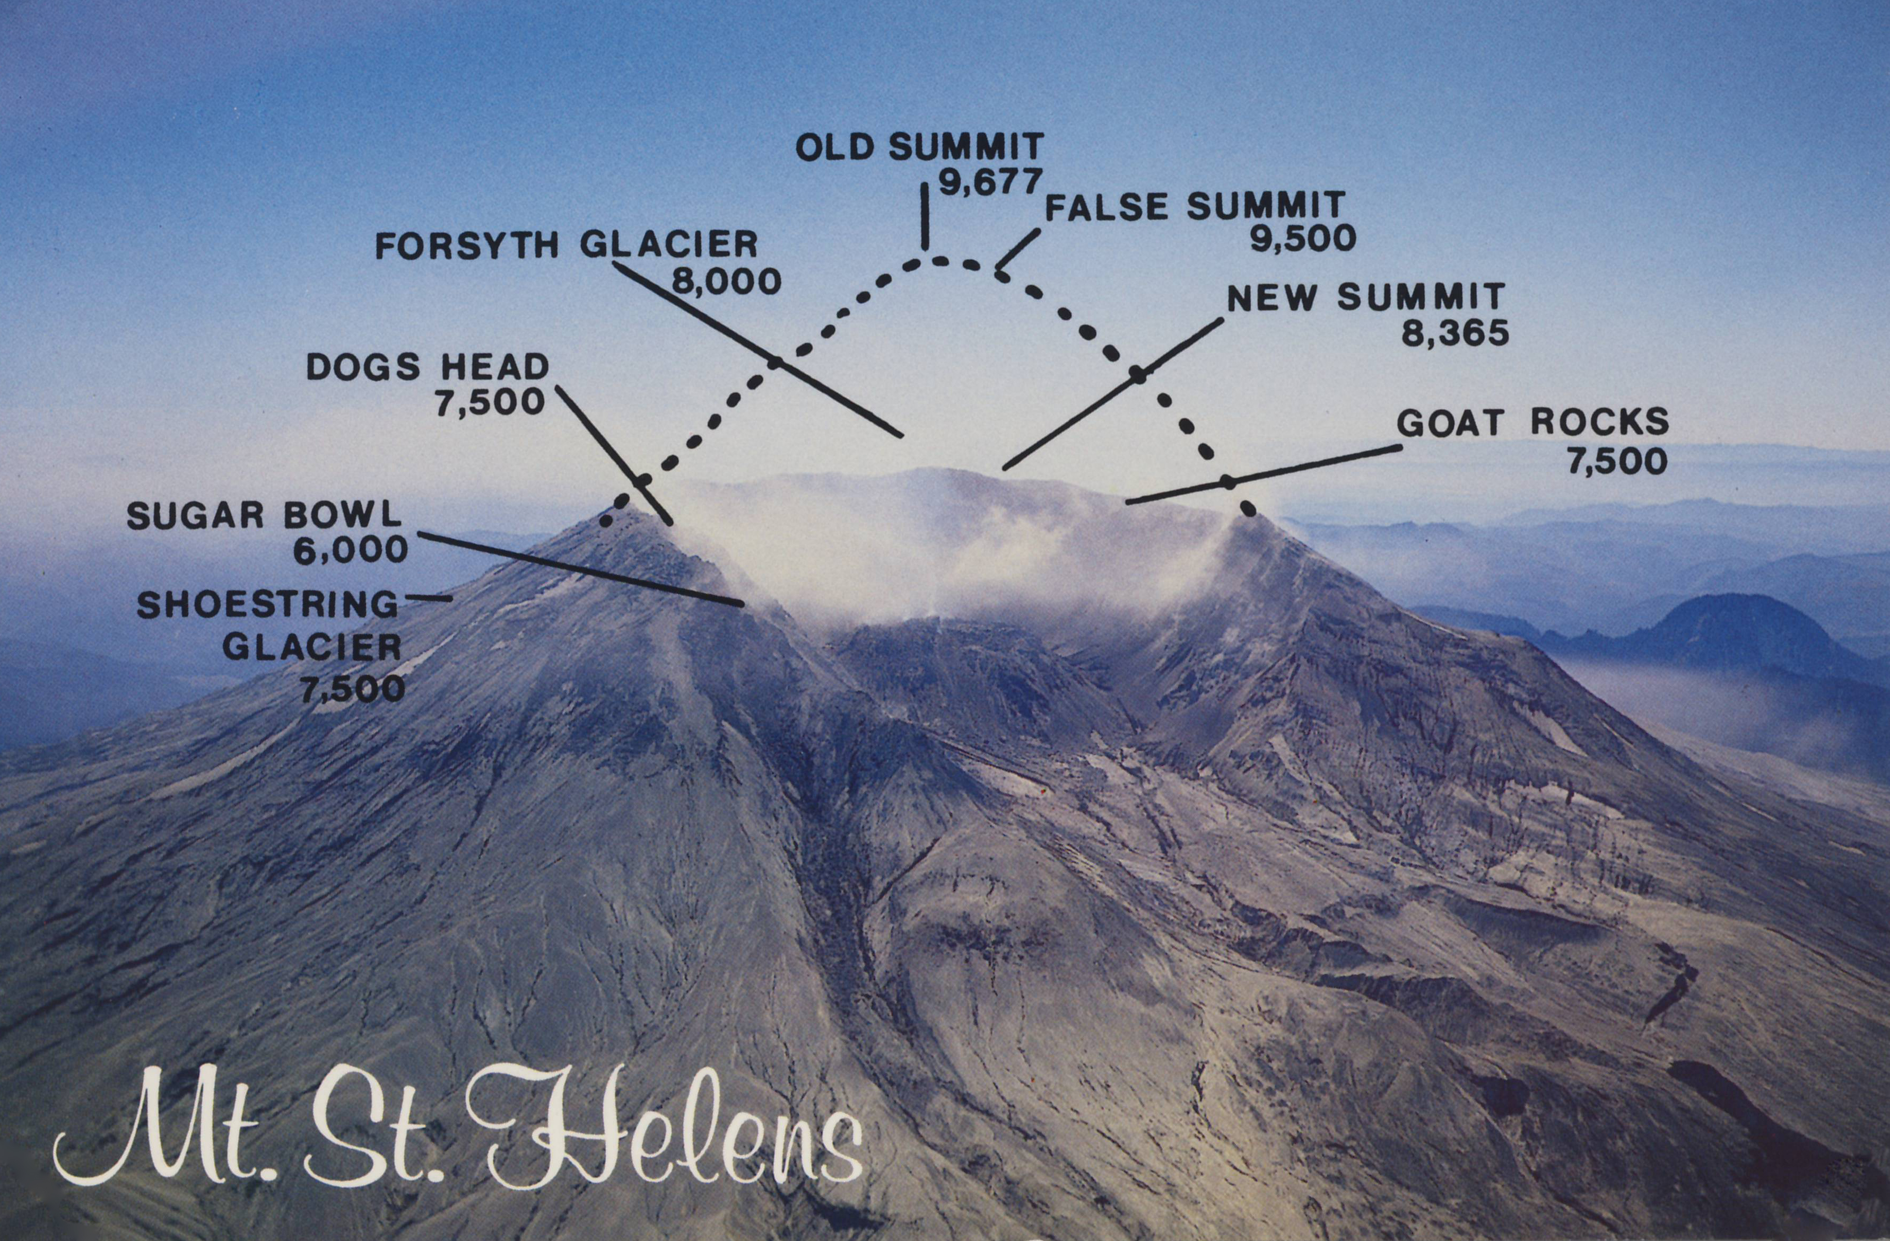
Presentation Title Presentation Subtitle
Smart Living in the Pacific Northwest

Slide 2
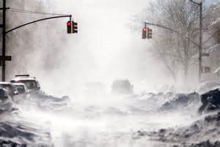
What are Natural Disasters?
With your group write as many types of natural disasters you can brainstorm.
Tsunami
Earthquake
Hurricane
Tornado
Landslide
Flood/ Flash Flood
Lightning Storm
Sand Storm
Wind Storm
Blizzard/Snow Storm
Drought
Forest Fire
Notes:
Beginning course details and/or books/materials needed for a class/project.

Slide 3
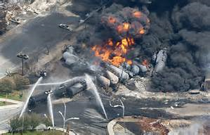
What are Non-natural Disasters?
With your group write as many types of non-natural disasters you can brainstorm.
Chemical spill
Auto accident
Loose electrical wires
Collapsed Building
Terrorism
House fire
Power outage
Gas leak

Slide 4
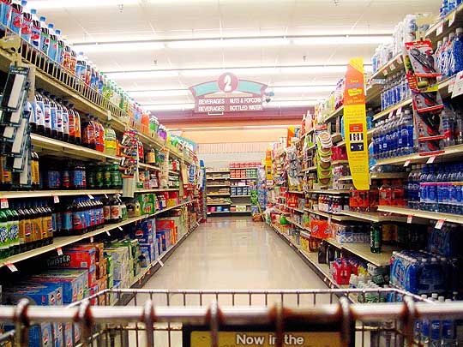
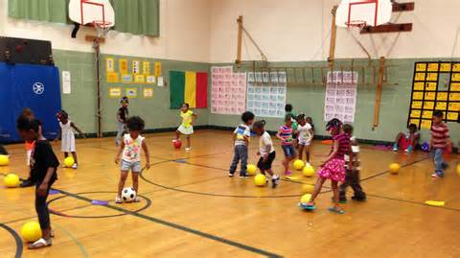
Limitations & Resources
What is a limitation?
List 2 limits for each scene.
What is a resource?
List 2 resources for each scene.
Notes:
A list of procedures and steps, or a lecture slide with media.

Slide 5
Live-Cam Video
Watch this video of cameras in action…
Outrunning a Mudslide video
Nisqually Quake in Seattle video
Megaquake Simulation Seattle
Notes:
Introductory notes.

Slide 6
Document Resources for You
Save the “On Shaky Ground” Resource
E-mail it to yourself (Then email it to your family)
(This information may save your life or someone you love).
Try to get your family to use the info and planning guide together.
If they won’t do this, consider being in charge of making your family emergency plan.
Notes:
Objectives for instruction and expected results and/or skills developed from learning.

Slide 7
Can we be prepared for this?
Who | What | When | Where
Adult | Landslide | 5 am-8 am | Park
Child | Volcano | 8 am-11am | Store
Student | Tornado | 11 am-2 pm | School
Elderly | Lightning Storm | 2 pm-5 pm | Movie Theater
Police Officer | Flood | 5 pm-8 pm | Home
Limited Ability | Blizzard | 8 pm-11 pm | Mall
Fire Fighter | Tsunami | 11 pm-1 am | Beach
Teacher/Childcare Provider | Earthquake | 1 am-5 am | Restaurant
Notes:
A schedule design for optional periods of time/objectives.

Slide 8
Emergency Backpack Activity
Open the backpack for your “Who, what, where, when.”
Divide jobs to plan for: Water & Food, Shelter & Warmth, Medical & Personal Care, Other
Use the resources pgs 17, 19, 20, 23 to answer:
What would you want in your backpack to be prepared for this scenario?
~Consider your limitations & Resources
After a few minutes of private brainstorming, compare your ideas with your teammates.
Notes:
Conclusion to course, lecture, et al.

Slide 9
Extra Credit: Real life Need
Use the backpage of the “On Shaky Ground” document to write down your families emergency info.

