Slide 1
LIVING SYSTEMS

Slide 2
Initial Thoughts:
Why do we study animal systems? (2 min)
Look at the diagrams & list as many parts as possible (2 minutes)

Slide 3
OBJECTIVES
EQ: How does using “Systems Thinking” help solve problems?
LT: Obtain, evaluate & communicate information about a life system phenomenon.
SC: Summarize topics on the life systems graphic organizer using discussion protocols.

Slide 4
Agenda
Label an assigned system
Read the aligning article in Actively Learn
Analyze as a team using Discussion Protocol
Report out to class your
Record info from other teams
Analyze new solutions

Slide 5
Set up this Graphic Organizer
Name of Plant or Animal | Issue or Phenomenon related to this plant or animal | System or Sub-system impacted by phenomenon
Honey Bee
Oak Tree
Starfish
Bird

Slide 6
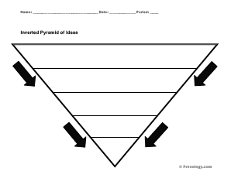
CLASS DISCUSSION (5 MIN)
What are the biggest things you can think of?
What are the smallest things you can think of?
This Photo by Unknown Author is licensed under CC BY-NC-SA

Slide 7
Draw an inverted pyramid with eleven spaces.
Biggest Lens
CLASS DISCUSSION (5 MIN):
Where do we exist right now?
We will move from the biggest to smallest lens.
Smallest Lens

Slide 8
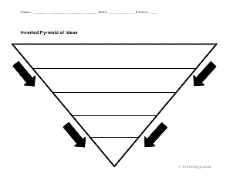
Group Practice: (3 min)
How can we do this for an Ecosystem?
This Photo by Unknown Author is licensed under CC BY-NC-SA

Slide 9
Gathering Information To Solve Problems
Read the 4 articles in Actively Learn about honeybee, oak tree, starfish and bird issues.
Go to actively learn, log in with Clever, use same username & PW you use to log in to your computer.
*Take notes in the Graphic Organizer (G.O., from slide 5) while you read about each of the 4 topics (Phenomenon)
Discuss & compare with your team (30 second talk time/team member)
*Add to notes in the G.O. from your team discussion
How can we study the issue to resolve the problem? (2 min)
* Choose a Group Leader (Class Reporter)
* Private Brainstorm: (30 seconds to list solutions)
* Group Brainstorm: (20 seconds to pitch your top idea)
* Team Vote: (10 seconds to pick the group idea)

Slide 10
Group Leaders Report Out To class (60 seconds each) Add onto your own graphic organizer as you learn what each group presents.

Slide 11
Group review (6 min)
Quickly prepare your answers for these questions by writing on your quadrant on the team’s poster (2 min).
* Did you use systems thinking to analyze your problem?
*If not, how could you change your analysis?
*Identify the big and small issues related to the problem.
* How can scientists use “Systems Thinking” to understand the problems?
Silent Discussion Protocol:
*Walk to next quadrant & do one of 3 things: (1 min/quadrant & Repeat for all)
-Ask a question in writing…
-Add to the notes…
- Draw common connections to other quadrants you have reviewed

