Slide 1
REACTION TIME LAB
DAY 1

Slide 2
How Do Neurons Communicate?
Learning Target
Success Criteria
Obtain information to plan an investigation about neuron messaging.
Complete research about “Reaction Time” for distracted vs focused conditions.

Slide 3
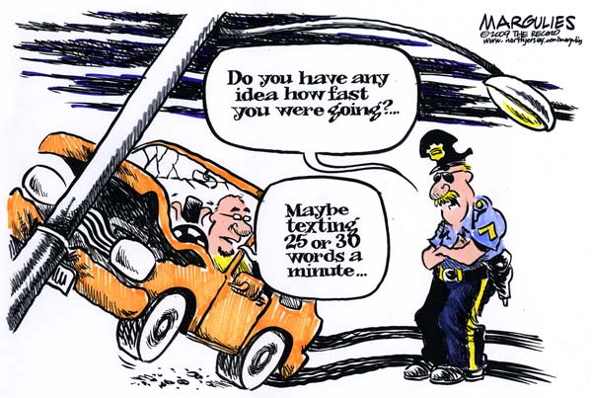

Slide 4
LAB PURPOSE
Students are regularly trying to complete classwork while listening to music, watching Netflix, or hanging out with friends. As access to technology grows, so does the question of how well the human brain can process different information received at the same time. Society recommends using headphones as “Hands-free” devices for improving peoples’ reaction times by eliminating distractions. This lab will help identify whether small distractions have significant impacts on reaction times.

Slide 5
PREPARING FOR THE LAB
How fast will the human nervous system process information when receiving information from more than one source?
Follow the resources on the next slides to research for the lab.

Slide 6
SIGHT REFLEXES RESEARCH
Go to Gizmo “Sight vs Sound Reflexes”
Make sure the “SIGHT” page is showing & click on “RANDOM” & “GREEN”
Once you press the start button, random green shapes will appear on the screen. As soon as you see them, click anywhere on the “Click Region” of the screen. Complete the whole trial & record results:
Average Reaction Time:______________
Number of extraneous mouse clicks:___________
Try a new object color: Avg. R.T.:_____________
Number of extraneous mouse clicks:____________

Slide 7
SOUND REFLEXES RESEARCH
Go to Gizmo “Sight vs Sound Reflexes”
Make sure the “SOUND” page is showing & click on “RANDOM” & “GREEN”
Once you press the start button, Keep your eyes directly on the screen. As soon as you hear a sound, click anywhere on the “Click Region” of the screen. Complete the whole trial & record results:
Average Reaction Time:______________
Number of extraneous mouse clicks:___________
Repeat with eyes closed: Avg. R.T.:_____________
Number of extraneous mouse clicks:____________

Slide 8
SENSORY REFLEXES RESEARCH
Compare your sight & sound reflex time. Was there a significant, (Big enough to matter), difference between the senses? Explain:
2. If you are driving a car, which of these two senses do you feel is more important? Explain:
3. If you were walking down a busy street, which of these senses do you feel is the most important? Explain:

Slide 9
LAB PRE-READING
whatsyourscience.com/7thgrade/semester2/neuroscience
Scroll down to “Reaction Time Pre-Reading”
(For full 24 page report open “Cognitive distraction white paper…”).

