Slide 1
Prepare.
Step 1: Gather supplies: Paper or Science Notebook, pen or pencil
Step 2: Write the title: Racism Slideshow, My Thoughts
Step 3: When you see this thought bubble, just think out loud or
share your thoughts with someone near you.
Step 4: Every time you see a pencil, you will write in your Science Notebook or on paper.
Notes:
Teachers, this is optional

Slide 2
Think Out Loud
Make some guesses about this man. Who is he? What is he like? What is his job?

Slide 3
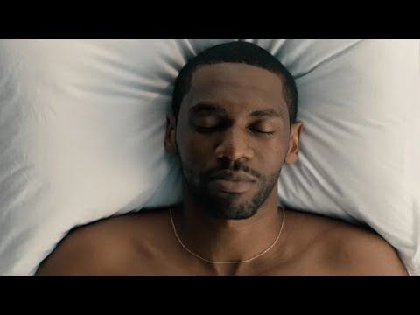
Notes:
Video Credit: P&G, The Look June 2019
https://www.youtube.com/watch?v=aC7lbdD1hq0
Production Company:Stink
Director: Anthony Mandler

Slide 4
Answer these questions in your Science Notebook or on paper.
What was the message or purpose of this commercial?
Were your guesses about this man accurate or not?
Based on this commercial, what do you predict this slideshow is about?

Slide 5
This slideshow is about
RACE,
RACISM,
& what we can do...
Notes:
1 min.

Slide 6
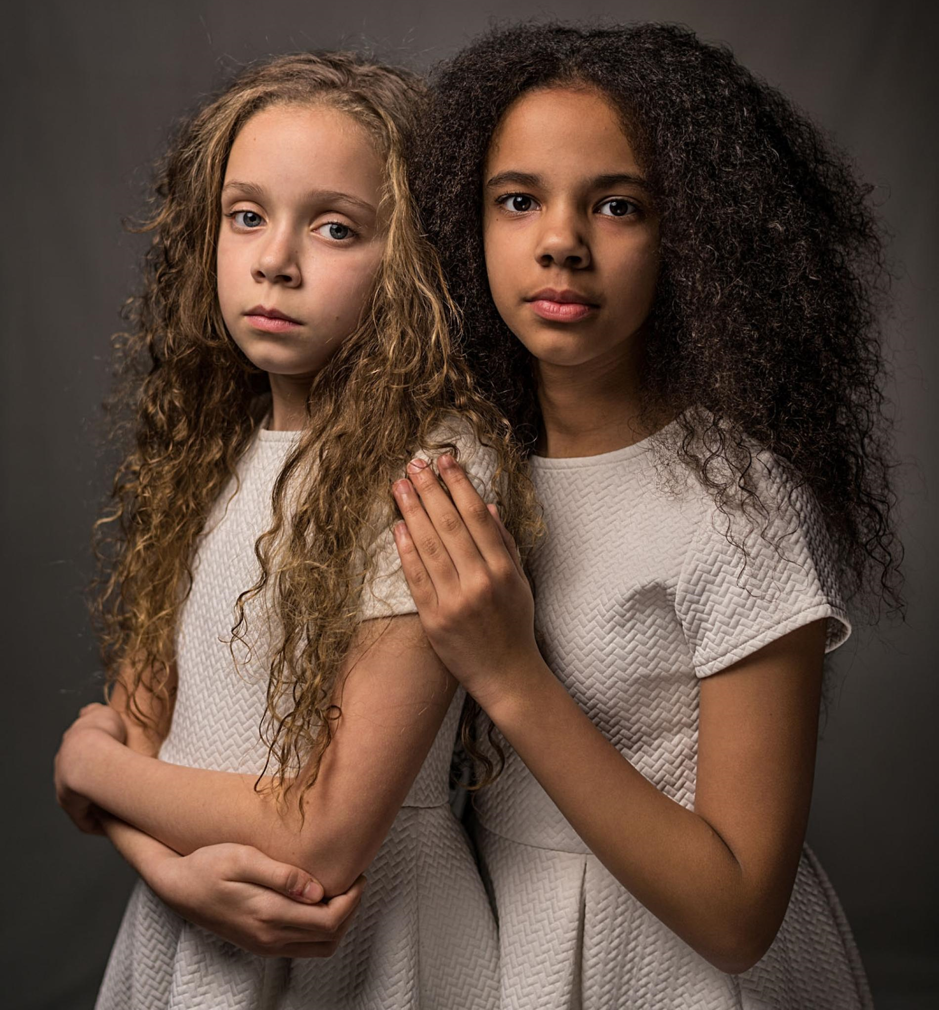
Think Out
Loud
What “race” are you?
What “race” do you think these two girls are?
Notes:
2 min.

Slide 7
4. Copy the highlighted words below:
“WHITE?”
“BLACK?”
Webster’s Dictionary defines race as a: “category of humankind that shares certain distinctive physical traits”
Examples: skin color, hair color & texture, & eye color
Notes:
2 min.

Slide 8
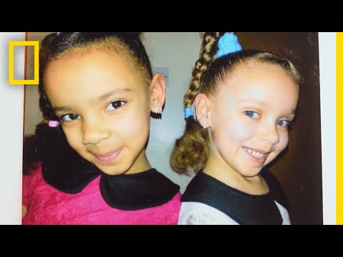
If that is how you define “race”, how do you explain…
Watch this video.
Click on picture
https://youtu.be/FS4DGri-NBo
Notes:
Video Credit: National Geographic
https://youtu.be/FS4DGri-NBo

Slide 9
5.Were you surprised at the video? How do these twins challenge Webster Dictionary’s definition of race?
Notes:
2 min.

Slide 10
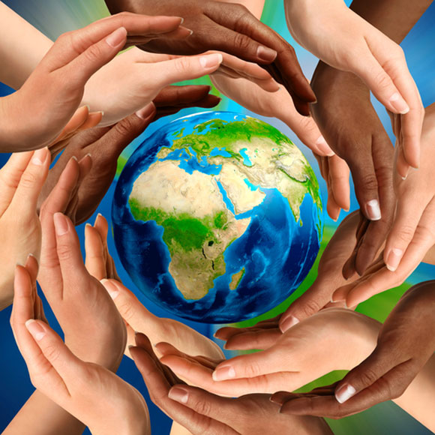
We are all part of the same race- the human species. 99.9% of our genes are the same, despite skin color, height, ancestry, etc.
Race is a SOCIAL CONSTRUCT- in other words, an idea created by society
Notes:
2 min.

Slide 11
We have different skin color & physical appearance based on where our ancestors migrated to thousands of years ago & the amount of something called MELANIN in our skin.
Notes:
To learn more about melanin, check out the video link on the last slide

Slide 12
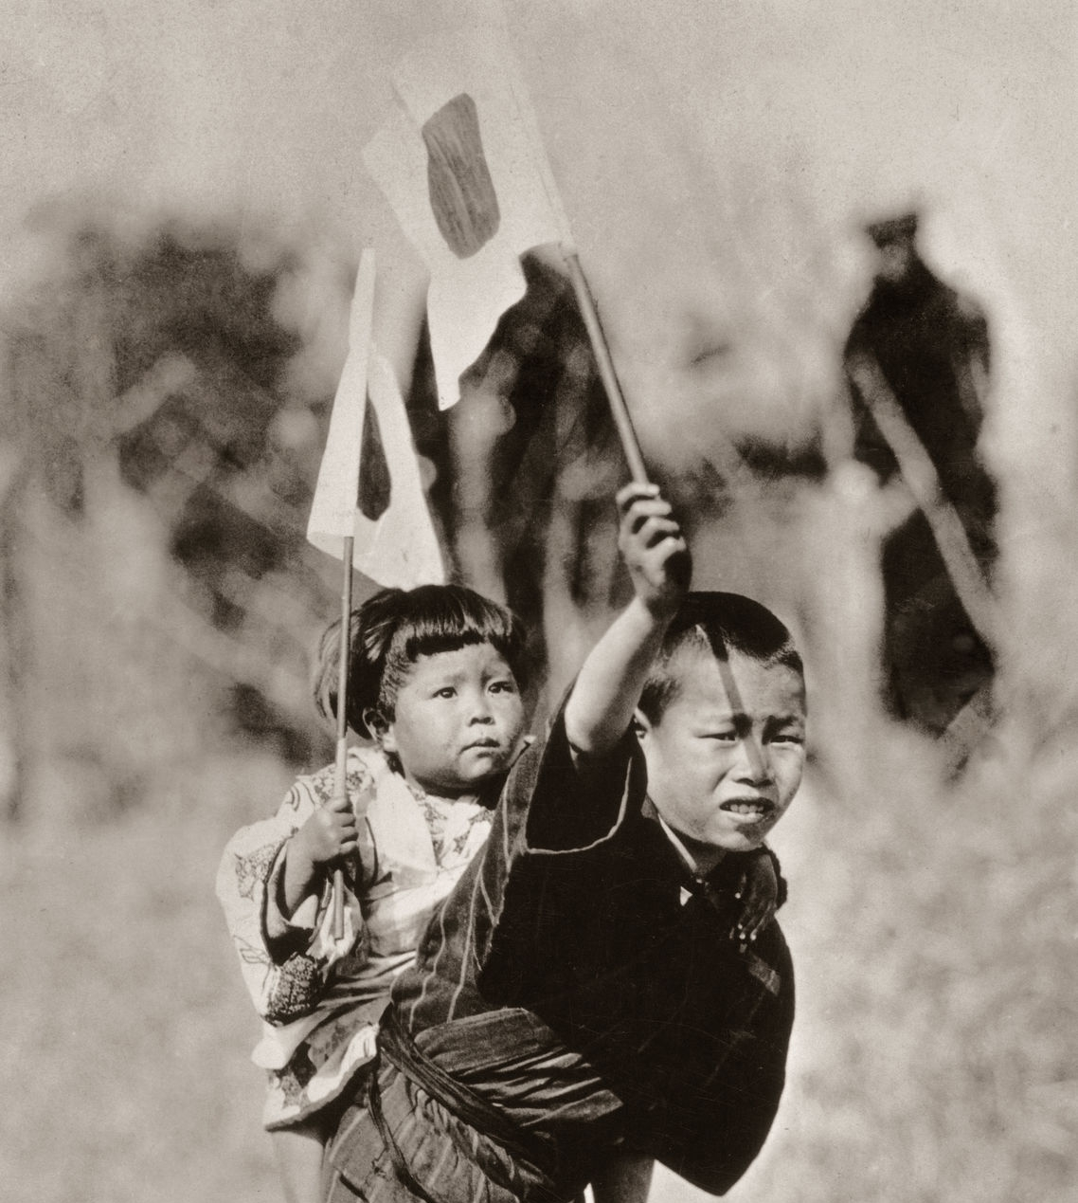
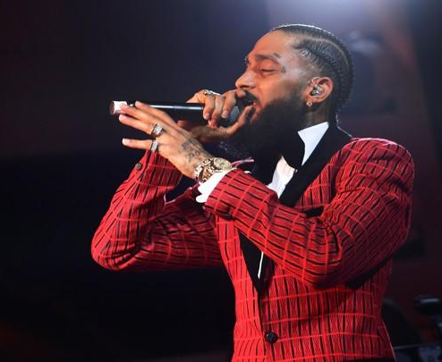
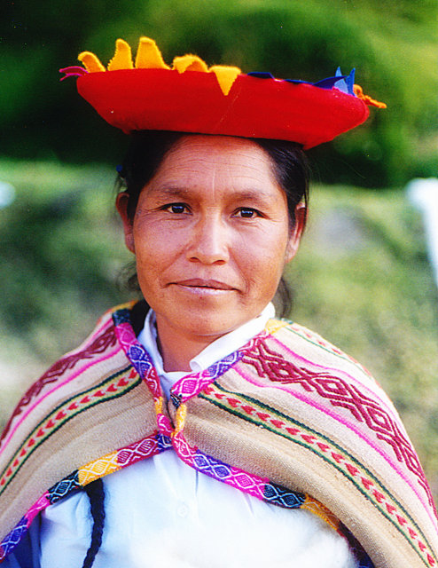
We are all human, but still unique. Being “colorblind” dismisses important parts of who we are.
CULTURE
Language, clothing, music, religious traditions, etc.
ETHNICITY
Where your ancestors are from
NATIONALITY
What country you are from
Notes:
Nipsey Hussle photo, https://www.vox.com/culture/2019/4/2/18290487/nipsey-hussle-death-rapper
(c) Matt Winkelmeyer/Getty Images for Warner Music
Peruvian Woman photo, copyright free, wikimedia commons
A Japanese boy carrying a little girl on his back, circa 1920. Both children are waving Japanese flags. (Photo by Spencer Arnold Collection/Hulton Archive/Getty Images)

Slide 13
Quiz yourself to see how much you remember !
Write down your answers
RACE IS A SOCIAL __________
WHICH COUNTRY SOMEONE IS FROM IS THEIR ________
Construct | Nationality
True | 99.9%
TRUE OR FALSE: YOUR SKIN COLOR IS BASED ON WHERE YOUR ANCESTORS LIVED
WHAT % OF GENES ARE THE SAME IN ALL HUMANS?

Slide 14
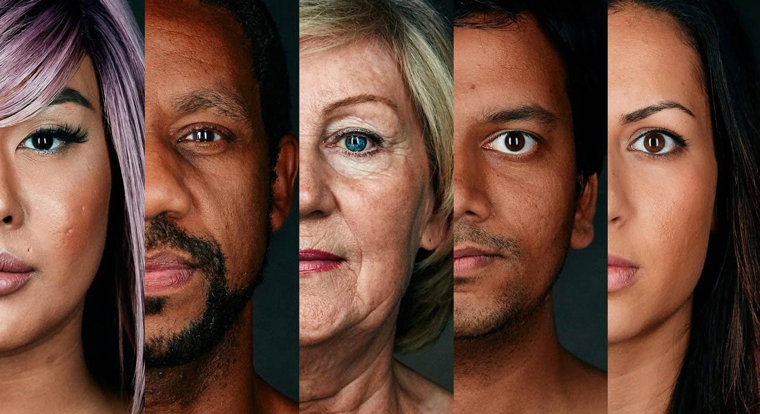
Even though we are all human, we aren’t seen as equals.

Slide 15
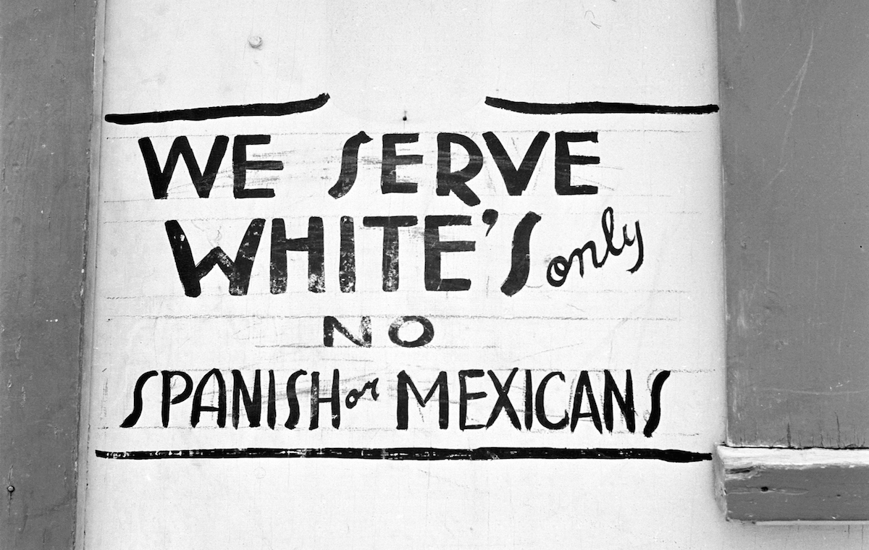
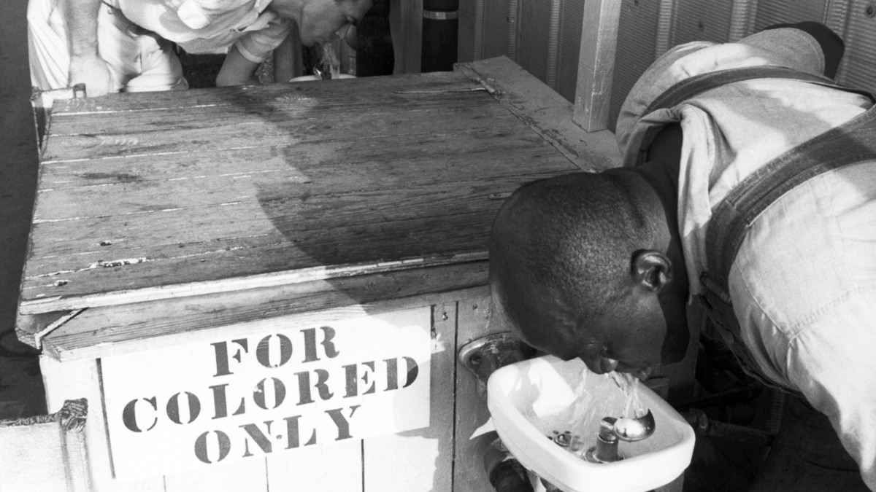
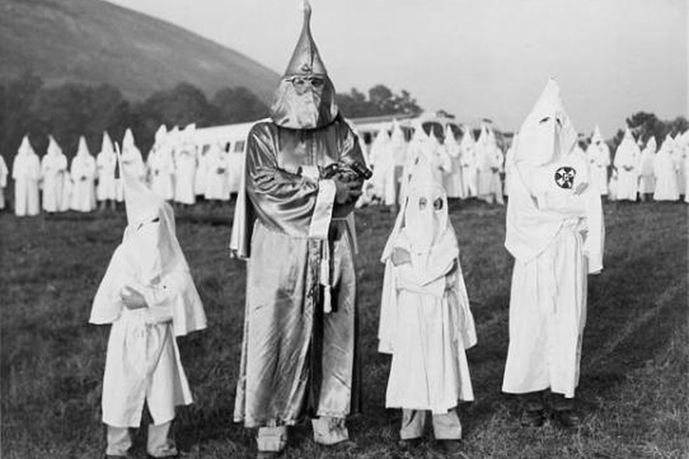
The belief that one “race” is superior to others is called racism.
Notes:
2 minutes

Slide 16
Look at these pictures.
For each one, write the first emotion you feel when you look at it.
Explain why you feel that way.
1
2
3
Notes:
2 minutes

Slide 17
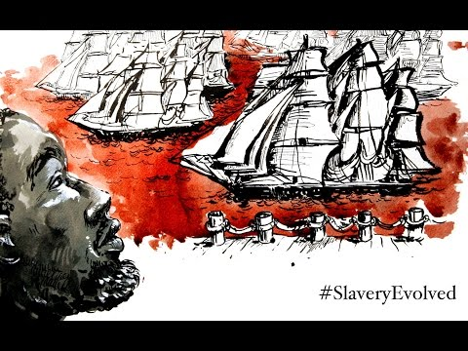
The three photos you just wrote about are all photos taken in the United States of America.
How did it become this way?
Watch this video on racism in the U.S.A. and write down 5 facts you learned from the video?
https://www.youtube.com/watch?time_continue=2&v=r4e_djVSag4&feature=emb_logo
Notes:
Video credit: Slavery to Mass Incarceration
Equal Justice Initiative, July 2015.
https://www.youtube.com/watch?time_continue=2&v=r4e_djVSag4&feature=emb_logo

Slide 18
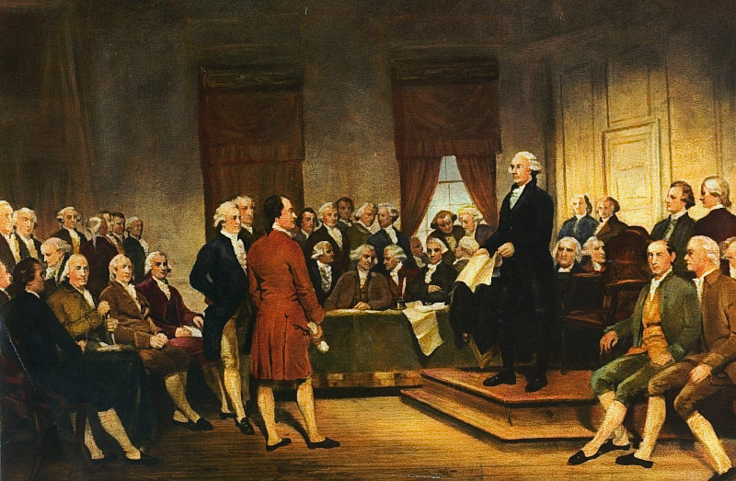
Consider the impact of these facts:
55 people attended the meetings to discuss & decide what the United States government would be after it became independent
All 55 people were men
All 55 men were of Western European descent (White)
25 out of these 55 men owned slaves, including George Washington, the country’s first President.
The decisions by these men shape the systems in the U.S., for example: prisons, schools, health care, courts, etc.
What do you think are the possible consequences of these men having all the power in deciding what the United States would be like?
Notes:
Painting: Washington at Constitutional Convention of 1787, signing of U.S. Constitution by Junius Brutus Stearns, 1856

Slide 19
Think about these questions
What does this timeline show you?
What does it not show you?
Do you think the end of slavery meant the end of racism? Why or why not.

Slide 20
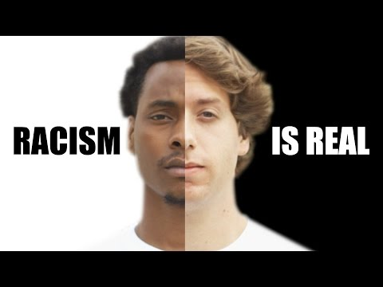
6. What are examples of racism you see in this video?
Have you ever personally experienced or witnessed any similar racist behaviors?
https://www.youtube.com/watch?time_continue=3&v=fTcSVQJ2h8g&feature=emb_logo
Notes:
Video credit: Racism is Real, Brave New Films, April 29, 2015
https://www.youtube.com/watch?time_continue=3&v=fTcSVQJ2h8g&feature=emb_logo

Slide 21
Quiz yourself to see how much you remember !
Write down your answers
The belief that one “race” is superior to others is called...
FALSE almost half owned slaves | Racism
True | Systemic Racism
True or False:
The men who formed the U.S. Constitution were against slavery
True or False:
Black drivers are twice as likely to get pulled over by the police than white drivers
The type of racism shown in the video that is a part of systems like prisons & politics is...
Notes:
6 min. total with discussion (20 minutes total for this part).
Click animation to reveal answers underneath

Slide 22
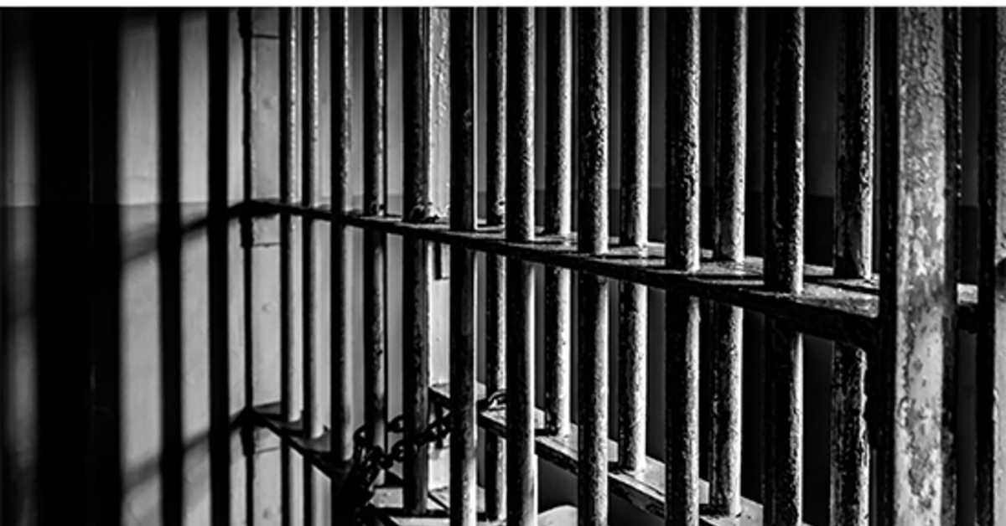
Racism takes many forms
The racism in the video you just watched is a part of our country’s systems and institutions. The examples you wrote about are examples of institutional racism.
You may not understand or see this as much as you might see: individual Racism

Slide 23
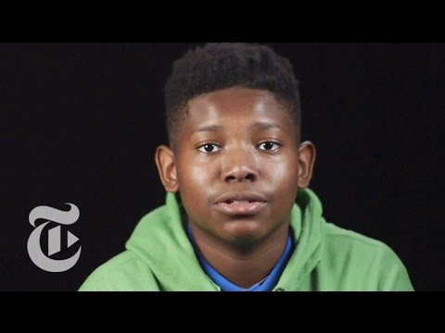
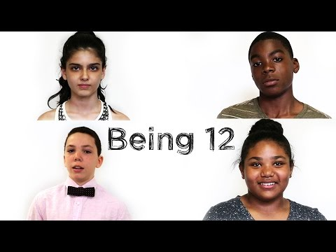
https://youtu.be/rSAw51caEeg
What are examples of individual racism discussed in these videos? Have you ever personally experienced or witnessed any similar racist behaviors?
Notes:
Video Credits:

Slide 24
Examples of individual racism:
Discrimination: When people or systems treat certain people or groups unfairly based on prejudice
Bias: favor towards or against a person, or group compared with another, usually in a way considered to be unfair. Many people have implicit bias, which means they have bias against a certain group & don’t even realize it sometimes, or realize how it affects their actions
Prejudice: Not liking or having a negative opinion about a person, a group, or a particular ethnicity, but without reason, facts, or experience
Stereotype: an idea about a group that assumes everyone in that group is the same, usually is untrue or partly true
Xenophobia: dislike of or prejudice against people from other countries.

Slide 25
Match types of individual racism to examples.
There isn’t always a clear answer & some examples may fit into more than one type of individual racism.
Stereotype | Xenophobia, Prejudice | Bias, Implicit bias
Bias | Discrimination | Xenophobia & Prejudice
Someone in class says “Oh, you must be good at math because you’re Asian”
At the grocery store, a man hears you speaking Spanish & says “Go back to Mexico”
You see a woman clutching her purse as she passed a Black man on the street
One day you notice that your teacher usually only calls on the White kids in class.
A student isn’t allowed to walk the stage to graduate unless he cuts his dreadlocks.
Your friend’s mom doesn’t want her to hang out with her new neighbor because she’s Muslim & her family is from Pakistan
Notes:
6 min. total with discussion (20 minutes total for this part).

Slide 26
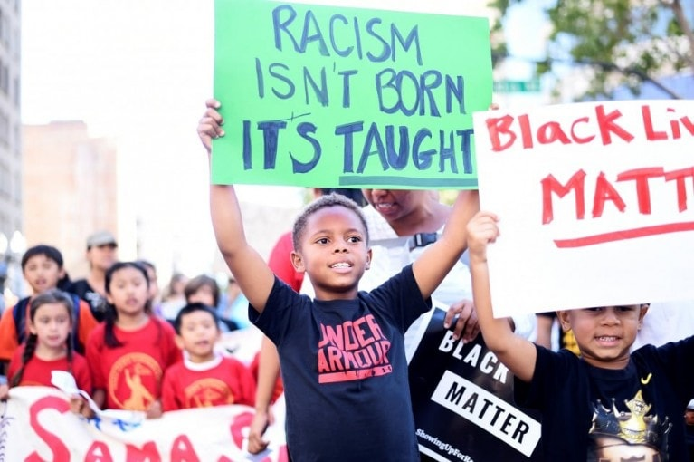
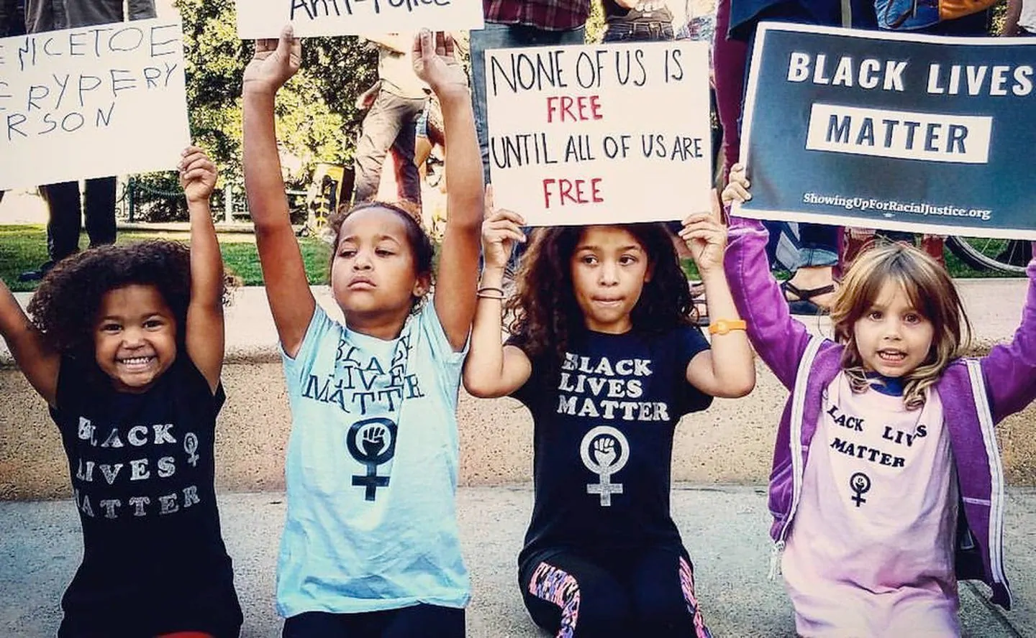
Respond to what you see written on one of the signs in these pictures. Copy it, write what you think it means & whether you agree or disagree & why.
Notes:
Photo Credits: Washington Post (1) https://www.washingtonpost.com/news/post-nation/wp/2016/07/22/blm-whats-next/
(2)
https://www.washingtonpost.com/education/2019/02/05/its-black-lives-matter-school-week-why-that-matters-especially-now-how-classrooms-are-taking-part/

Slide 27
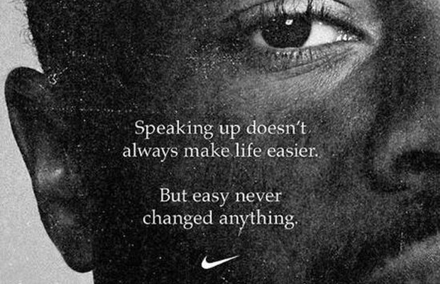
Some people might think that kids have no power and there is nothing they can do, but this is UNTRUE. You DO have power and influence. You can make positive changes in our country.

Slide 28
Extensions: In the time of COVID-19
Using trustworthy sources, answer one or more of these questions:
Who was Ahmaud Arbery? How is he related to this presentation? How is his life being remembered?
The COVID-19 virus has been called the “Great Equalizer” because anyone can catch it and it has killed so many. Is this true? Is the COVID-19 virus killing different ethnic groups at an equal rate? Explain.
Find an example of institutional racism being carried out now in the time of the COVID-19 pandemic. Even though you may be staying at home, what is one thing you could do about this issue, specifically.

Slide 29
Resources for kids and adults
Books:
“This Book Is Anti-Racist 20 Lessons on how to Wake Up, Take Action, and Do the Work”, By Tiffany Jewell, 2020 here
“How to be an Antiracist” By Ibram X. Kendi, 2019 here
“ Me and White Supremacy, Combat Racism, Change the World, and Become a Good Ancestor” By Layla F. Saad, Robin J DiAngelo, 2020 here
Video with more information about the science of skin color here
Video: Origin of Race in America Here
Timeline & information on history of racism in the U.S. Here
Numerous resources for learning about racism from Teaching for Tolerance Here
Notes:
https://www.ted.com/playlists/250/talks_to_help_you_understand_r

