Slide 1
The Golden Hour: Day 1
Student Interactive PPT

Slide 2
INITIAL THOUGHTS
What do you know about Traumatic Brain Injury?
Have you heard or seen anything in the media about brain injury?
Do you have any personal experiences with Traumatic Brain Injury that you would like to share?

Slide 3
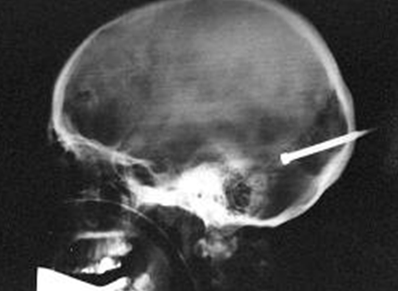
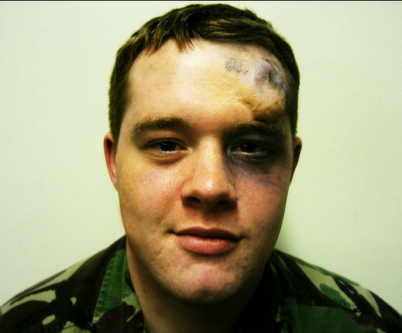
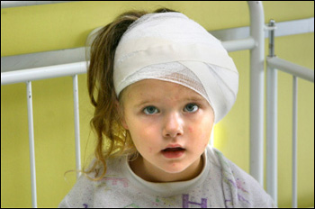
2
1
Which individual has an injury?
3
5
4
Source: http://maketheconnection.net/conditions/traumatic-brain-injury?gclid=CIvngc7W7LACFeUBQAodpFgHuA
Source: http://www.streetdirectory.com/etoday/i-ve-suffered-a-head-injury-cfwcle.html
Source: http://www.nydailynews.com/news/galleries/the_x_factor_amazing_xrays/the_x_factor_amazing_xrays.html
Source: http://www.flickr.com/photos/9346632@N07/3614205726
Source: http://www.healthadvocates.info/2008/03/poor-kids-lives-are-only-half-worth.html

Slide 4
2
1
Which individual has a worse injury?
3
5
4
Source: http://maketheconnection.net/conditions/traumatic-brain-injury?gclid=CIvngc7W7LACFeUBQAodpFgHuA
Source: http://www.streetdirectory.com/etoday/i-ve-suffered-a-head-injury-cfwcle.html
Source: http://www.nydailynews.com/news/galleries/the_x_factor_amazing_xrays/the_x_factor_amazing_xrays.html
Source: http://www.flickr.com/photos/9346632@N07/3614205726
Source: http://www.healthadvocates.info/2008/03/poor-kids-lives-are-only-half-worth.html

Slide 5
2
1
Is it possible to tell which injury is worse by looking at appearance?
3
5
4
Source: http://maketheconnection.net/conditions/traumatic-brain-injury?gclid=CIvngc7W7LACFeUBQAodpFgHuA
Source: http://www.streetdirectory.com/etoday/i-ve-suffered-a-head-injury-cfwcle.html
Source: http://www.nydailynews.com/news/galleries/the_x_factor_amazing_xrays/the_x_factor_amazing_xrays.html
Source: http://www.flickr.com/photos/9346632@N07/3614205726
Source: http://www.healthadvocates.info/2008/03/poor-kids-lives-are-only-half-worth.html

Slide 6
2
1
Which images show an open head injury? Closed head injury?
3
5
4
Source: http://maketheconnection.net/conditions/traumatic-brain-injury?gclid=CIvngc7W7LACFeUBQAodpFgHuA
Source: http://www.streetdirectory.com/etoday/i-ve-suffered-a-head-injury-cfwcle.html
Source: http://www.nydailynews.com/news/galleries/the_x_factor_amazing_xrays/the_x_factor_amazing_xrays.html
Source: http://www.flickr.com/photos/9346632@N07/3614205726
Source: http://www.healthadvocates.info/2008/03/poor-kids-lives-are-only-half-worth.html

Slide 7
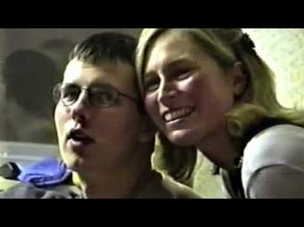
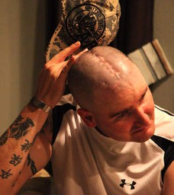
What is Traumatic Brain Injury?
Can an injury be severe even if the patient appears to be fine?
http://maketheconnection.net/conditions/traumatic-brain-injury?gclid=Clvngc7W7LACFeUBQAodpFgHuA
Google: Natasha Richardson, Gabby Giffords

Slide 8
Activity 1: TBI Stories
You will work in groups to read & discuss news articles about real situations involving TBI. Cases of TBI fall into one of three different general classifications: mild, moderate, or severe. Your group will read three different articles, each of which discusses an example of one of the three different TBI classifications. While reading, make sure to identify and highlight the main points that could be used as distinguishing factors to help classify the cases of TBI.

Slide 9
Lesson 1: What is TBI? Group Discussion Questions:
Please describe how the injury occurred.
Did the victim have any immediate consequences of the injury, such as loss of consciousness? If so, what were they and how long did they last?
Were there any accompanying injuries in this case (i.e. brain contusions)?
Were there any long-term effects or symptoms that persisted in the victim’s life?
What are other main points from the article that you think may be important to consider when classifying Traumatic Brain Injury?

Slide 10
Class Summary Discussion
Do you notice anything that could be useful to classify these three articles as mild, moderate, or severe?
In any of the cases was the victim unconscious at all? If so, for how long? Do you think that may be important?
Look at the numbers that are included for the GCS.
What is the Glasgow Coma Scale?
What do you think the GCS numbers could mean?
Could they help to identify what category a patient would be in?
Are there any associated injuries with any of the cases (i.e. contusion, hematoma)?
Based on all of this information, which article do you think is about a mild TBI? Moderate? Severe? Why?
Is it difficult to clearly define which case goes into which category?

Slide 11
Assessing an Injury…
What are vital things to consider after an injury to the head?
Could the friend tell us any information that the patient could not? (i.e. unconscious, how he landed, etc.)
Could brain damage hinder any other functions of the body that are not commonly associated with the brain area sustaining the initial injury?
What could we ask to discover if the patient is experiencing any abnormalities in his daily life?
Do you think that mood change or behavior change could be a result of a brain injury?
Would there be anything that we could potentially discover by looking at the appearance of the patient?

Slide 12
WRITE IT DOWN…
In your journal list ONLY 3 questions you would ask to determine if someone had a Traumatic Brain Injury.

Slide 13
Activity 2: Play the Game
Golden Hour Game Link: Scene 1
Complete your EMS report & write your conclusion on the back.
When done…consider this:
Of the questions you wrote before the game, which ones were in the game? Which were not? Why? Should they have been in the game? What information would these extra questions add?

