Slide 1
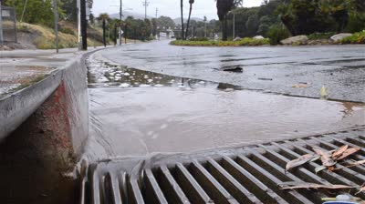
Stormwater

Slide 2
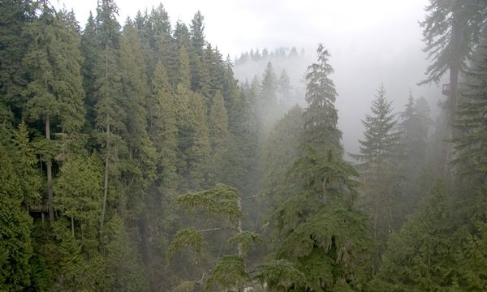
Stormwater is not a problem

Slide 3
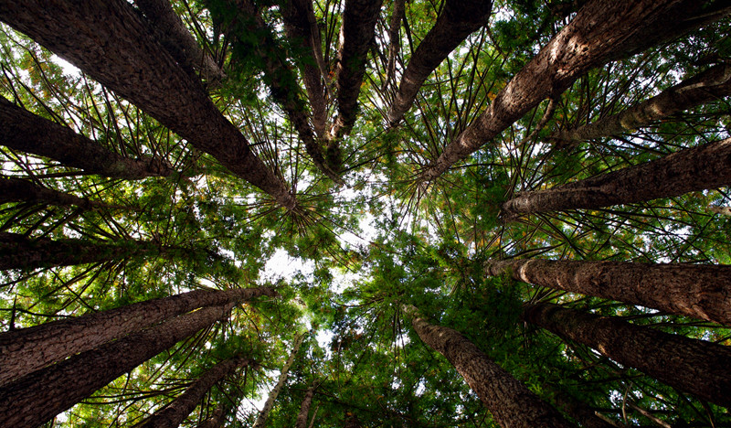
40% is captured
in the forest canopy

Slide 4
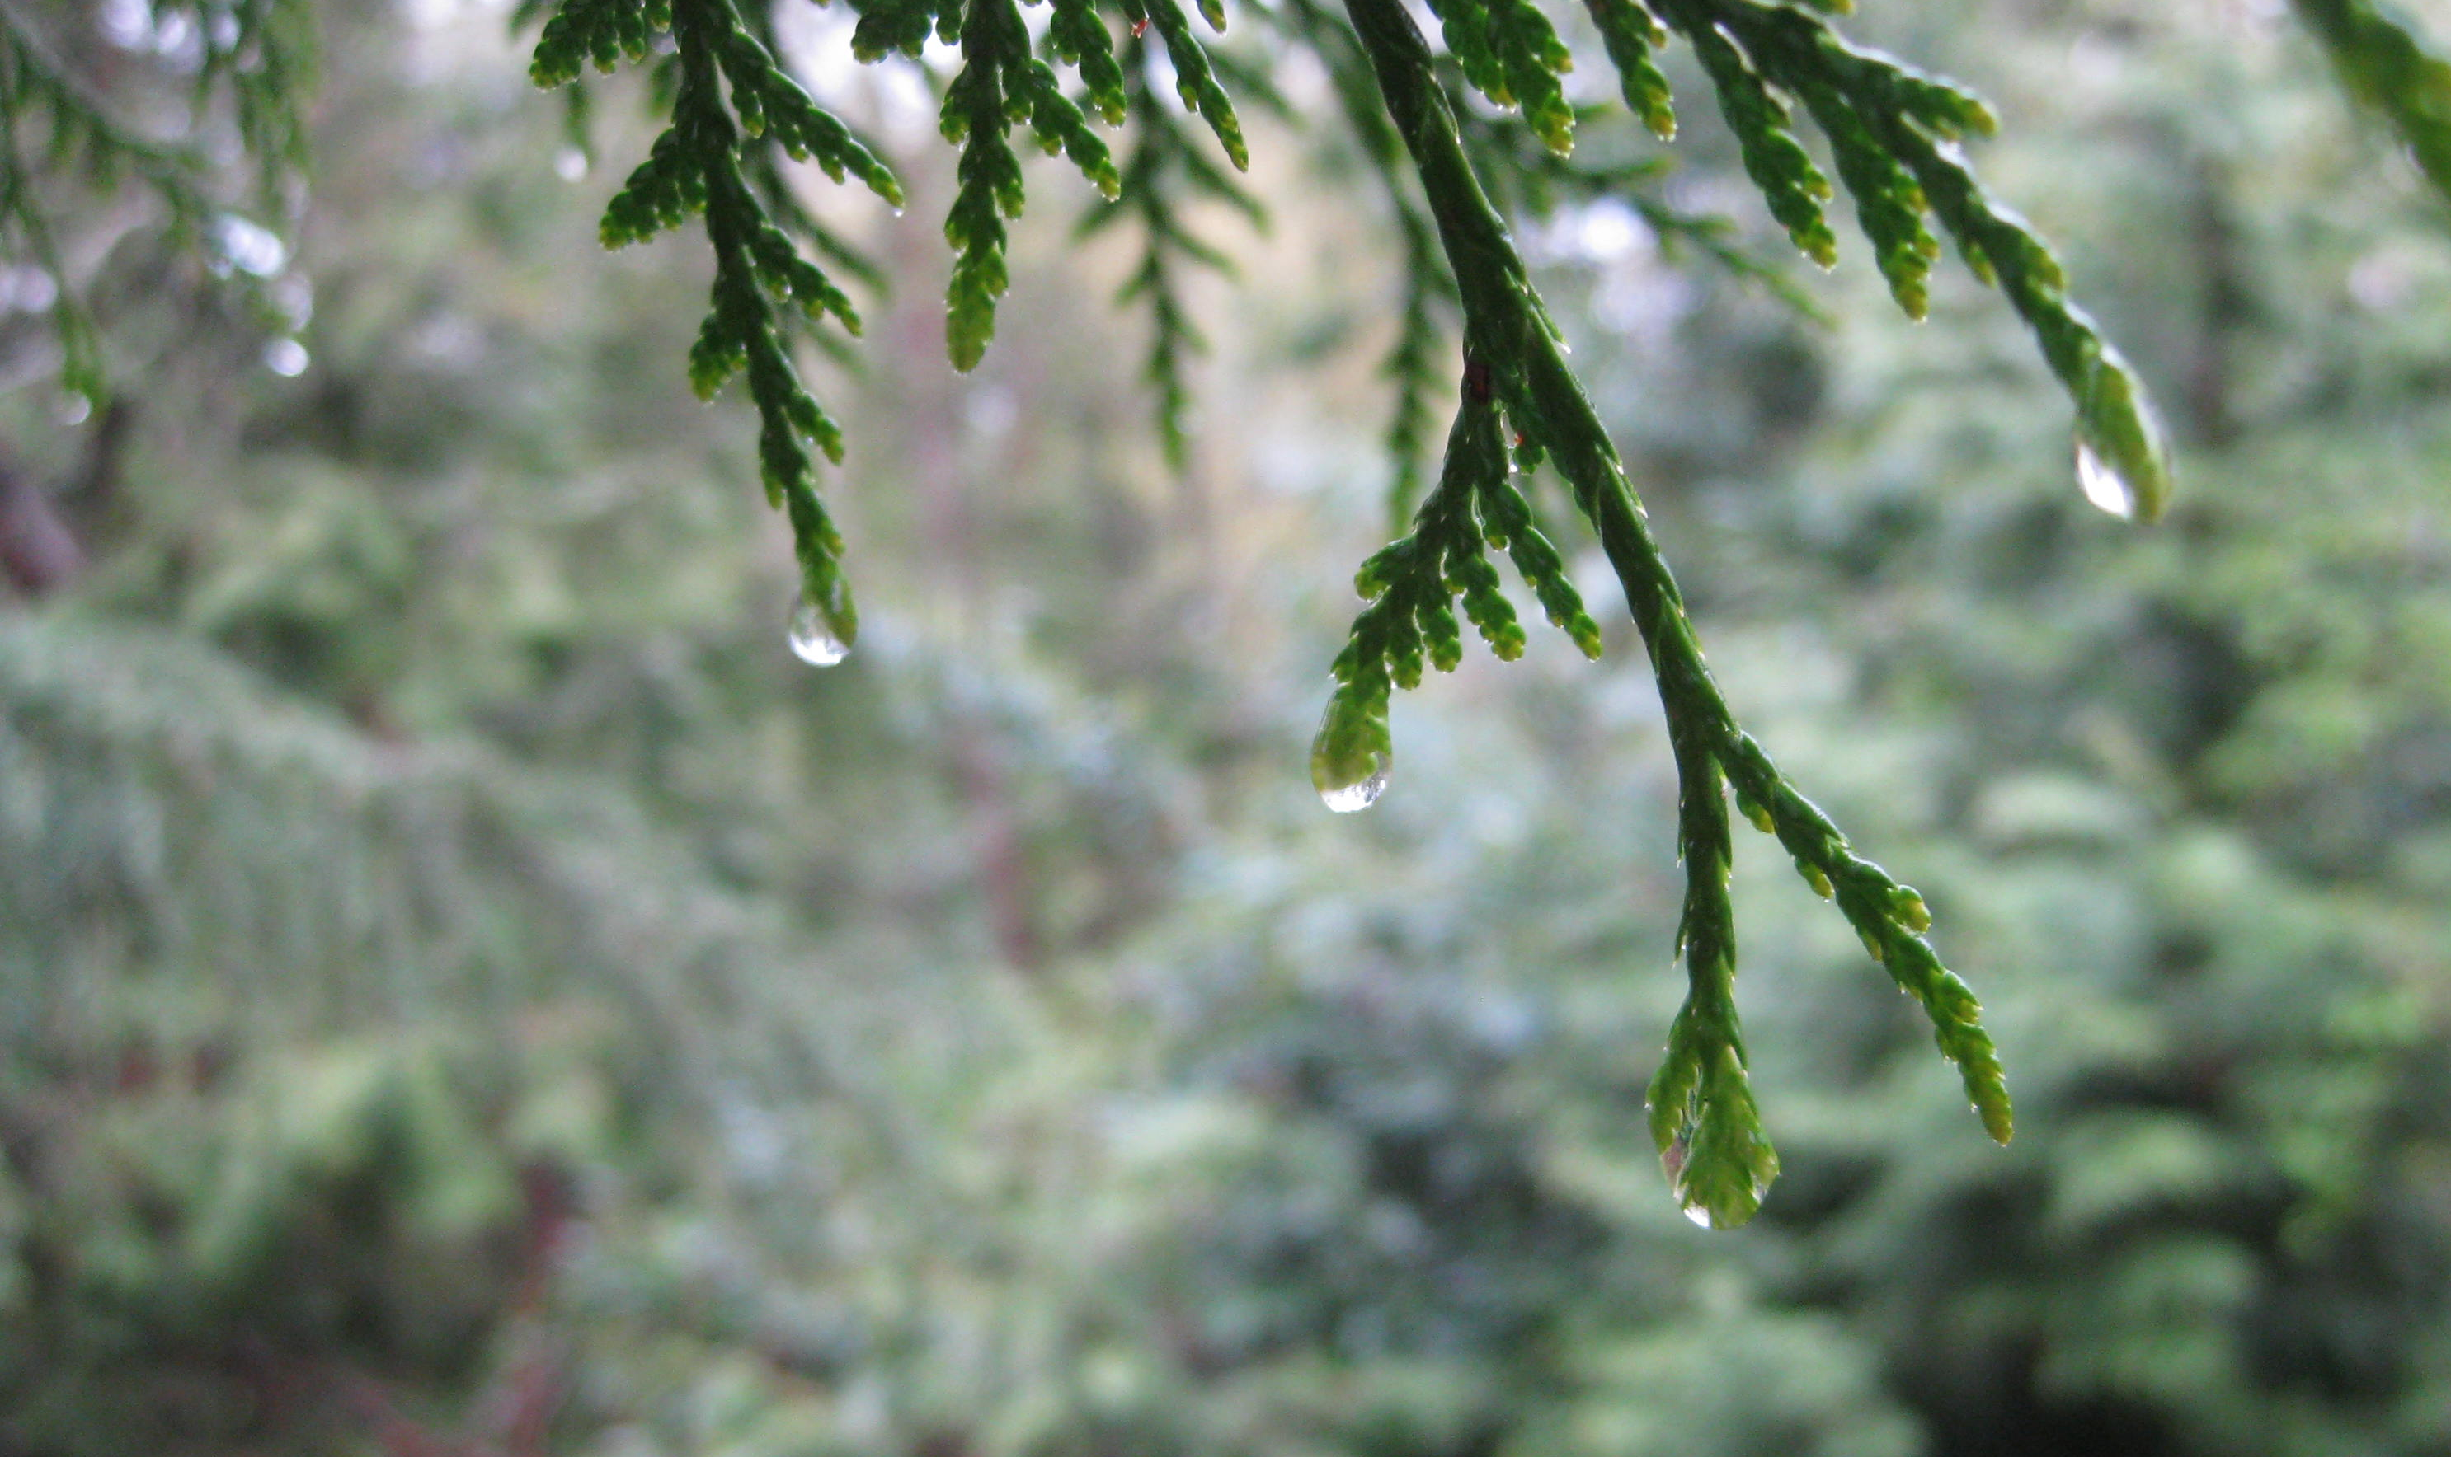
Needles evolved to
drip water slowly

Slide 5
Most of it seeps into
the ground water

Slide 6
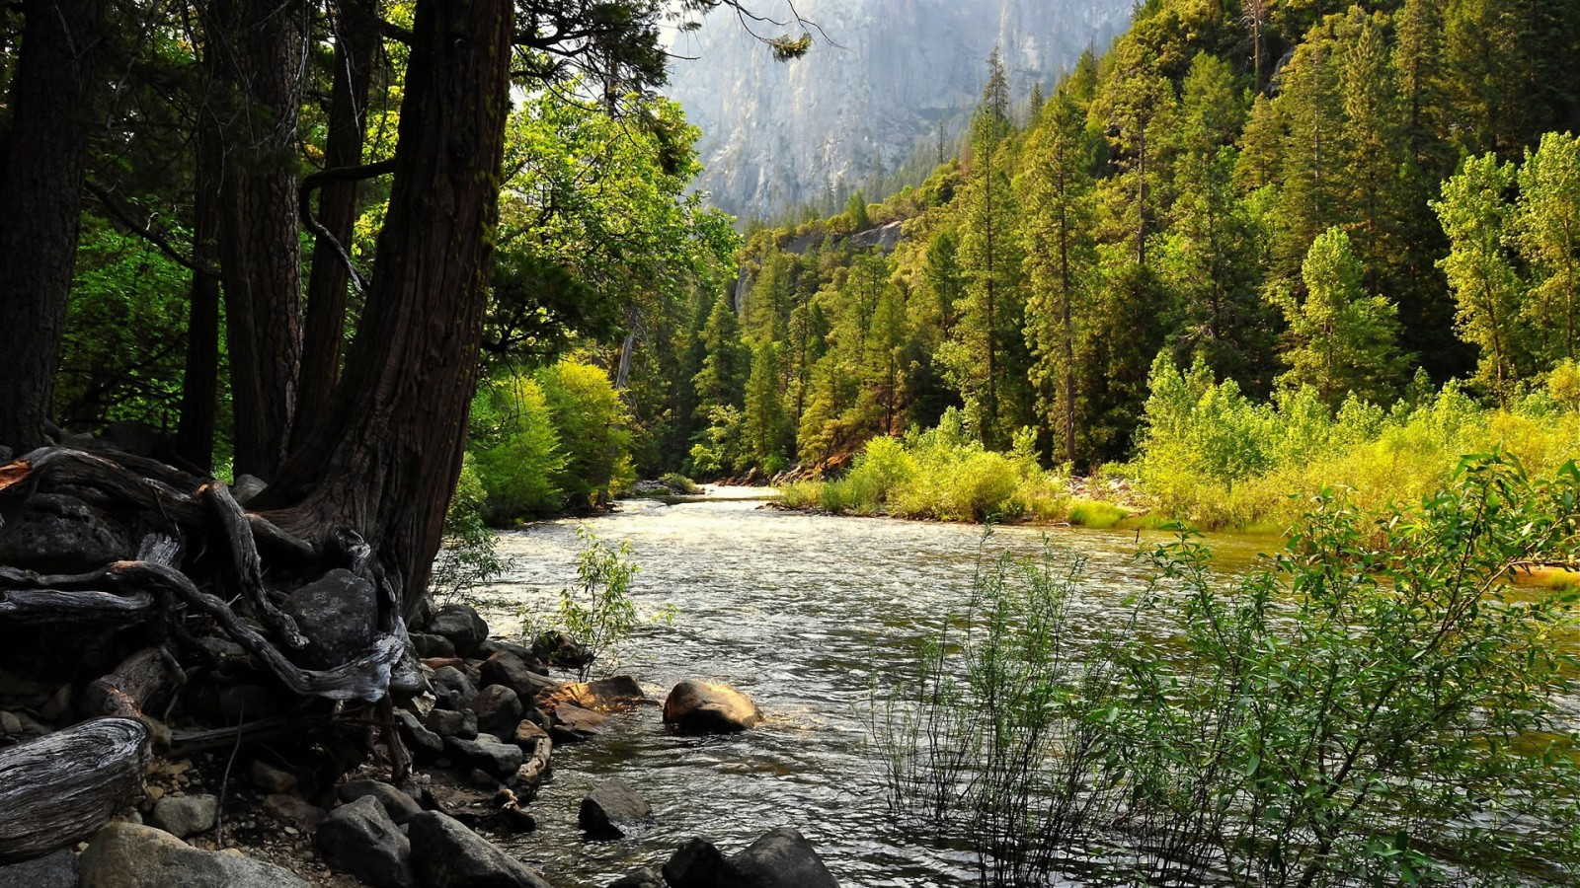
Natural runoff
accumulates
in streams and
rivers…

Slide 7
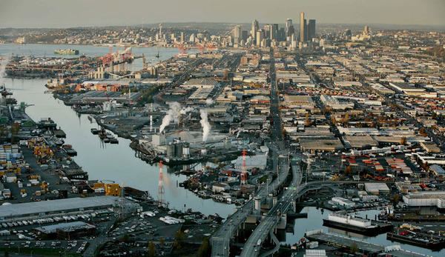
Except in cities
with a lot of
impervious surface area

Slide 8
Notes:
Kent School District Impervious Map…. Stop and ask students to local landmarks, highways, commercial areas, airport, Lake youngs, find school, find home…

Slide 9
Notes:
Mill Creek Middle School Impervious Map…. (one mile radius with school in the middle) Stop and ask students to locate landmarks, find school, find local business, green areas, Hillside Church, find home…

Slide 10
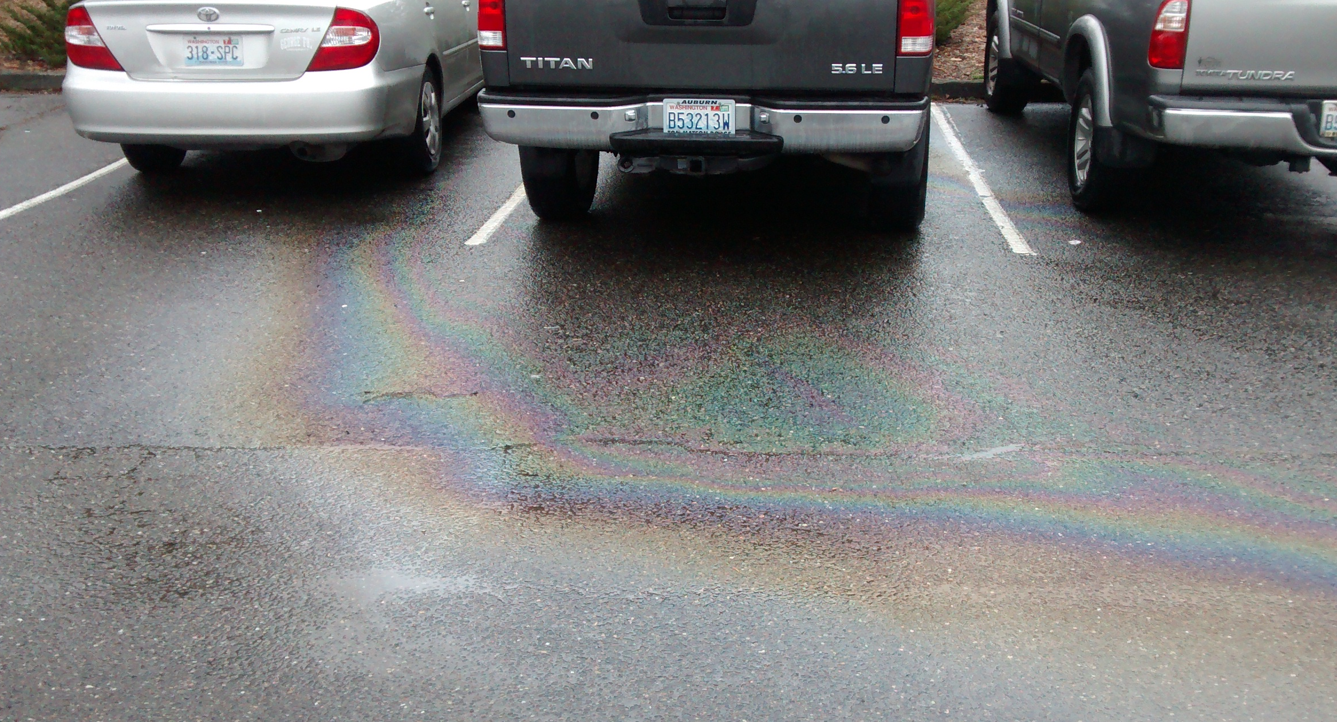
polluted
stormwater
runoff

Slide 11
Where does it go?

Slide 12
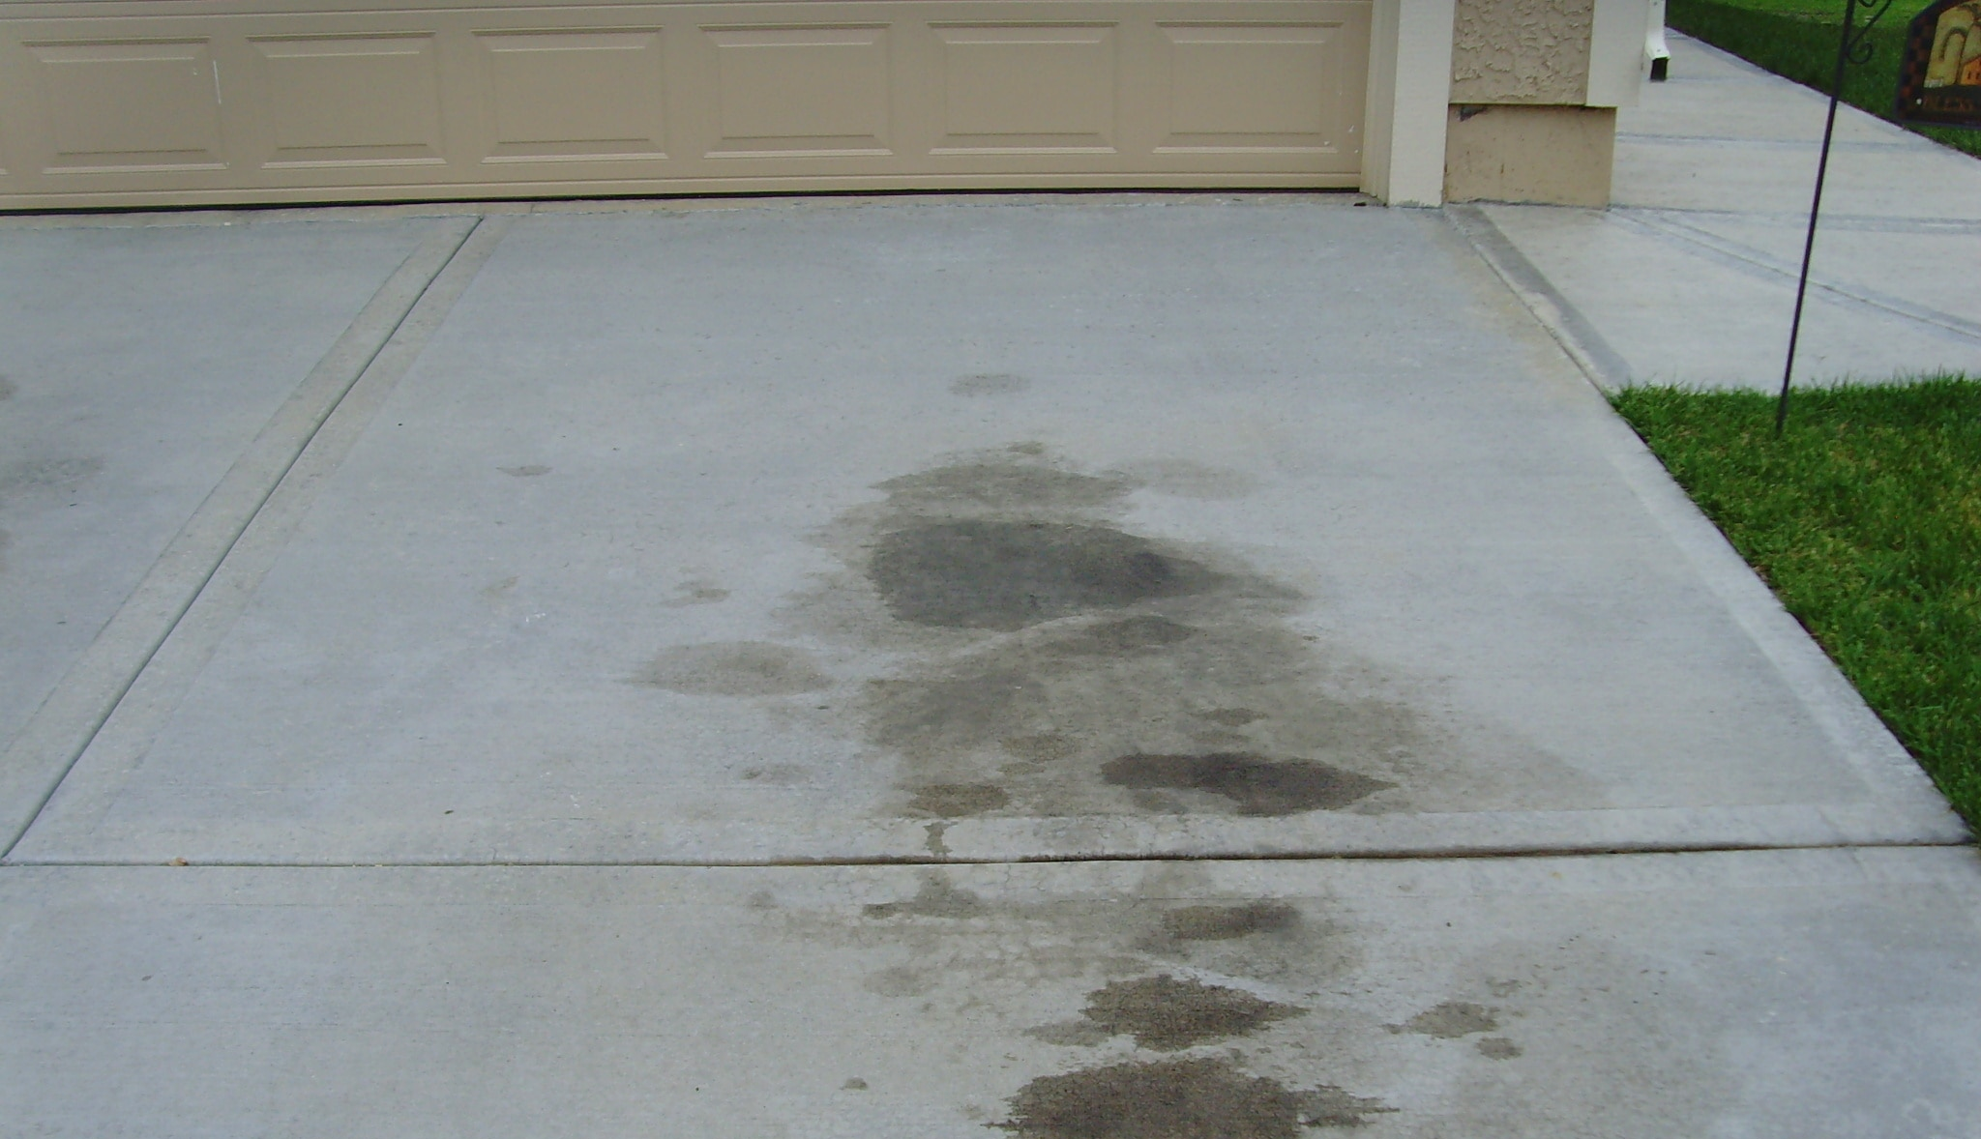
Just a couple little spots
can’t be that big a deal…

Slide 13
4,500,000
People in the Puget Sound Region
200 more people every day
6,000,000 by 2030

Slide 14
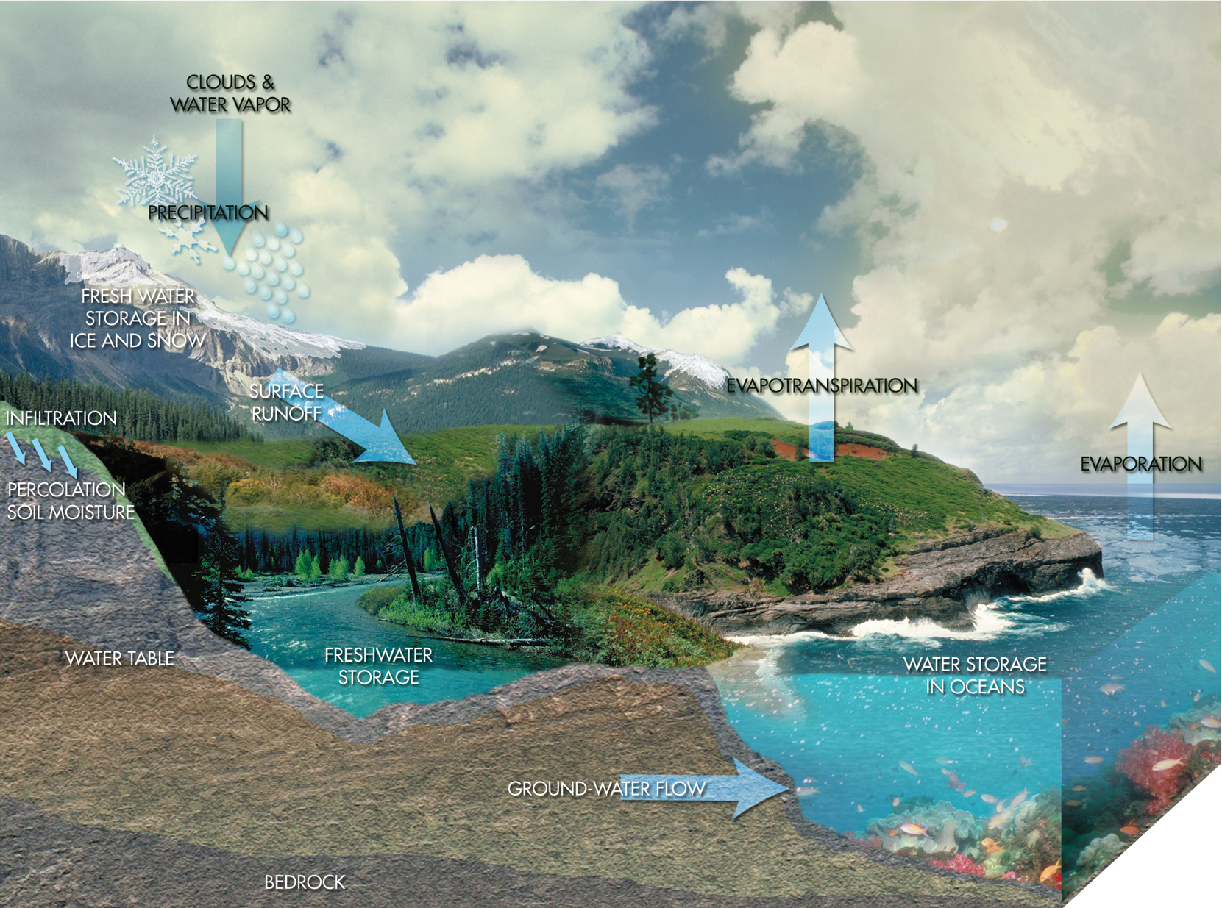
Water Cycle Watershed Groundwater
C O N D E N S A T I O N

Slide 15
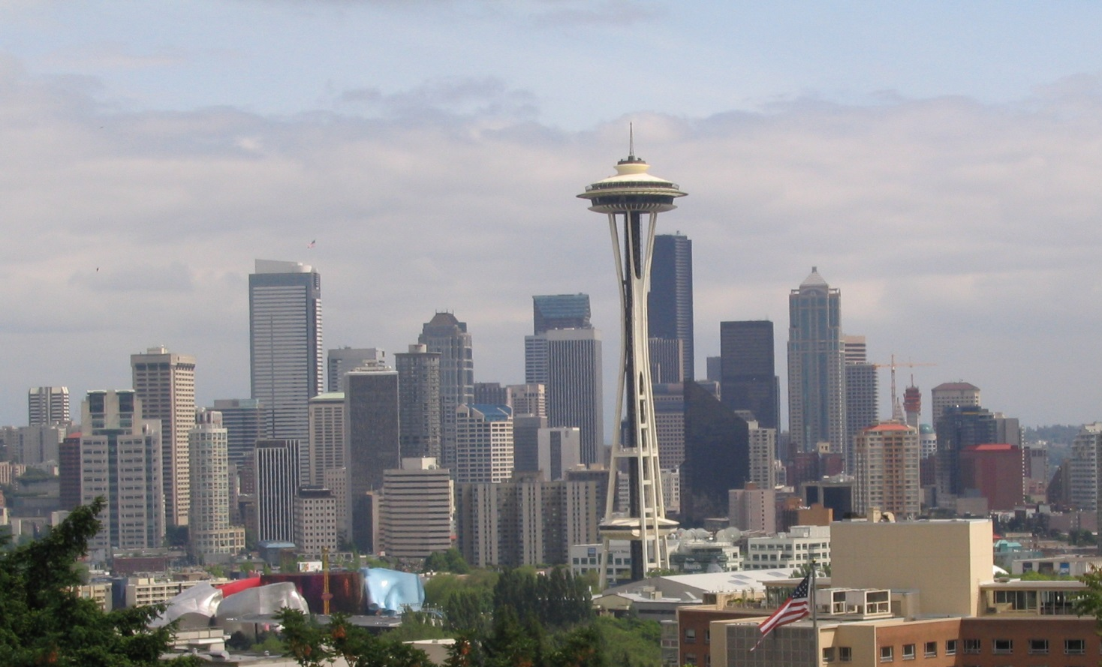
What elements of the natural systems are interrupted when you build a city on top? Water Cycle Watershed Groundwater
C O N D E N S A T I O N

Slide 16
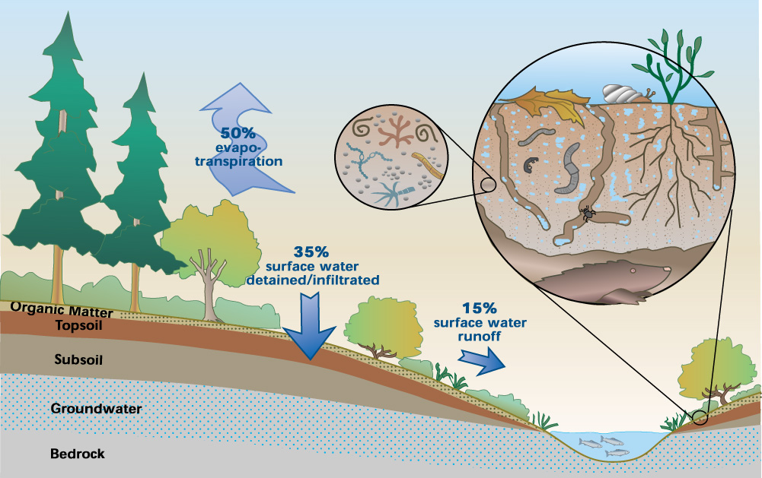
Notes:
Stop, students reflect on handout
But in conventional development, we strip and compact the soil, destroying that soil sponge. Rain rushes quickly off roofs, pavement, and compacted soil, carrying oil and metals from cars, and fertilizer and pesticides from landscapes into the nearest stream.

Slide 17
Notes:
Stop, students reflect on handout

Slide 18
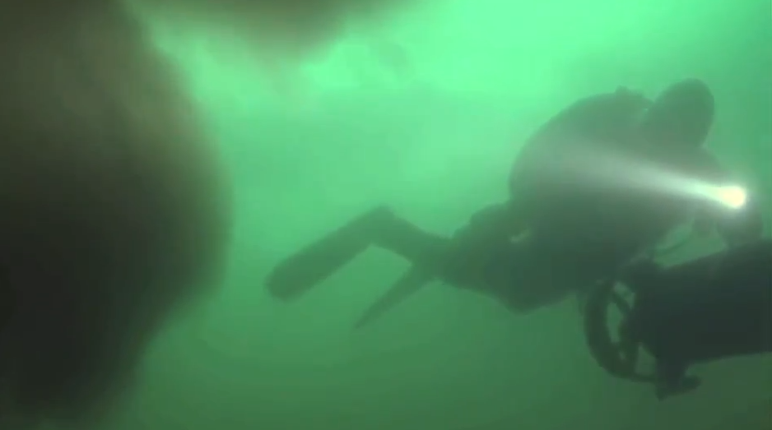
The end of the pipe…

Slide 19
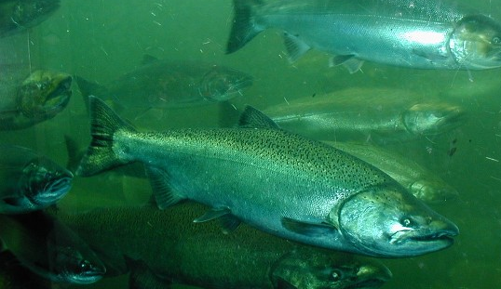
What are the sources of pollution
in stormwater runoff?
How does it affect the biological
health of living organisms?
What about our own health?
What can we do?

Slide 20
Let’s follow one set of toxins called
PCBs

Slide 21
Let’s follow one set of toxins called
PCBs
polychlorinated biphenyl
banned in 1979 but very persistent
in the food web

Slide 22
polychlorinated biphenyl (banned but persistent chemicals)
Notes:
Stop, students reflect on handouts, (infographic plus reading on PCB’s) then students stand and present main idea on each slide

Slide 26
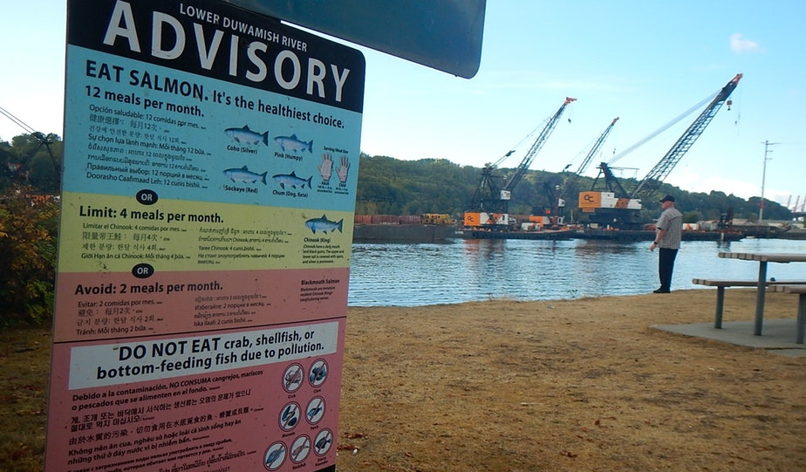
What about our place
in the food web?
Notes:
Stop, students reflect on handout

Slide 27
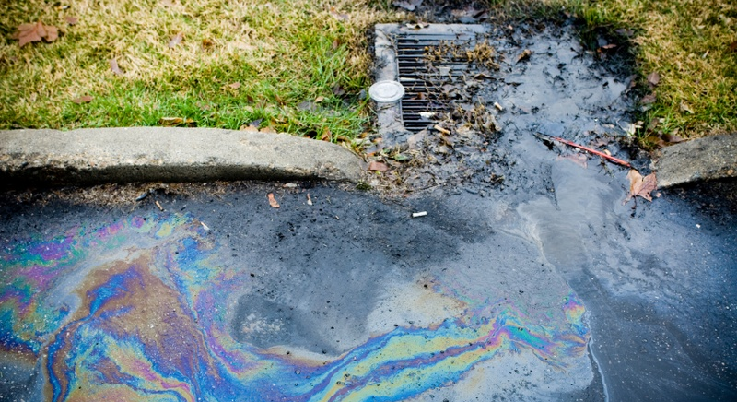
What are the sources of
pollution in stormwater runoff?

Slide 28
Source of Toxin Solution
PCBs
Enact a law to ban PCB’s
Invent other chemical solutions to replace PCBs
Remove old materials with PCB’s

Slide 29
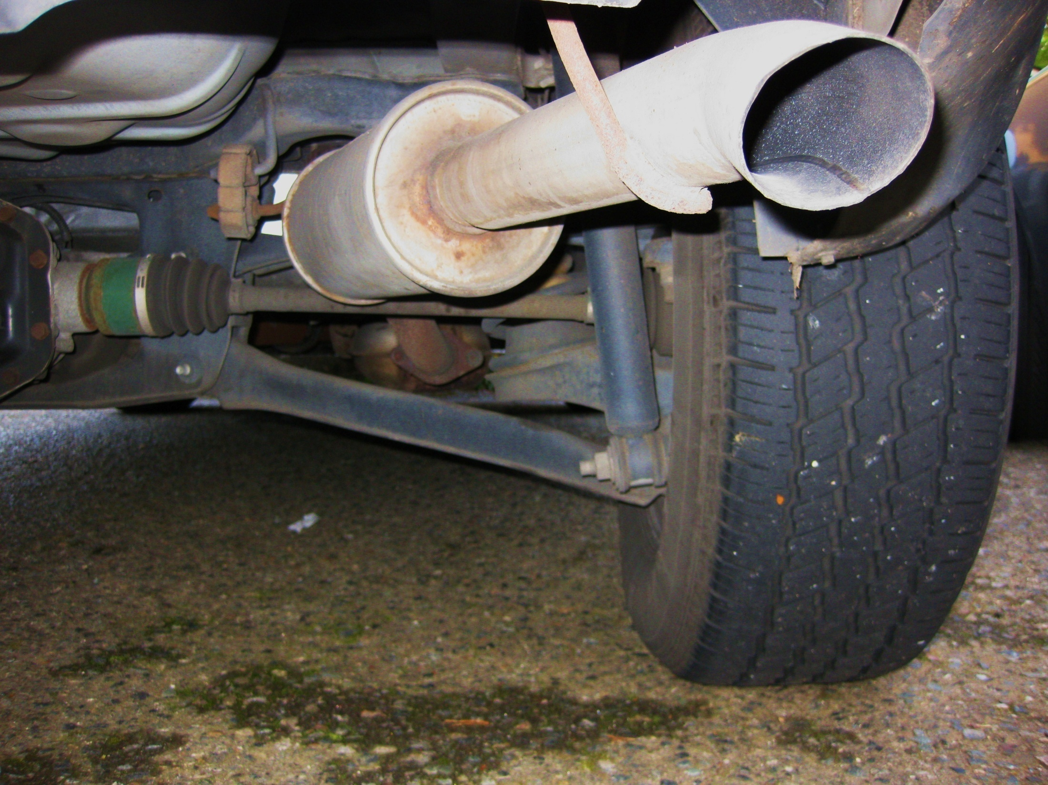
oil drip

Slide 30
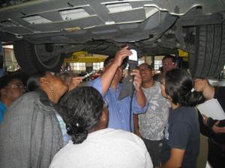
Don’t Drip and Drive

Slide 31
acid
rain

Slide 32
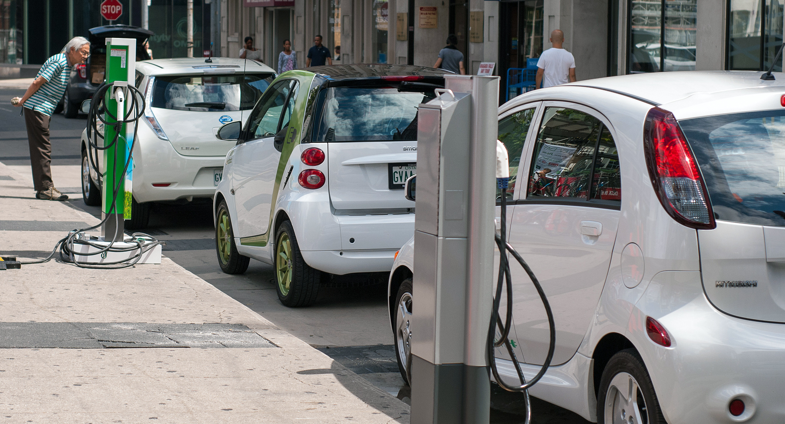
EV Revolution

Slide 33
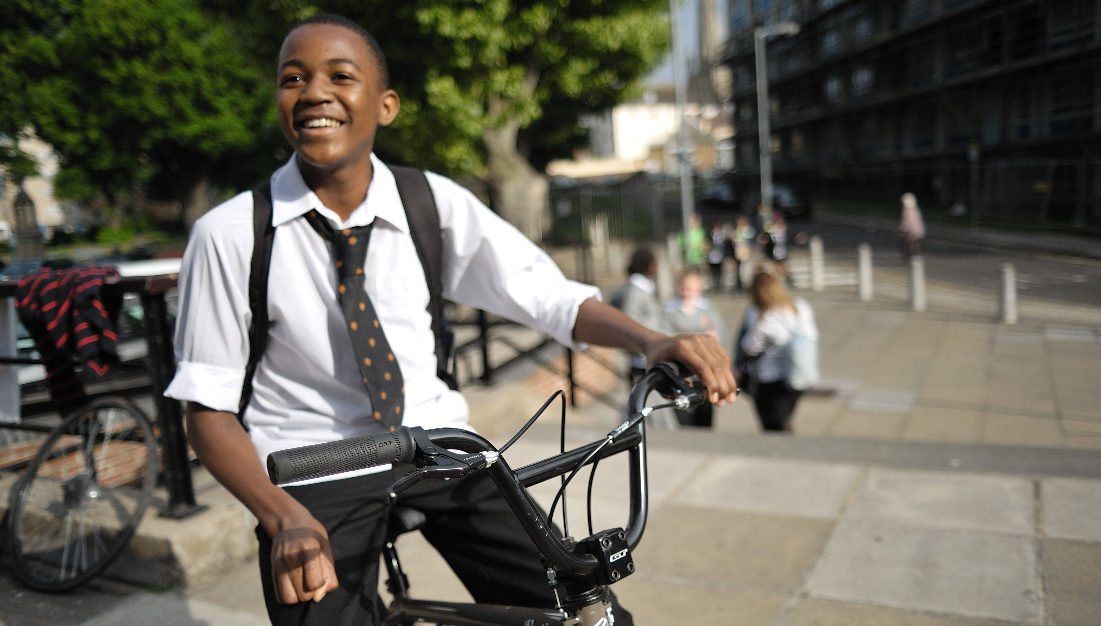
Bike, walk or
bus to school

Slide 34
copper brake
pad lining

Slide 35
Brake pad diagam

Slide 36
grime
grease
soap

Slide 37
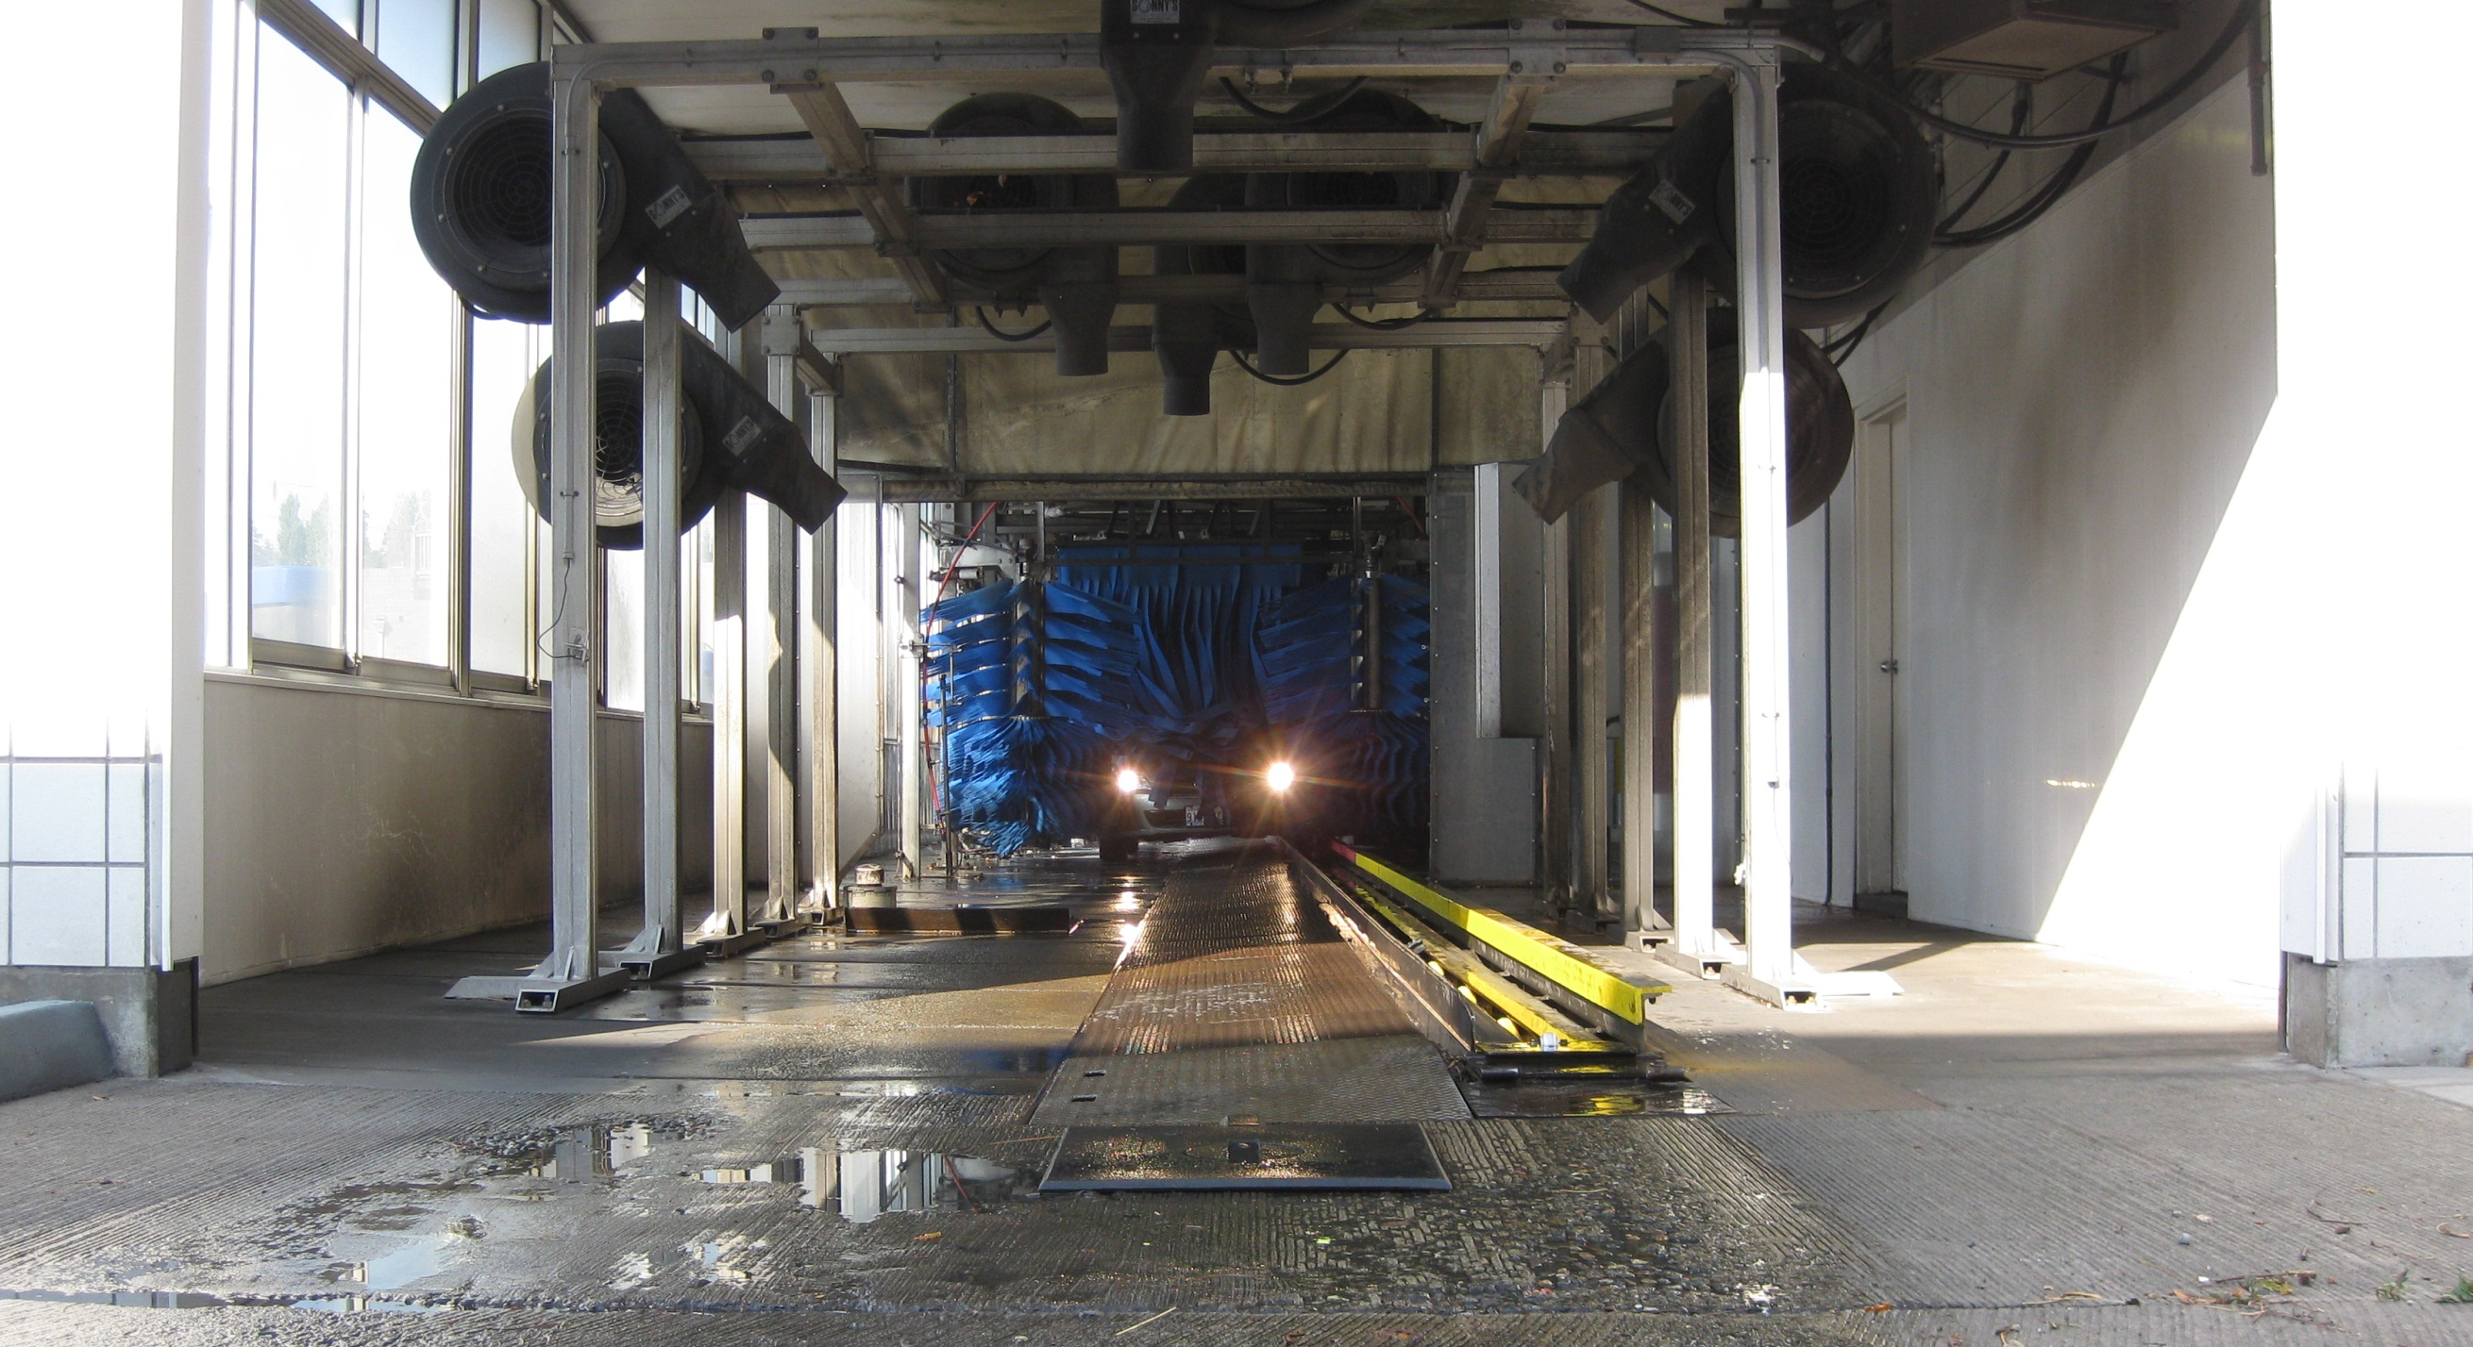
Commercial Carwash

Slide 38
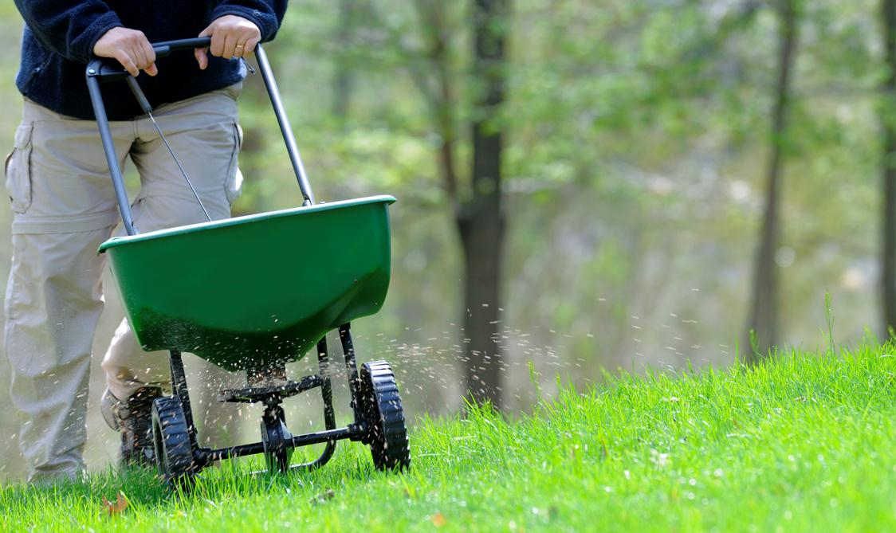
excess
nutrients

Slide 39
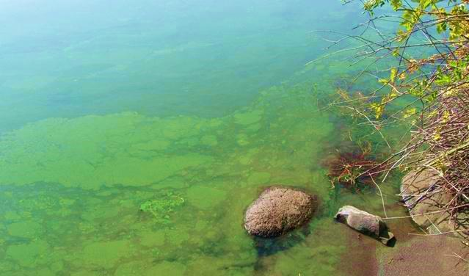
nitrogen and phosphorus
algae blooms
blocks sunlight
uptakes DO2
fish suffocate
ecosystem weakens

Slide 40
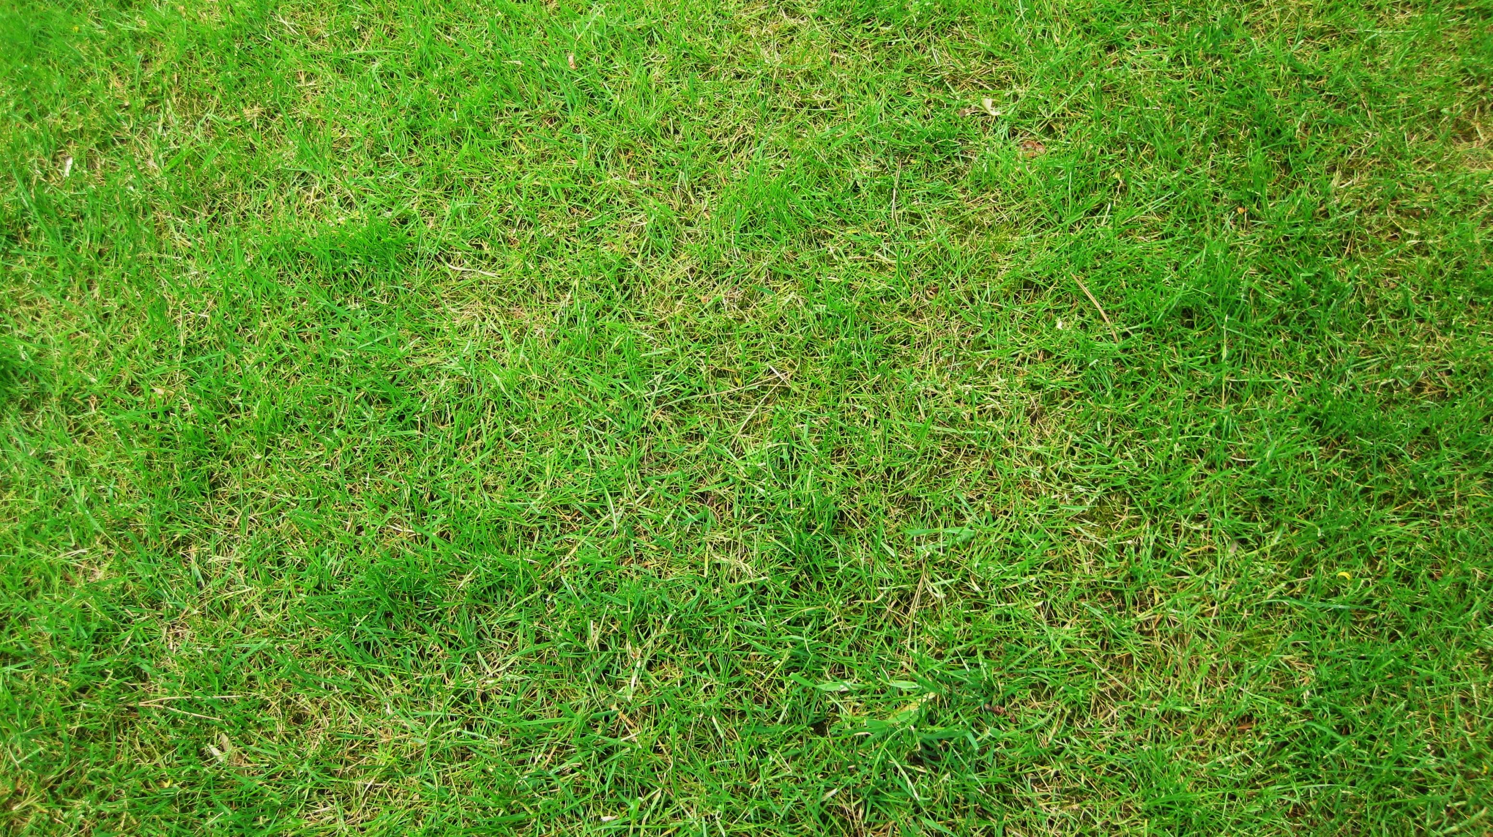
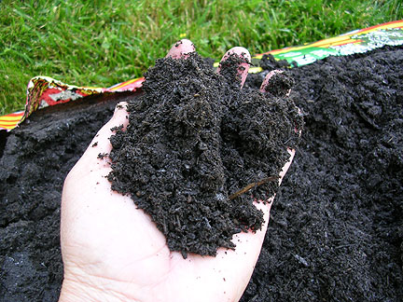
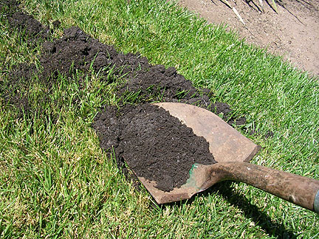
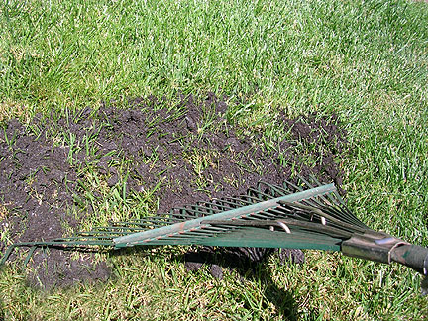
Natural Yard Care
With compost

Slide 41
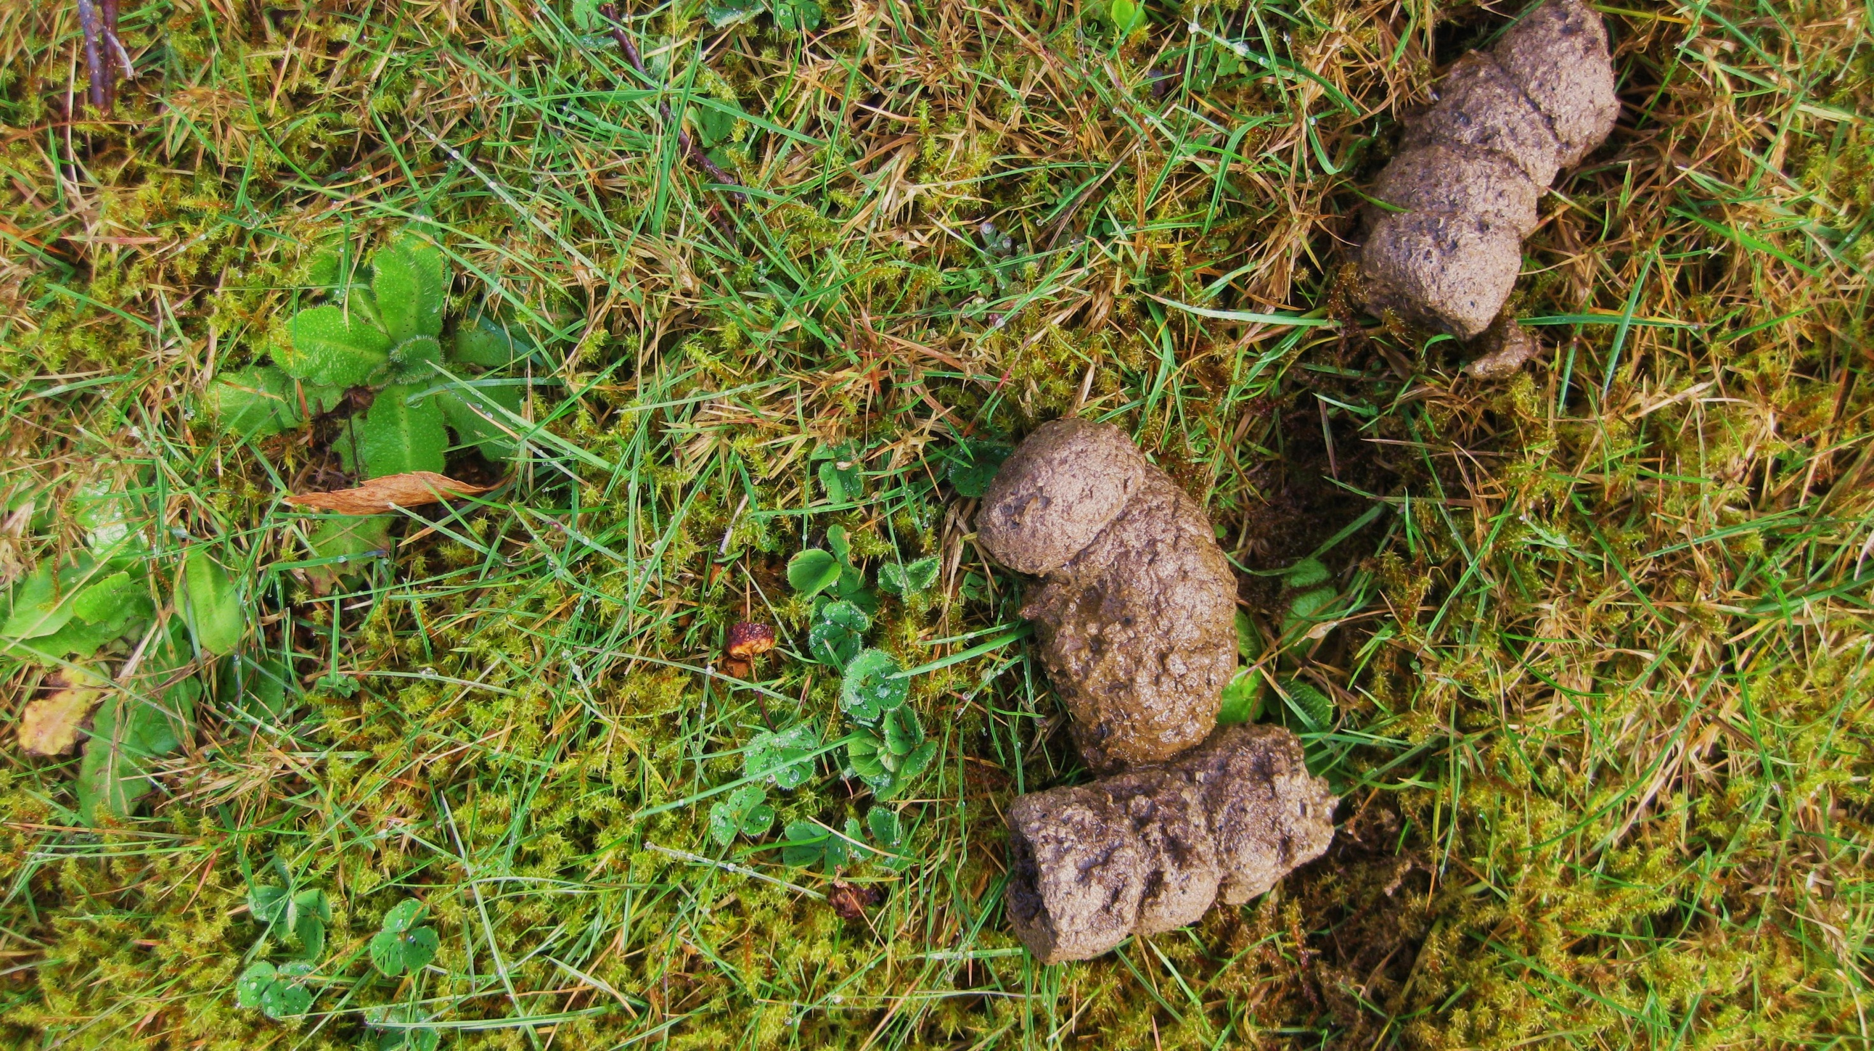

Slide 42
125,000 dogs in just Seattle
15,000 pounds of poop per day
one gram of poop
the size of a pea
contains 23,000,000
fecal coliform bacteria

Slide 43
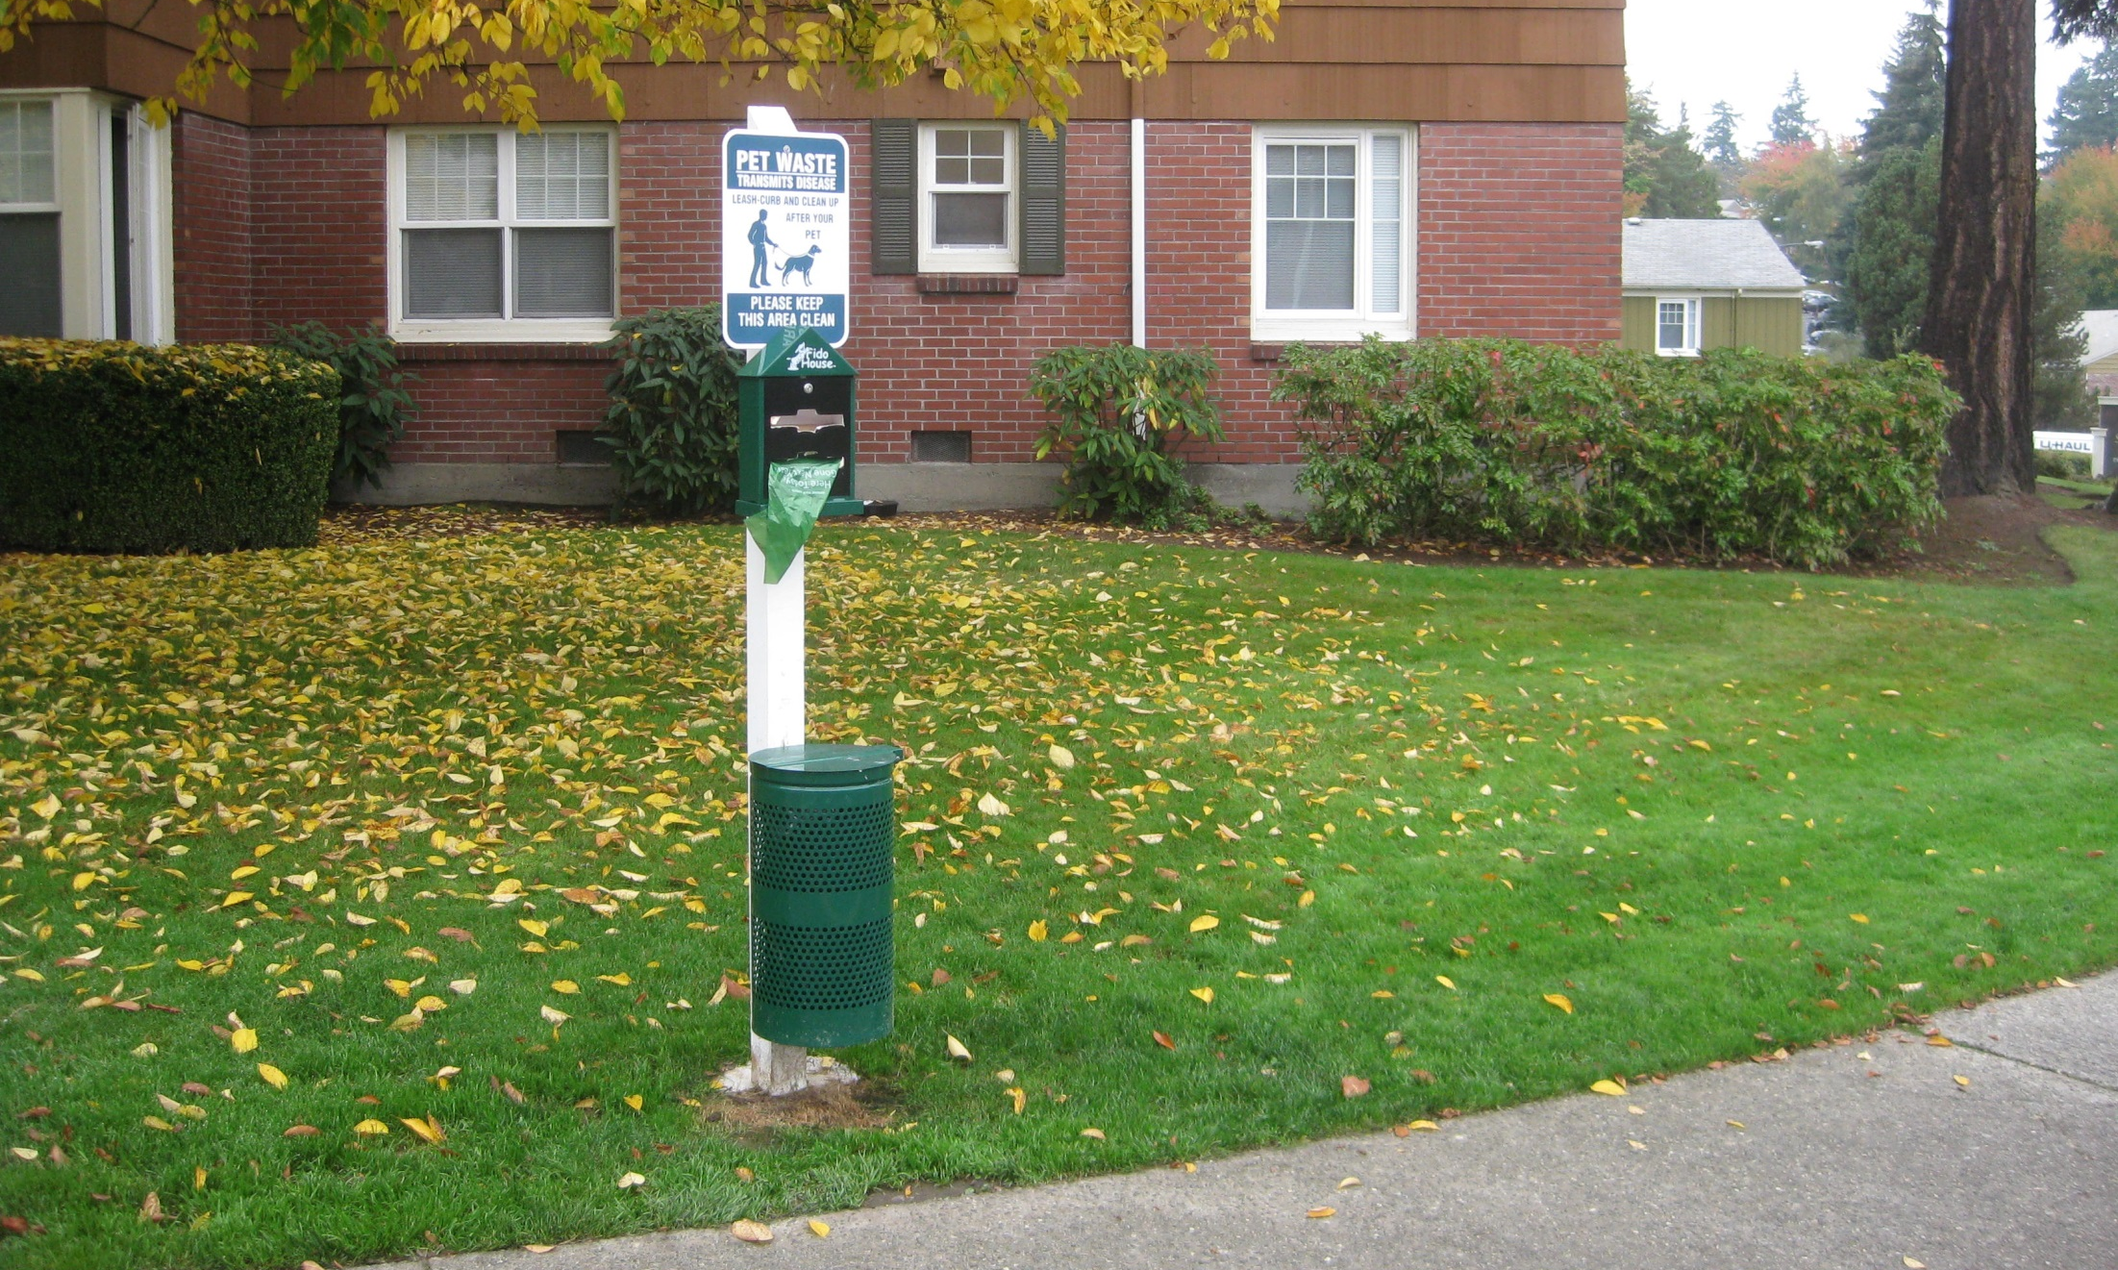
Scoop the Poop

Slide 45
Plastic will not biodegrade
Plastic will solardegrade…
But only into its smallest polymers

Slide 46
Plastic will not biodegrade
Plastic will solar-degrade…
But only to its smallest pieces and polymers

Slide 47
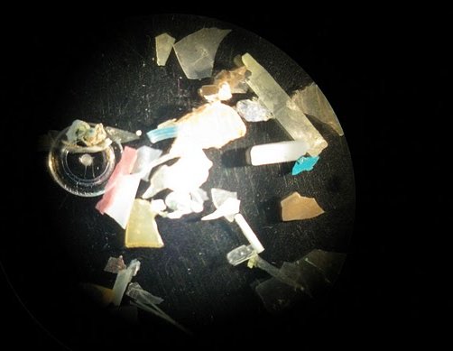
J. Baker, UW Tacoma

Slide 48
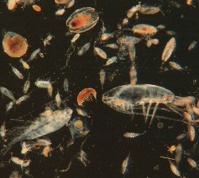
Plastic
Plankton
J. Baker, UW Tacoma

Slide 49
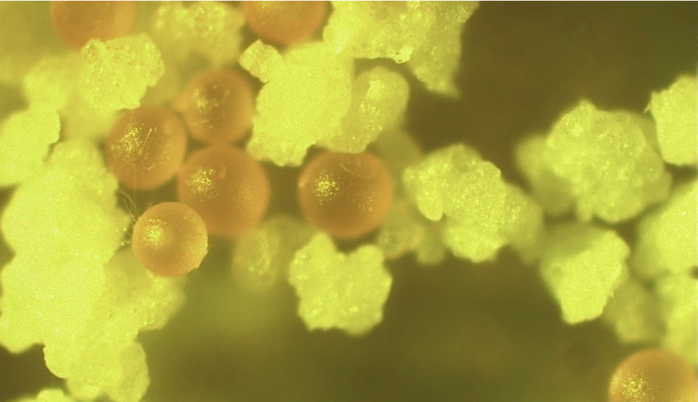
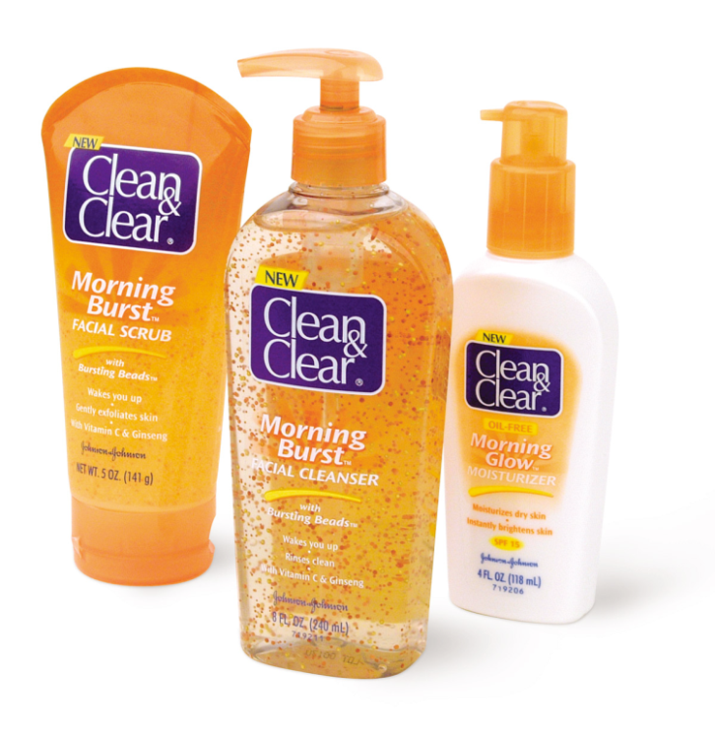
contains polyethylene
confirmed by melting point
determination
J. Baker, UW Tacoma

Slide 50
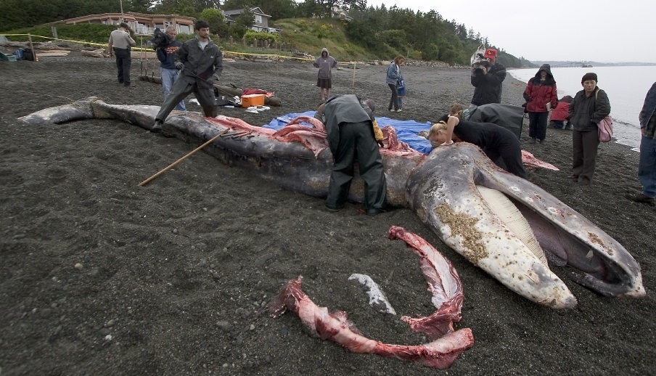
April 20, 2010
Grey Whale, West Seattle
20 plastic bags, towels,
surgical gloves, sweat pants, plastic pieces, duct tape…
And there’s the microscopic stuff…

Slide 51
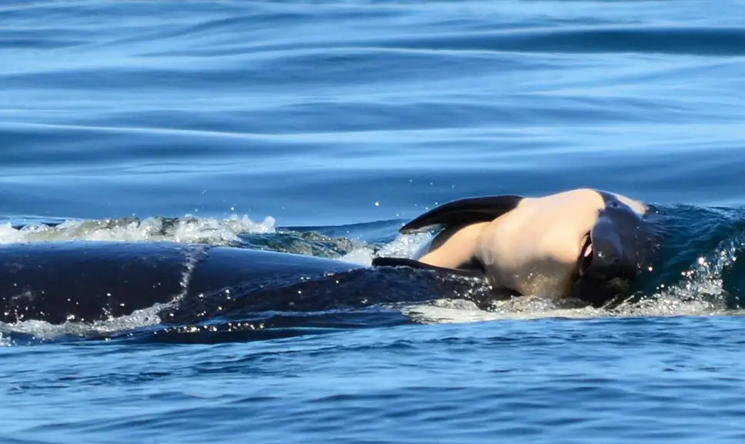
Toxins bioaccumulate in the mother Orca’s fat
Milk is very rich in fat
Baby Orcas receive a dose of poison
every time they nurse
Mother Orca in Puget Sound
carried her dead baby on her
nose for two weeks.

Slide 54
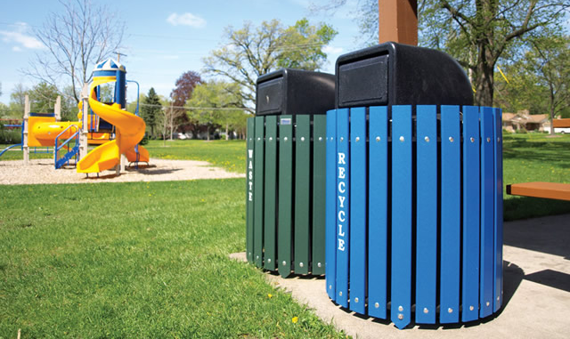
Recycle

Slide 55
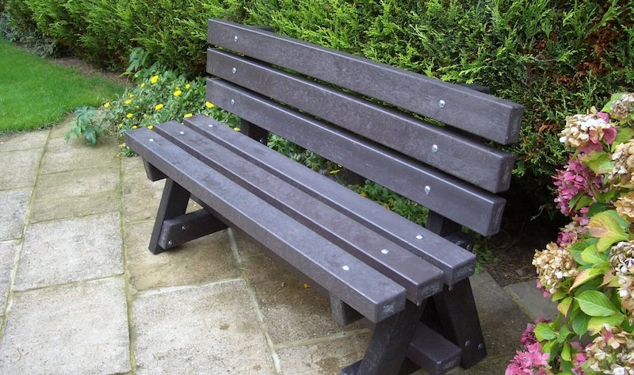
Manufacture new products

Slide 56
Rain Garden Work Party

Slide 57
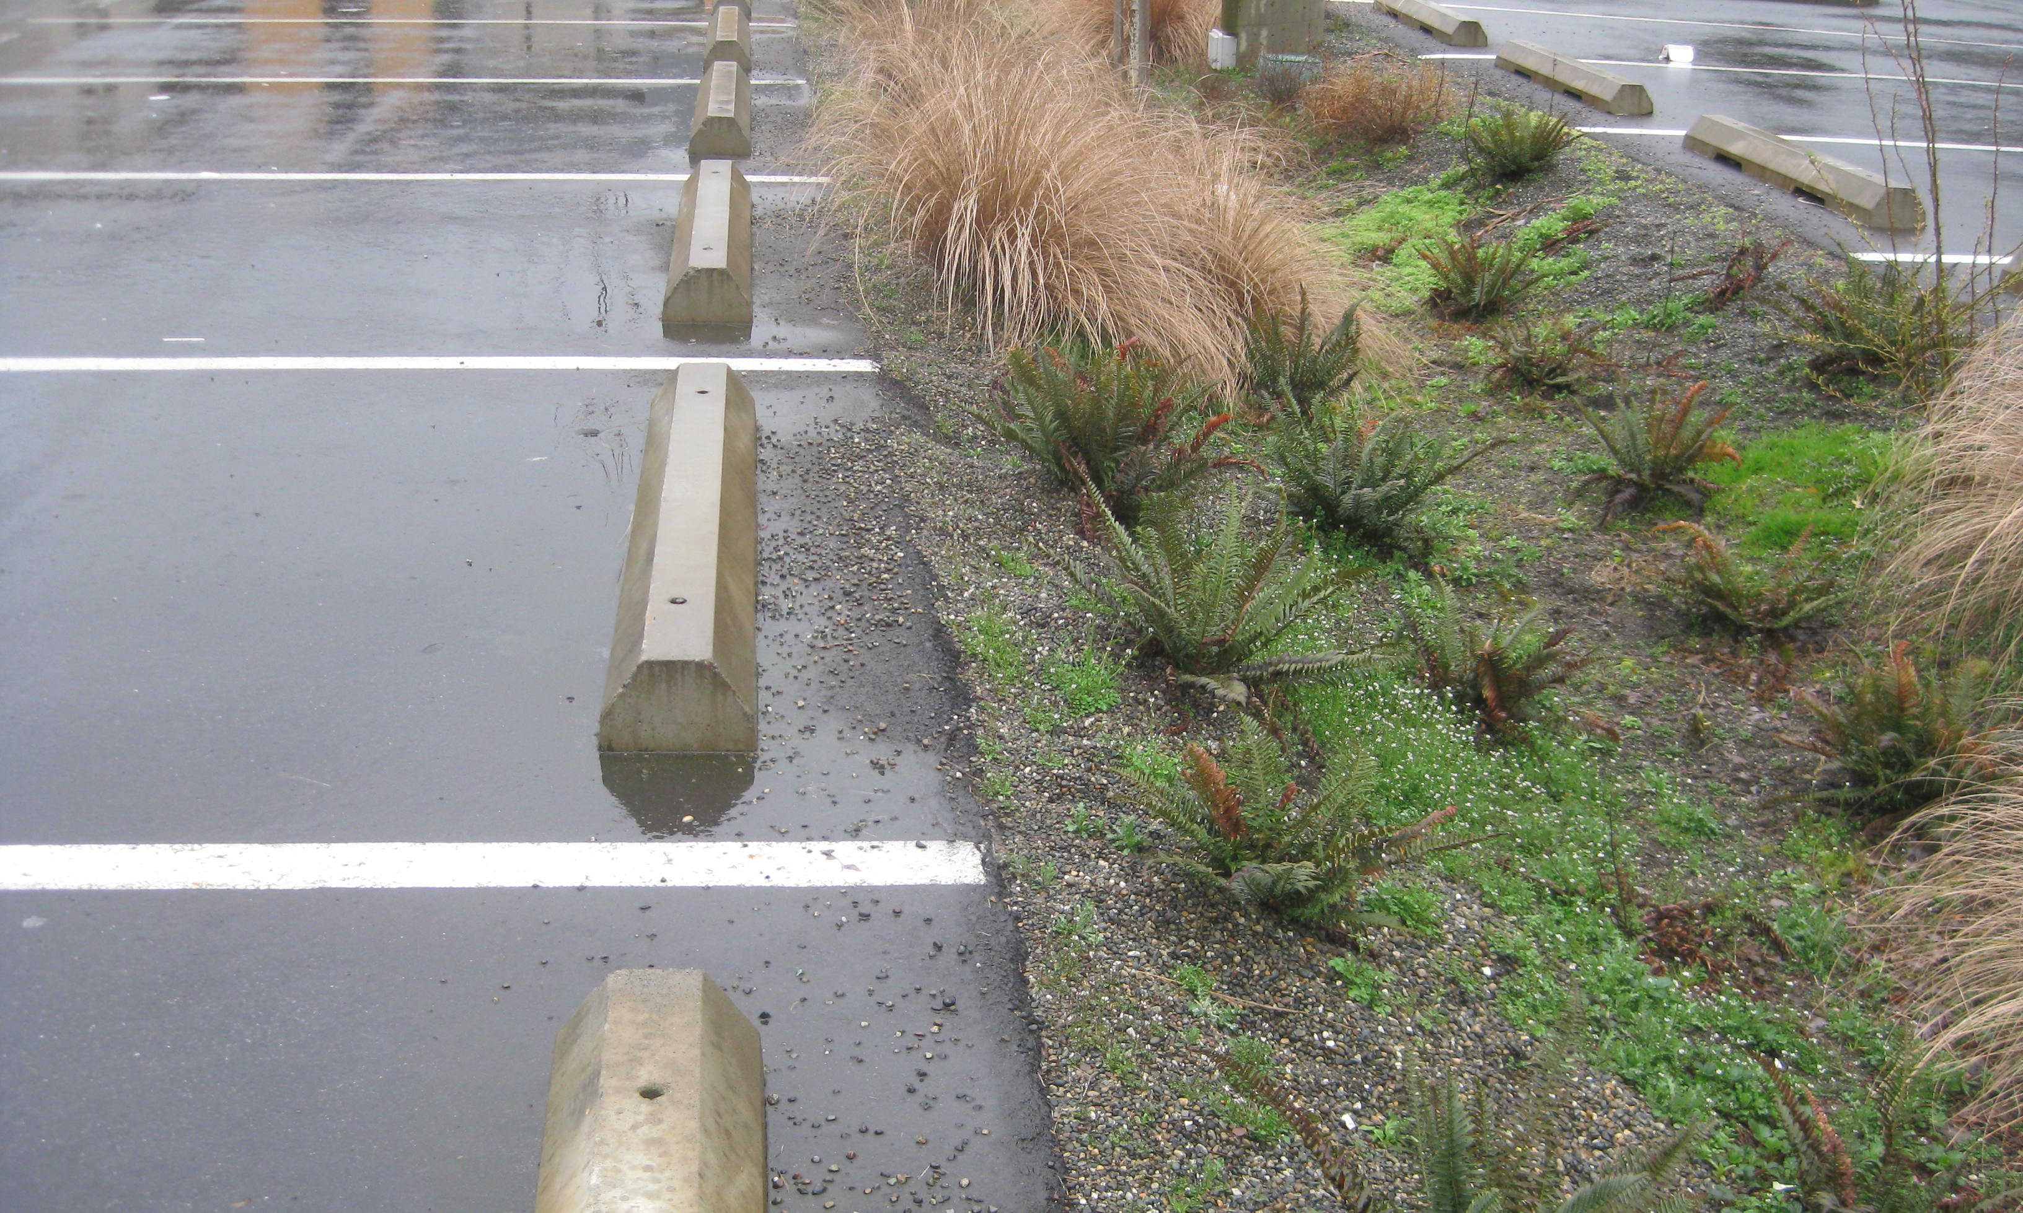
School Parking
Lot Bioswale

Slide 58
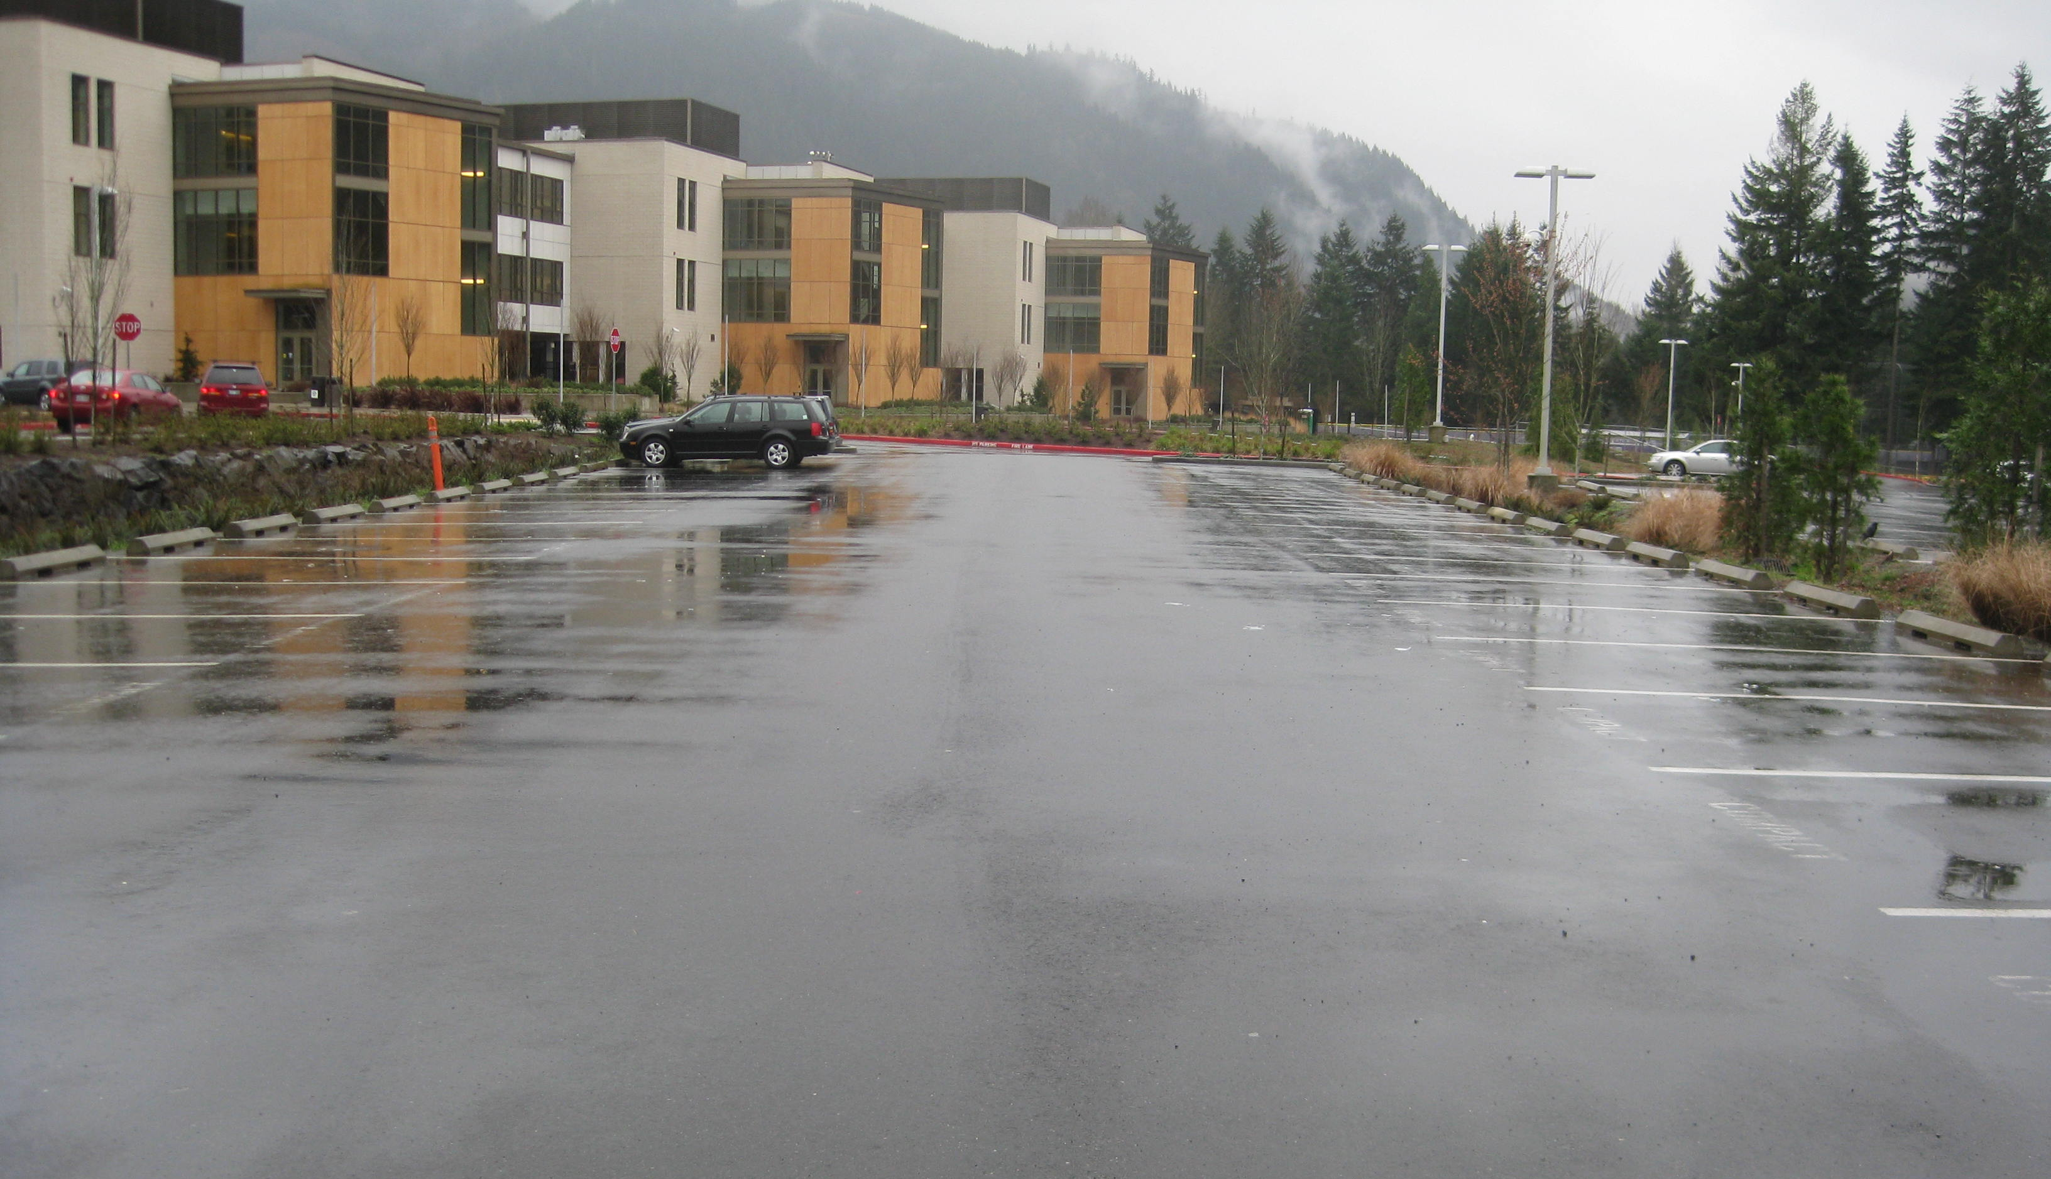
Convex
Flows to side bioswales

Slide 59
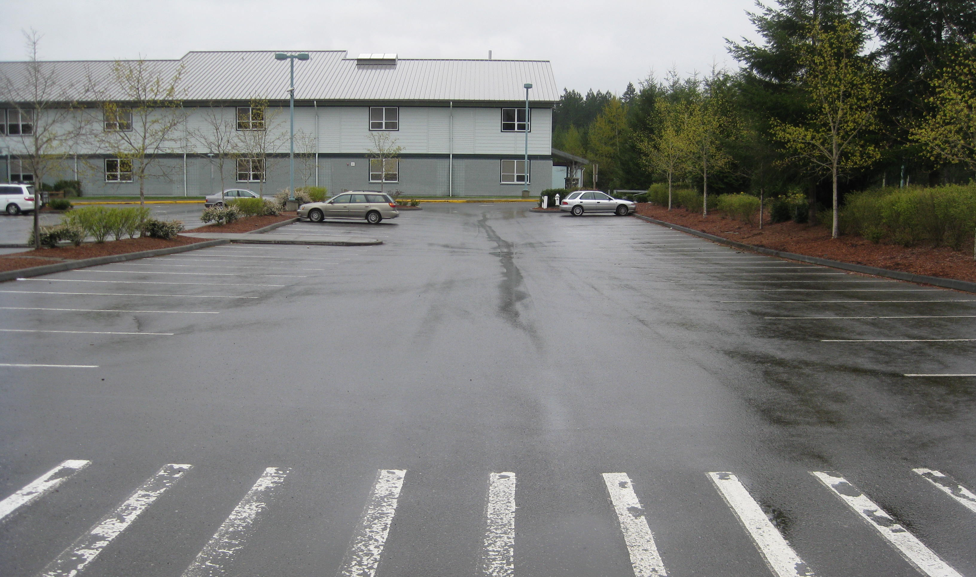
Concave
Flows to center into storm drain

Slide 60
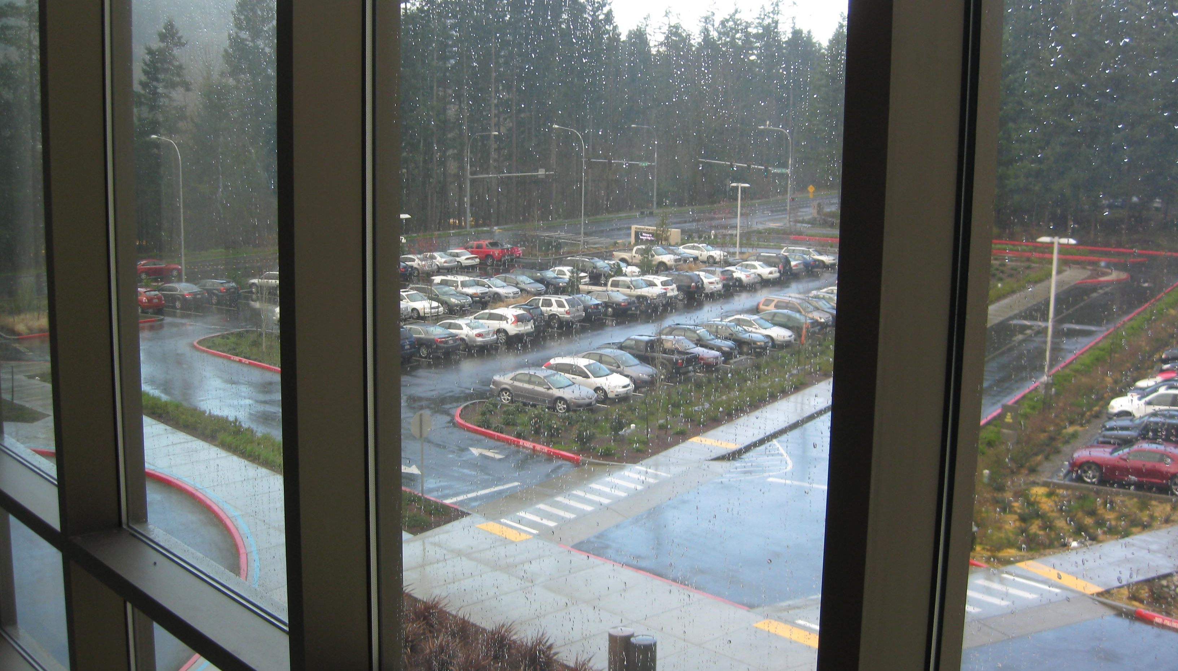
The whole parking lot
is a rain garden

Slide 61
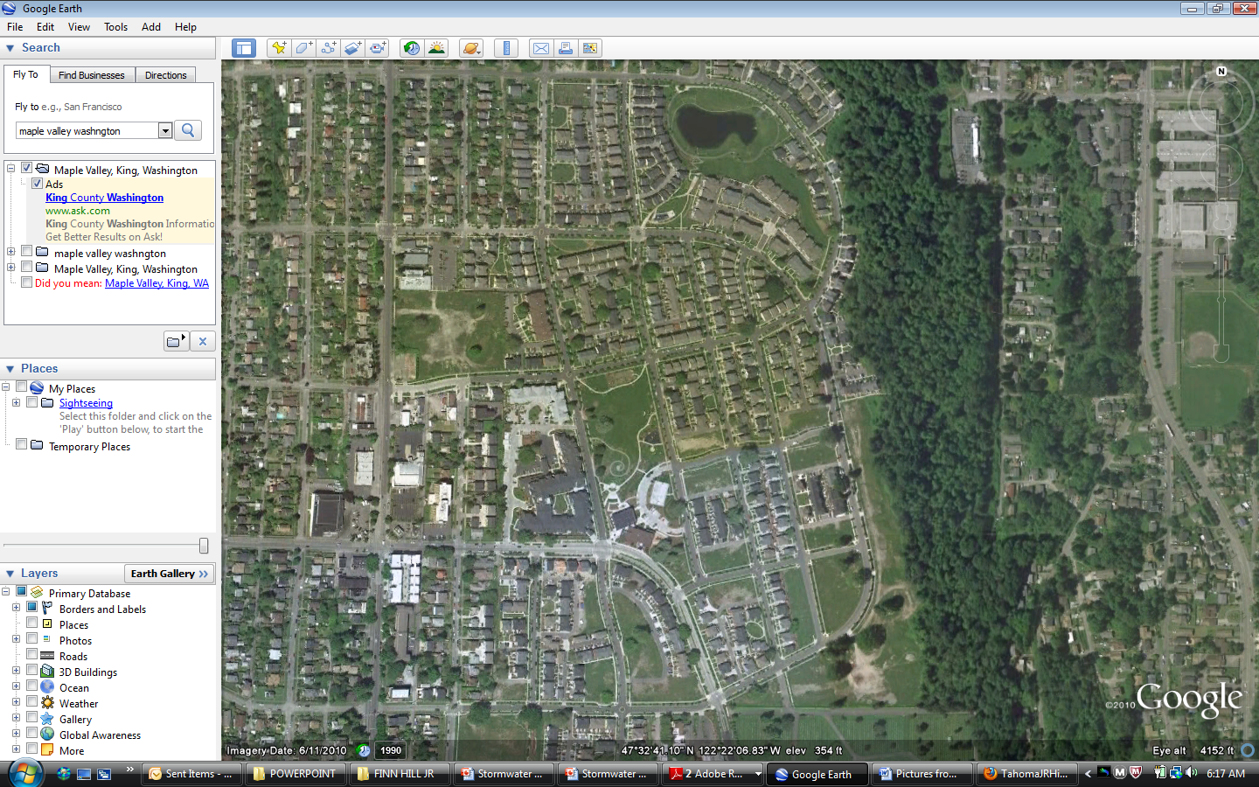
The whole
neighborhood
is a rain garden

Slide 62
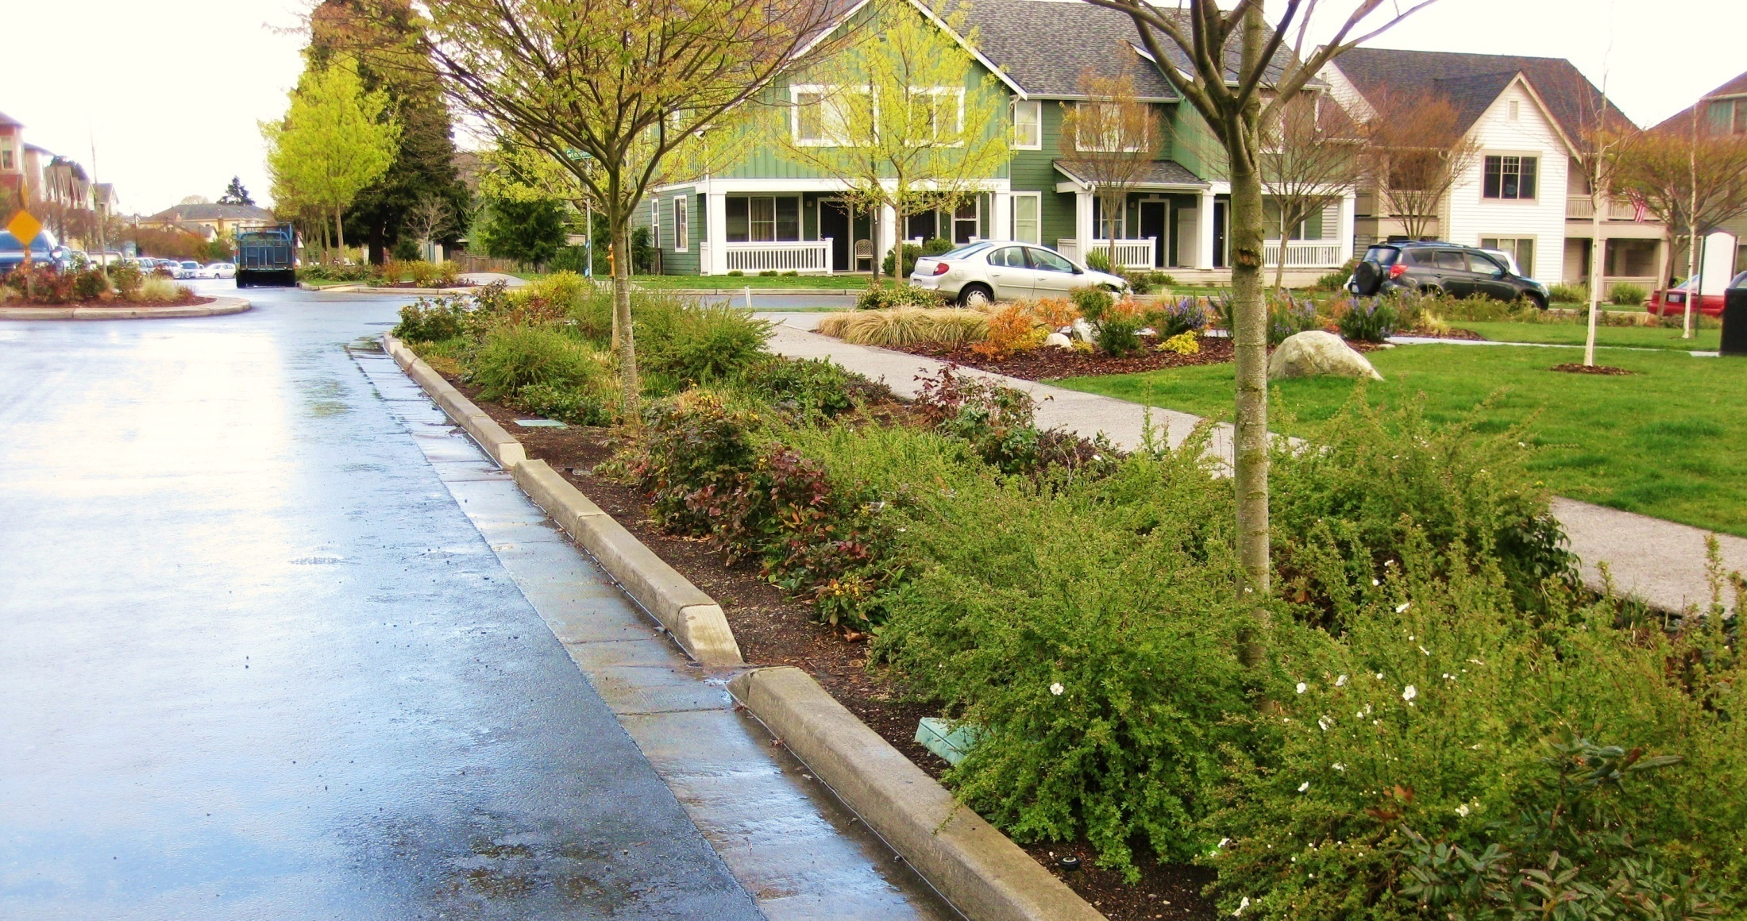
Curb cuts
with bioswale

Slide 63
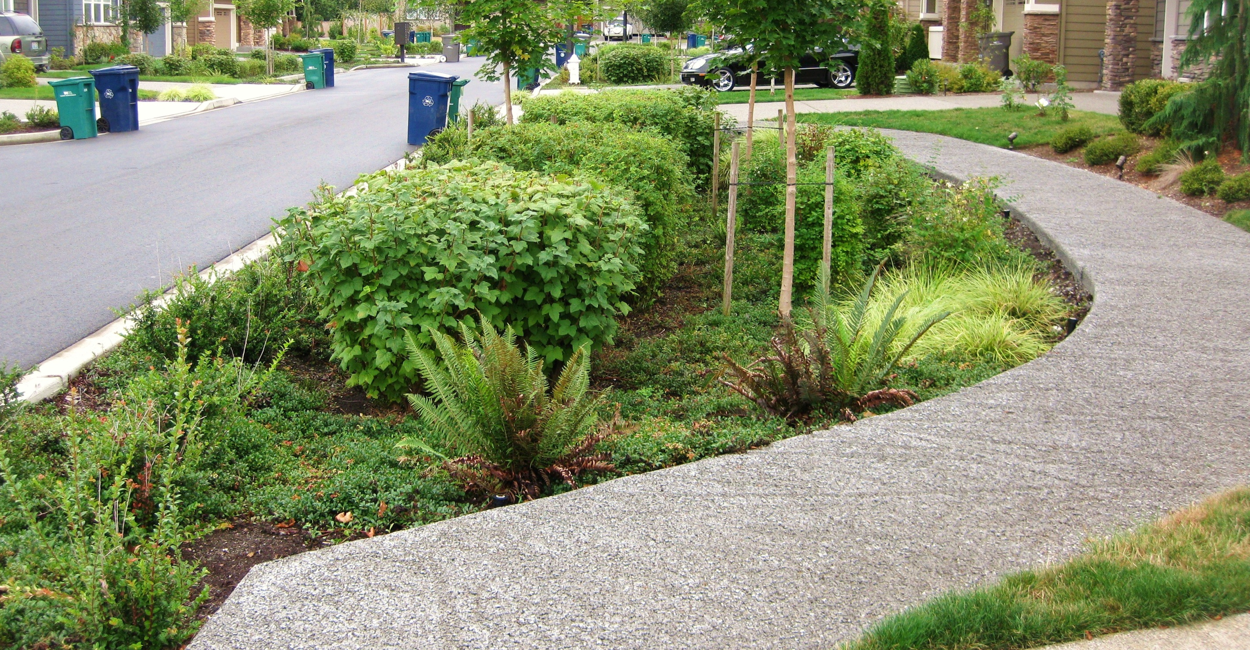
Rain garden with
pervious pavement sidewalk

Slide 64
p e r v i o u s

Slide 65
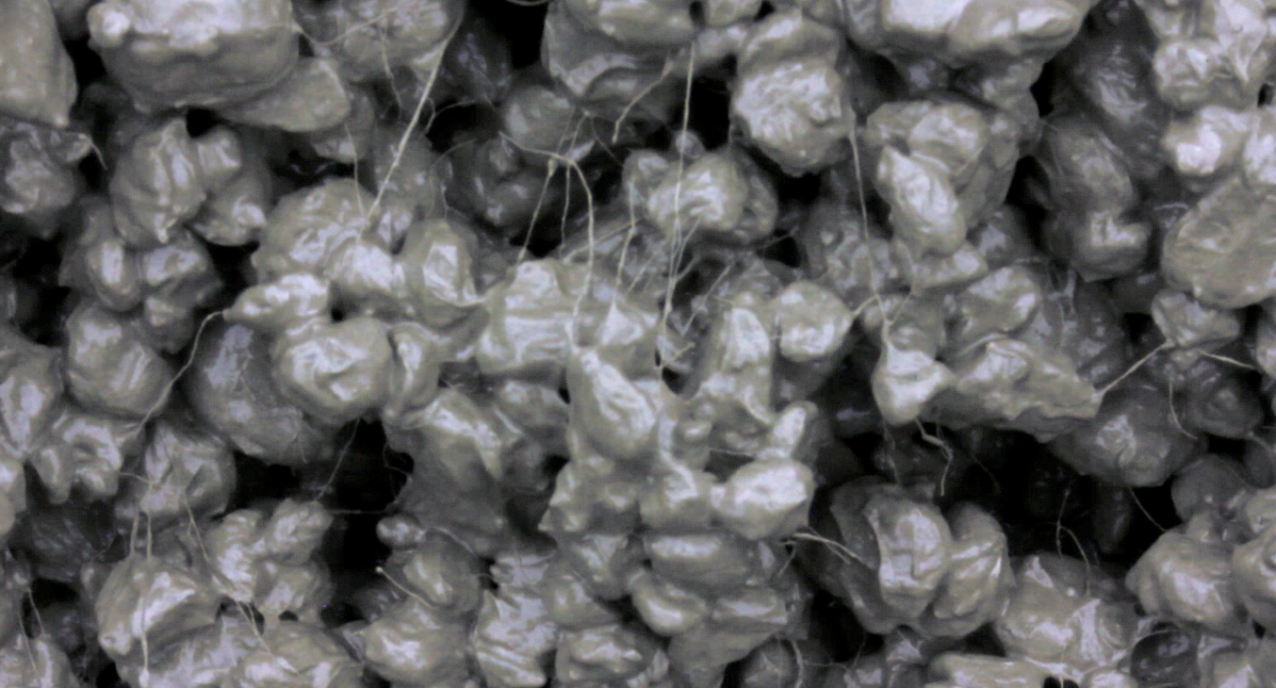

Slide 66
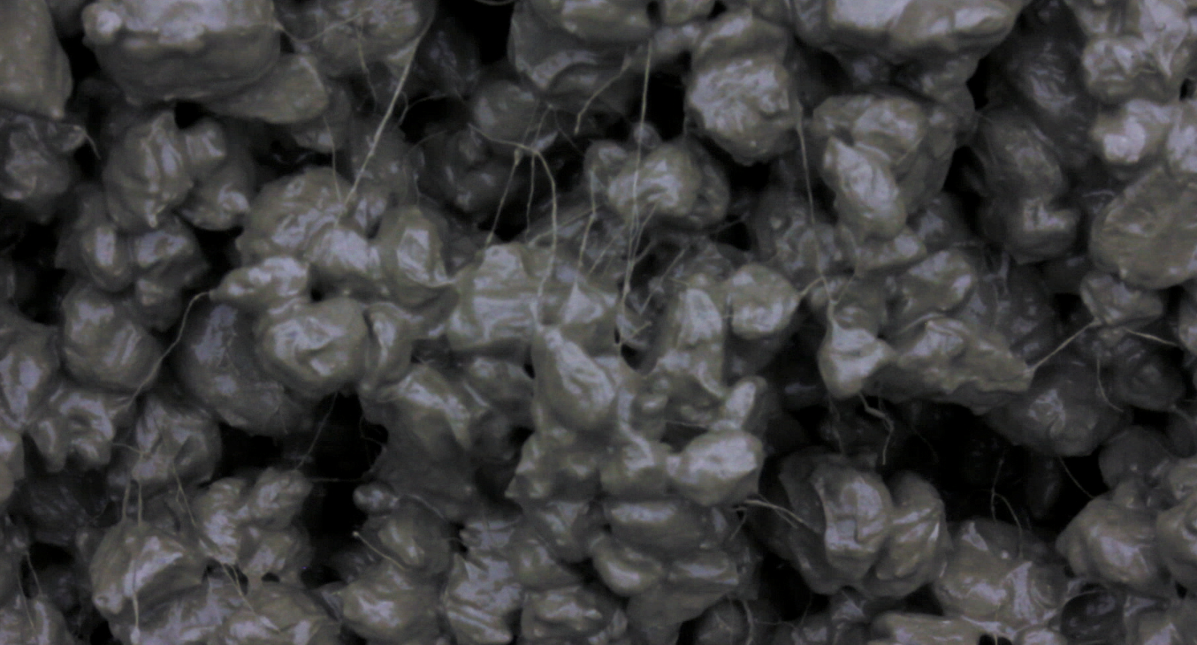
Recipe for Pervious Pavement
Same amount of gravel
No sand
Twice the amount of cement
Polypropylene fibers

Slide 67
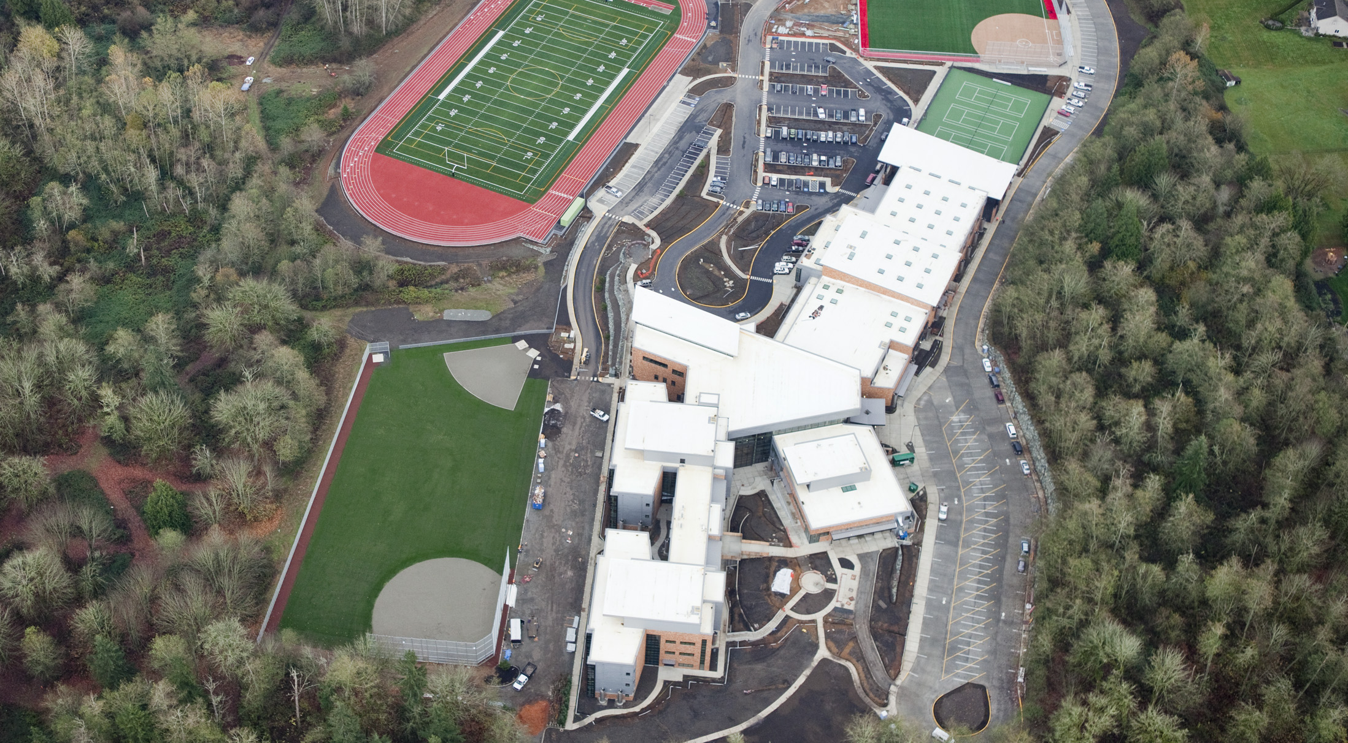
Pervious pavement
school parking lot

Slide 68
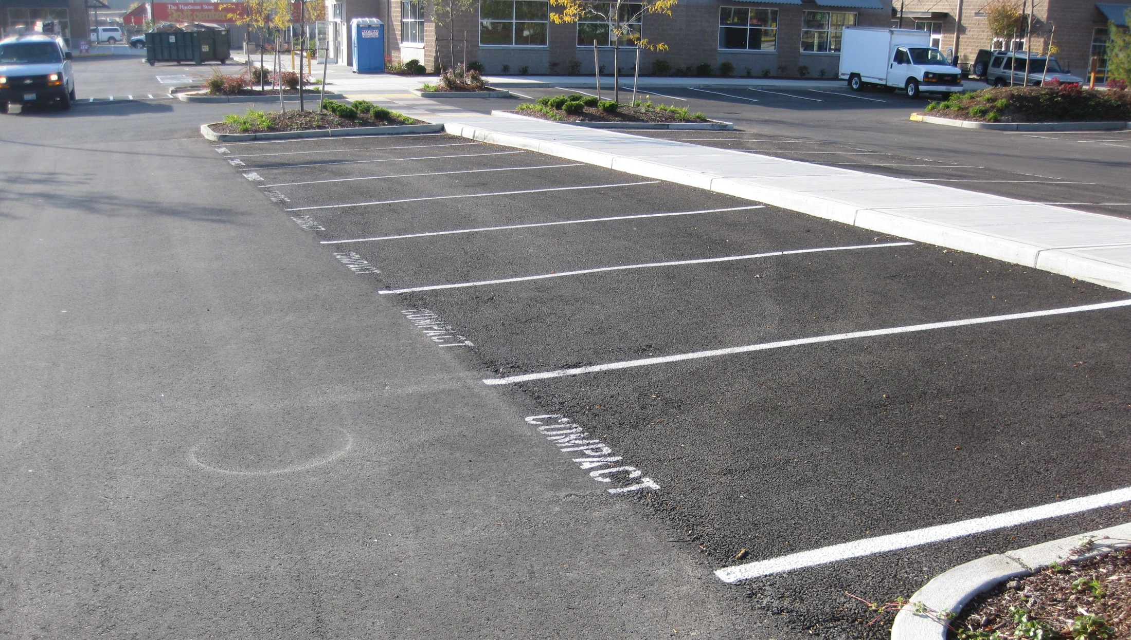
impervious asphalt
pervious asphalt

Slide 69
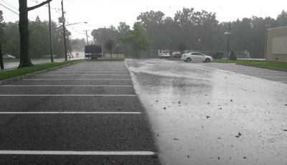

Slide 70
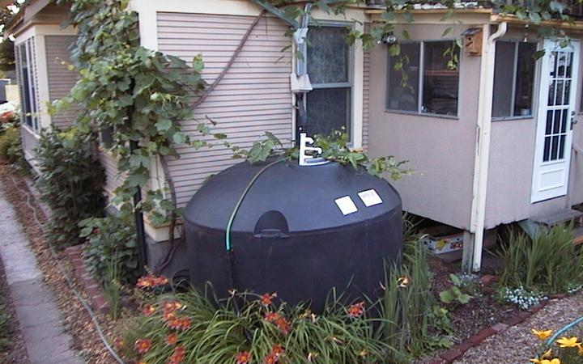
1,500 gallon cistern

Slide 71
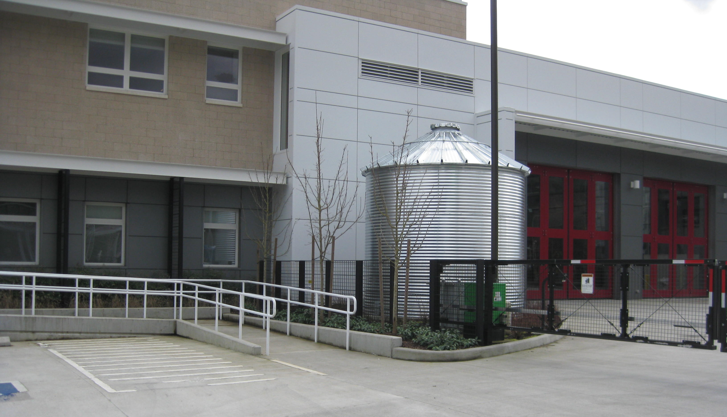
10,000 gallon cistern

Slide 72
32 x 1,000 gallon cisterns
Valley View Middle School

Slide 73
Ford Truck Assembly Plant in Michigan
10.4 acres
The largest green roof in the world, a living prairie with seven
species of grass that attract butterflies and hummingbirds.
Green Roof

Slide 75
Plant trees

Slide 76
Improve your city’s
tree canopy

Slide 77
What can you do?

