Slide 1
Level 1 CERER Practice
PART 3

Slide 2
How can we win arguments?
LEARNING TARGET
Communicate information by using reasoning to support evidence topics
SuCCESS CRITERIA
Write a CER using 2 reasoning statements to support 2 evidence topics

Slide 3
INITIAL THOUGHTS (5 min)
1. How can we win
arguments?

Slide 4
COPY THESE CERER NOTES
CLAIM:
1 simple sentence
DO NOT use the word because in the sentence

Slide 5
COPY THESE CERER NOTES
EVIDENCE #1
Identify your “Evidence Topics” first
DO NOT use “Because”
EXAMPLE:
____(copy your evidence topic here)_______ is strong evidence to support _____(write about the claim here)_______.

Slide 6
COPY THESE CERER NOTES
REASONING #1
Use the “Evidence #1 Topic” to explain how the evidence connects to the claim
MUST use “Because”
Can be many sentences

Slide 7
COPY THESE CERER NOTES
EVIDENCE #2
Identify another “Evidence Topic”
DO NOT use “Because”
EXAMPLE:
____(copy your evidence topic here)_____ is also strong evidence to support _____(write about the claim here)_______.

Slide 8
COPY THESE CERER NOTES
REASONING #2
Use the “Evidence #2 Topic” to explain how the evidence connects to the claim
MUST USE “Because”
Can be many sentences

Slide 9
How can we win arguments?
Middle Check
LEARNING TARGET
Communicate information by using reasoning to support evidence topics
SuCCESS CRITERIA
Write a CER using 2 reasoning statements to support 2 evidence topics

Slide 10
ASSESSMENT
Watch This Video about Science to find evidence for…
CLAIM:
All humans should study science

Slide 11
Level 1 GRADING CERER
COPY THIS IN YOUR NOTEBOOK
Claim /1
Evidence /1
Reasoning /1
Evidence /1
Reasoning /1
TOTAL /5

Slide 12
REVISED THOUGHTS
What was surprising?
What did you already know but see in a new way?
What do you still need help with?
Level 1
CERER Practice

Slide 13
How can we win arguments?
End Check
LEARNING TARGET
Communicate information by using reasoning to support evidence topics
SuCCESS CRITERIA
Write a CER using 2 reasoning statements to support 2 evidence topics

Slide 14
Extension
NATURE of SCIENCE

Slide 15
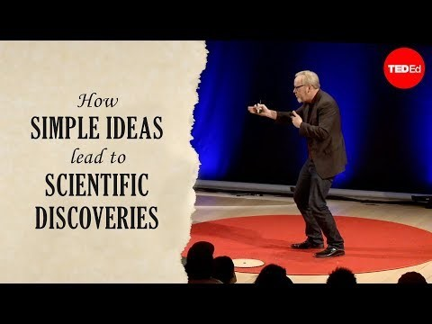
Adam Savage Ted Talk Link

Slide 16
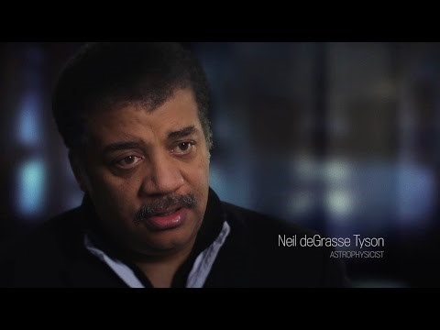
Neil DeGrasse Tyson Video Link

