Slide 1
INITIAL THOUGHTS: (5 min) Nervous System
What’s more important, the brain or the heart?
Estimate the % of the brain used by most people?
What parts of the body are connected to the nervous system ?
Notes:
Standards Alignment
Next Generation Science Standards (NGSS)
From Molecules to Organisms: Structures and Processes
· MS-LS1-2
· MS-LS1-3
· MS-LS1D-8
Common Core Standards: English Language Arts (ELA)
Language Standard 4c & 6: Vocabulary Acquisition & Use
· CCSS.ELA-Literacy.L.6.4c
· CCSS.ELA-Literacy.L.6.6

Slide 2
Central Nervous System
LEARNING TARGETS
SUCCESS CRITERIA
I can evaluate information to show understanding of the structure and function of the nervous system.
Compare & contrast the brain to a computer using a T-chart or Venn diagram.
Notes:
Neuroscience Core Concepts
• The nervous system controls and responds to body functions and directs behavior.
• The brain is the body’s most complex organ.
• The nervous system influences and is influenced by all other body systems (cardiovascular,
endocrine, gastrointestinal, immune systems, etc.).
• Neurons communicate using electrical and chemical signals.
• Synapses are chemical or electrical junctions that allow electrical signals to pass from neurons to
other cells.
• All thoughts and behaviors result from combinations of signals among neurons.

Slide 3
Central Nervous System
ESSENTIAL QUESTION
How does the brain communicate with the rest of the body?
For today’s learning, gather information to help you answer this question later.

Slide 4
Central Nervous System
The nervous system influences and is influenced by all other body systems. The nervous system receives signals from the body and the outside world, processes this information, and sends signals to muscles, glands, and organs to ensure the survival of the organism.

Slide 5
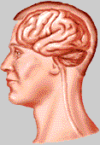
Functions of the Nervous System? (3 min)
The Senses:
see, hear, smell, taste, touch
Emotions:
happiness, sadness, anger
Movement:
muscle control
Automatic responses:
heart rate, breathing
Cognition
think, plan, problem solve
Language
speech, reading, writing
Notes:
ADD PICTURES?

Slide 6
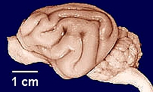
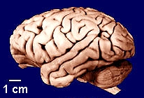
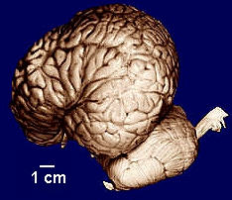
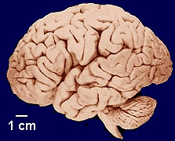
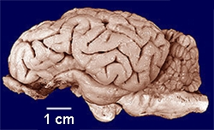
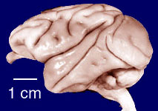
Comparative Neuroanatomy (5 min)
Write Letters A-F & record which animal matches the image
A
B
Cat Chimpanzee
Dolphin Human
Sheep Monkey
Choices
1. Cat
2. Sheep
3. Human
4. Monkey
5. Dolphin
6. Chimpanzee
C
D
F
E
http://www.brainmuseum.org

Slide 7
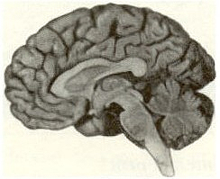
The Brain
Cerebral cortex
Thalamus
Midbrain
Hypothalamus
Cerebellum
Brainstem
Size (weight)?
Gender differences?
Don’t get your science from Waterboy!!!!!

Slide 8
OBTAIN INFORMATION INDEPENDENTLY (5 min)
Use a favorite notetaking strategy while reading Page 19 of the Neuroscience 101 article.
DO NOT READ ON…
DONE EARLY?
mid lesson check
Review the vocab list at the end

Slide 9
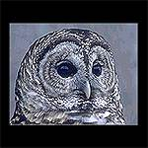
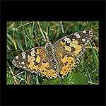
The Senses (4 min)
Everyone is their own laboratory with which to test the senses.
Beware of food allergies; be sensitive to individuals with disabilities.
Non-human animals are sensitive to different “energies” in the environment.
Notes:
Ask students what are the special senses of these animals

Slide 10
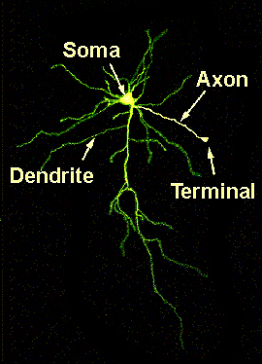
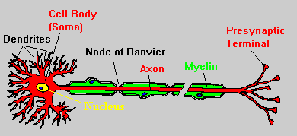
The Neuron
How many neurons are in the brain?
~100,000,000,000
Model Neuron Actual Neuron

Slide 11
OBTAIN INFORMATION INDEPENDENTLY (5 min)
Continue taking notes while reading “NEURONS” pg 20-21
DO NOT READ ON…
NEXT… class video & activity.

Slide 12
OBTAIN INFORMATION INDEPENDENTLY (5 min)
Continue taking notes while reading “THE SYNAPSE” pg 21
DONE EARLY?
Review your notes
Write down questions
NEXT… class video

Slide 13
How is the brain similar or different to a computer? Create a T-chart or Venn Diagram (EXIT TICKET)
Things to think about…
Brain vs. Computer
Similar Different
The Brain vs. the Computer LINK
Do they both use energy?
Do they store information in the same way?
Do they have parts?
Do they use electricity?
Do they contain chemicals?
Notes:
Computer vs. Brain
Similarities Differences
Brains and computers both…
· Store tons of knowledge.
· Process things.
· Work automatically.
· Are effective.
· Need energy to function.
· Send messages.
The brain…
· Can feel emotions.
· Can feel pain.
· Is faster.
· Thinks independently.
· Can take shortcuts rather than going
through the entire problem.
· Doesn’t do the same thing every
time.
5. Add a summary of students’ responses to the “K” column of the K/W/L chart.

Slide 14
Brain Metaphor Practice (3 min)
A brain is like ____________.
Write a brain metaphor showing your understanding so far… (CREATIVITY IS NECESSARY).
Notes:
Brain Metaphors. Explain to students that saying that “the human brain is a computer” is one
example of using a metaphor to describe the brain. Ask students to help develop a definition for “metaphor.” Compare students’ definition to the definition provided by the Merriam-Webster dictionary:“
Metaphor: A figure of speech in which a word or phrase literally denoting one kind of object or idea is used in place of another to suggest a likeness or analogy between
them.”

