Slide 1
PHINEAS Gage
Understanding a 3D Neural Network

Slide 2
How does brain damage affect the rest of the body?
LEARNING TARGET
SUCCESS CRITERIA
Evaluate information for the structure and function of the nervous system’s relationship with other body systems.
Synthesize systems thinking and neuroscience to predict the effects of brain damage on other parts of the body.

Slide 3
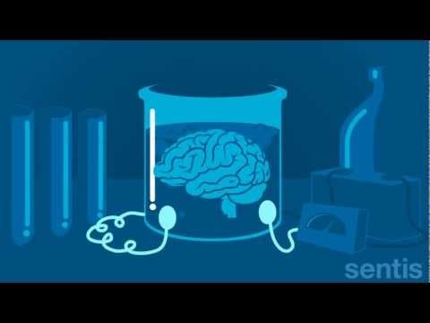
How the brain works….

Slide 4
Understanding Phineas Gage
Discuss with your lab group & answer:
Phineas Gage Video Link
Phineas Gage Video Link 2
What was Phineas like before the accident?
What stayed the same for Phineas after the accident?
What changed?
What region of his brain was most affected by the accident?
What information did his injury provide to neuroscientists?

Slide 5
Make a Neuron Model
1. Use the materials to make a neuron model:
Green Wires= Dendrites
Bath Sponge = Cell Body
Fuzzy Neon Wire = Axon
Noodles= Myelin
Bubble Wrap = Pre-synaptic Terminal
2. Attach your neuron to your class lobe
3. Record your neuron’s “Assigned Node” ex T21, or P14

Slide 6
Group Review Questions
Consider your class brain (Lobe).
Discuss the following with your group…
1. What actions are controlled in this region of the brain?
2. How do the neurons communicate with each other?
3. Do the neurons touch each other to communicate?
4. Which neurons are the most important? Explain why.

Slide 7
How is the body controlled by the brain?
How might damage in one region affect other connected regions?
Are there alternative pathways for action potentials to travel in the class model?
Neuroplasticity video link

Slide 8
How does neuroplasticity help injured brains?
What happens to each lobe when it’s injured?
What is an advantage of these alternative paths?
TBI Video Link

Slide 9
Make a node diagram.
INSTRUCTIONS:
Sketch a diagram of the "Class" neural network on your worksheet.
Correctly label each of the nodes in your diagram.
Label your diagram & identify the primary function of your class lobe.
Identify the most important nodes in your neural network.

Slide 10
Connecting the Regions
NEXT we will connect the regions of our lobe to other lobes:
INSTRUCTIONS:
Sketch a diagram all neural network on your worksheet.
Correctly label each of the nodes in your diagram.
Now Watch this video:
View Path of Tampering Rod

Slide 11
Evidence of Understanding:
Apply what you have learned about neuroplasticity to explain differences in Phineas before and after his accident using evidence & reasoning.

