Slide 1
Earth’s Materials
Where does it all come from?

Slide 2
How can we break down matter?
Brainstorm in a group different ways matter can be made smaller…
(MAKE A LIST & PREPARE TO SHARE OUT).

Slide 3
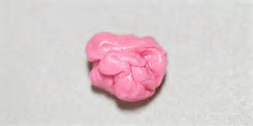
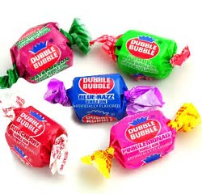
Make a Prediction
What happens when you swallow gum?

Slide 4
TRY THIS…
Have you ever gotten gum stuck in your hair?
How did you get it out? What are some life hacks people use to remove sticky stuff? Why do/don’t they work?
Chew a piece of gum until its smooth
Add a piece of chocolate and chew them together
What did you think will happen? What was surprising about this activity? Why did this happen?

Slide 5
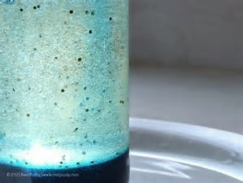
“Like dissolves like”
Gum & Chocolate, Sugar and water, Salt & Water
Different substances (Solvents) can dissolve in different substances (Solute). Together they make (solutions).
Other substances cannot dissolve in a solvent. This means they are (Insoluble), such as sand & water.

Slide 6
REVISITING THE MODEL
Redraw your model to include matter that might “Dissolve” in the rock cycle.

Slide 7
Revised Thoughts
What was surprising?
What did you already know but see in a new way?
What do you still need help with?

Slide 8
TOMORROW: What about other stuff???
What happens if I chew on sand with my gum?
Will the sand or gum dissolve? Why/why not?
Can everything dissolve?

