Slide 1
The Golden Hour: Day 3
Student Interactive PPT

Slide 2
INITIAL THOUGHTS
What are the different major landmarks in the brain?
Can you remember what the functions of these areas are?
What are the different types of brain injuries you learned about?
How does a CT scan work?

Slide 3
Consider This & Discuss…
You need to now conduct surgery on the patient to remove the hematoma in order to relieve the pressure it is putting on the brain.
In order to get to the brain, what will you, as
you perform surgery, need to cut through first?

Slide 4
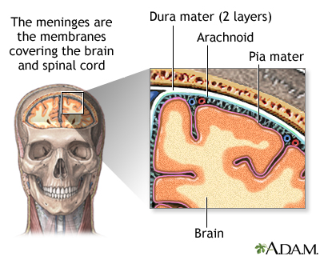
Layers Surrounding the Brain
Based on what you know about the patient’s injury in The Golden Hour from the CT scans, where is the build-up of blood, the hematoma?
Retrieved from: http://www.nlm.nih.gov/medlineplus/ency/imagepages/19080.htm
http://www.nlm.nih.gov/medlineplus/ency/imagepages/19080.htm

Slide 5
NEXT STEPS…
What layers will you need to cut through during the surgery to get to the hematoma?
NEXT: LOOK AT THE CSF—the cerebrospinal fluid (CSF). This is a clear, colorless body fluid that is located between the arachnoid layer and the pia mater.
What do you think is one of the purposes of the cerebrospinal fluid?

Slide 6
ACTIVITY 1
Take turns shaking the balloons.
What did you notice? Were the two balloons the same or different? How?
What did the water appear to be doing?
If we were to use these balloons as a model for the skull, brain, and CSF, what would represent the skull? The brain? The CSF?
How might this model help us to understand the role of the CSF?
This balloon demonstration is a model—what are some shortcomings of this as a model for the brain, CSF, and skull?

Slide 7
Activity 2: What to Expect
In Scene 3, the Surgery scene, a neurosurgeon will guide you through a step by step surgery procedure to remove the hematoma. In this process you will experience the following steps:
Disinfect the patient’s head before beginning
Use a scalpel to make an incision in the scalp
Use a bone drill to separate and then remove a piece of the skull
Use a dura scalpel to cut through the dura
Use irrigation and suction to break up and remove the hematoma
Place a surgical sponge at the site of the hematoma

Slide 8
Play the Game
Golden Hour Game Link: Scene 3
Complete your Surgery Report & write your conclusion on the back.

Slide 9
Class Summary Discussion
Did you remove the layers that we had discussed before starting the game? What layers did you have to cut?
What are some of the difficulties the patient might have after surgery?
What is your evidence? What is your reasoning?
What kinds of difficulties might he have had if the hematoma was in the frontal lobe? The occipital lobe?

